Slide 1
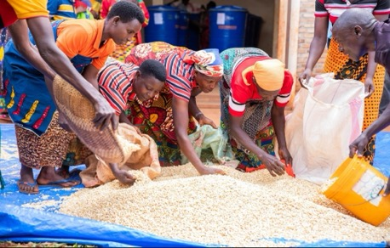
USAID Local Capacity Strengthening Policy 2023
USAID/Burundi Industry Day 2024
Chantal Ninteretse
Program Development Specialist
June 26, 2024
USAID - supported women coffee growers
*
1

Slide 2
Agenda
USAID Local Capacity Strengthening
Burundi Localization journey
Key takeways
Conclusions/Recommendations

Slide 3
The Local Capacity Strengthening Policy Principles
PRINCIPLES FOR EFFECTIVE PROGRAMMING OF LOCAL CAPACITY STRENGTHENING
PRINCIPLES FOR EQUITABLE PARTNERSHIPS IN LOCAL CAPACITY STRENGTHENING
1
4
Align capacity strengthening with local priorities.
Start with the local system.
2
Strengthen diverse capacities
through diverse approaches.
5
Appreciate and build on existing capacities.
3
Plan for and measure performance improvement in collaboration with local partners.
6
Be mindful of and mitigate the unintended consequences of our support for local capacity strengthening.
7
Practice mutuality with local
partners.
Notes:
Community health workers: Abaremesha kiyago, 3) Collaborate with local parters in identifying performance indicators, eg.: land titling activity; 4) National Development Plan, Plan communal de development; 5) International primes build on local organizations: e.g local subs

Slide 4
USAID Burundi Localization Journey
FY 25
FY 26
FY 24
4 primes
>10 local subs
FY 23
FY 21
FY 22
21.7 %
4 %
14.6 %

Slide 5
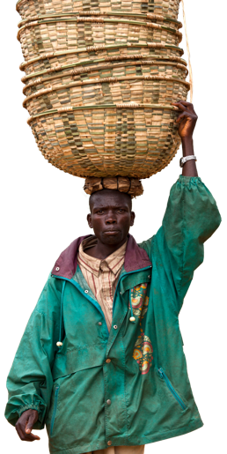
USAID/Burundi
Partner Landscape Assessment
Purpose:
Uncover the challenges and opportunities to increase Mission engagement with local and nontraditional organizations
Identify promising local organizations whose priorities align with USAID’s
Inform a three-year localization strategy

Slide 6

Analysis Criteria
Staff size
Business model resilience
Value proposition
Revenue past three years
Revenue sources beyond major donors

Slide 7
Findings
Revenue Sources Beyond Major Donors | USAID Readiness | Business Model Resilience | Value Proposition
Yes | Level 1 | Strong | High
Yes | Level 1 | Strong | High
Yes | Level 1 | Strong | High
Yes | Level 1 | Strong | Medium
Yes | Level 1 | Strong | Medium
Yes | Level 1 | Moderate | Medium
Yes | Level 1 | Moderate | High
Yes | Level 2 | Moderate | High
Yes | Level 2 | Moderate | Medium
Yes | Level 2 | Strong | Medium
Yes | Level 2 | Strong | Medium
Yes | Level 2 | Weak | High
No | Level 1 | Moderate | Medium
No | Level 1 | Moderate | Medium
No | Level 2 | Weak | High
No | Level 2 | Moderate | Medium
No | Level 2 | Moderate | High
No | Level 2 | Weak | Medium
No | Level 2 | Weak | High
No | Level 2 | Moderate | Medium
No | Level 2 | Moderate | Medium
No | Level 2 | Moderate | Medium
No | Level 3 | Weak | Medium
No | Level 3 | Weak | Medium
No | Level 3 | Weak | Low
No | Level 3 | Weak | Low
No | Level 3 | Weak | Low
No | Level 3 | Weak | Low
No | Level 3 | Weak | Low
No | Level 3 | Weak | Low
Diverse revenue streams increase the stability of an organization, enabling it to:
develop strategies and operational plans;
invest in staff, systems, and resources; and
support long-term, sustainable growth.

Slide 8
We Commit To:
01
Prioritize strengthening the business model resilience & value proposition
02
Focus on progress for building local resilience above programmatic output

Slide 9

MURAKOZE CANE.
MURAKOZE CANE

