Slide 1
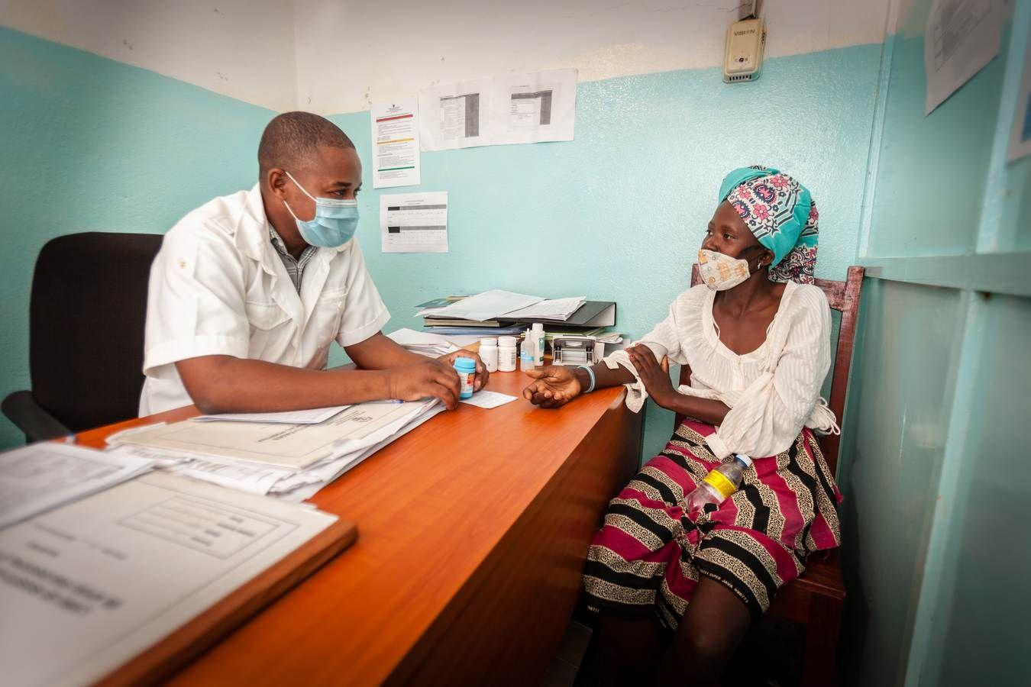
FY24 HRH Inventory - Implementing Partner Training
September 19, 2024

Slide 2
Agenda Overview
8:30 - 8:35 am Introduction and Process Review
8:35 - 9:10 am Overview of FY24 HRH Inventory Template and Changes
9:10 - 9:45 am HRH Inventory Template Demo w/ Staffing Examples
9:45 - 10:10 am Overview of Data Reporting / How to obtain a DATIM account
10:10 - 10:30 am Next steps

Slide 3
Introduction
Presenter: Risa Griffin, Health Workforce Branch
Notes:
Note: this session will be recorded

Slide 4



Monitoring Human Resources for Health investments is critical for optimizing current programing and informing sustainability planning
FY23 USAID by the numbers
204,008
USAID Supported Staff (Individuals)
119,891
USAID Supported Staff (FTE)
51%
of USAID Total Expenditures are HRH
56%
of USAID Staffing Expenditures are through Local Partners
In FY23, USAID partners employed over 204k staff,
representing 51% of total USAID expenditures.
Source: FY23 HRH Inventory Post Clean Data.

Slide 5
The HRH Inventory reporting requirement captures PEPFAR-supported staffing and related expenditures
As PEPFAR looks forward to the next 5 years, understanding and optimizing HRH is critical to reaching and sustaining epidemic control.
More robust data enables further optimization and increases accountability of HRH investment by providing insight in:
Staffing functions
Staffing location
Staffing compensation
HRH Inventory data informs sustainability planning

Slide 6
Alignment of the HRH inventory to Expenditure Reporting (ER)
HRH Employment Titles are mapped to ER Cost Categories
HRH Inventory collects Mode of Hiring (Salary, Contract, Non-monetary only) aligned to ER Cost Categories
HRH Primary Program Areas are aligned to ER Program Areas
HRH Inventory collects Expenditure data
HRH Inventory separates Salary/Contract Expenditure from Fringe Expenditure, which is the same as ER
Keep an eye out for this note on later slides
Important Note: Connecting HRH to ER

Slide 7


HRH Inventory Format and Reporting Process
HRH Inventory Excel Template
Template 1) Uploaded and 2) Submitted to DATIM
The final version of the FY24 template is currently available to download within the HRH DATIM App
1 template per mechanism
1 entry (row) in template per individual
Do not modify the HRH template (e.g. do not add or delete columns)
All those submitting or reviewing HRH Inventory templates will need to request an HRH DATIM account
All data validation checks will be shown upon upload into DATIM and will need to be corrected before the template is accepted.
Notes:
Note: for regions there is just one template and the country is part of the hierarchy structure
DO NOT modify the template, it may cause DATIM to reject the uploaded template

Slide 8
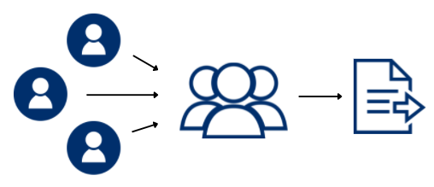
Who Needs to Report HRH Inventory
All mechanisms that report staffing expenditures to ER (Expenditure Reporting) should report to the HRH Inventory*
Subrecipient partners submit completed templates to prime
Prime partner consolidates prime and subrecipient staffing and submits one template per IM
*all mechanisms with expenditures associated with COP approvals

Slide 9
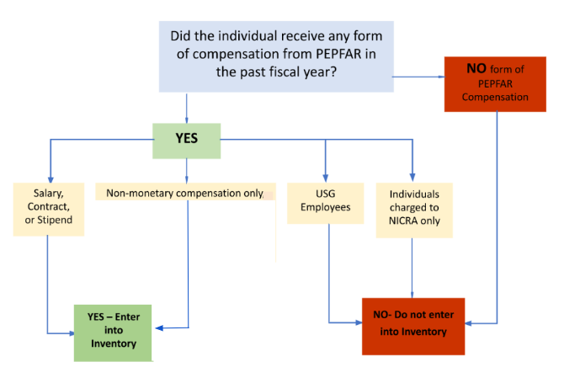
Applicable individuals/ staff to be reported in the HRH Inventory
Every individual that has received any form of compensation from PEPFAR over the past fiscal year:
ALL types of staff: Health workers, program management, TA, HQ-based staff charged directly to the IM
Salary, stipend, contract, fringe including non-monetary support
Prime and subrecipient IPs
Not included in the Inventory:
  Staff charged to NICRA only
  USG

Slide 10
FY24 HRH Reporting Timeline
Risa Griffin, Health Workforce Branch
Notes:
Note: this session will be recorded

Slide 11
FY24 HRH Inventory Reporting Timeline
Current Reporting Timeline (matches other PEPFAR data streams and is included in the published FY24 PEPFAR Data Calendar):
Dec. 2nd: Q4 Data cleaning period opens
IPs re-submit data, as needed
Oct. 1st: Q4 Data entry opens in DATIM
Sept.
2024
Jan. 2025
DATIM users request new HRH accounts
Nov. 15th: Q4 Data entry closes in DATIM
Dec. 13th: Data cleaning upload deadline for IPs

Slide 12



What is needed in order to complete the HRH inventory requirement?
A copy of the OU specific FY24 HRH Inventory Template
  A final version of the template is available to download within the HRH DATIM app
The HRH Inventory Guidance Materials
  See DATIM Zendesk materials here
Internal Records
  HR/ Payroll
  Program Records that capture staff work and location
An HRH DATIM Account
  Register.datim.org (see later slides)

Slide 13
Knowledge Check
What mechanisms need to complete and submit the HRH Inventory excel tool?
Response: All mechanisms that report in ER and that have expenditures associated with COP approvals.

Slide 14
Knowledge Check
What types of staff should be included?
Prime partners
Sub-recipients
Program management staff
Clinical and ancillary staff who deliver services
Other staff that provide technical assistance and support non-service delivery activities
All of the above
Response: f) All staff that receive some form of support should be reported: health workers, program management, TA, and HQ-based staff charged directly to the IM. This applies to prime partner and subrecipient staffing. Staff receiving all types of compensation should be included (salary, stipend/contract, non-monetary support).

Slide 15
Knowledge Check
Should staff working for subrecipient partners be reported in the HRH inventory?
Yes
No
Response: a ) Yes All PEPFAR-supported subrecipient staff working for a mechanism should be reported. There should be one template submission per IM, which should include staffing information for the prime partner as well as any subrecipients.

Slide 16
Knowledge Check
When can partners begin to submit completed FY24 HRH Inventory templates into DATIM?
Response: HRH Inventory follows the standard PEPFAR Reporting Calendar for Q4. DATIM will open October 1st 2024.

Slide 17
Overview of Key HRH Inventory Template Data Elements
Presenters: Risa Griffin, Health Workforce Branch
Notes:
Note: this session will be recorded

Slide 18
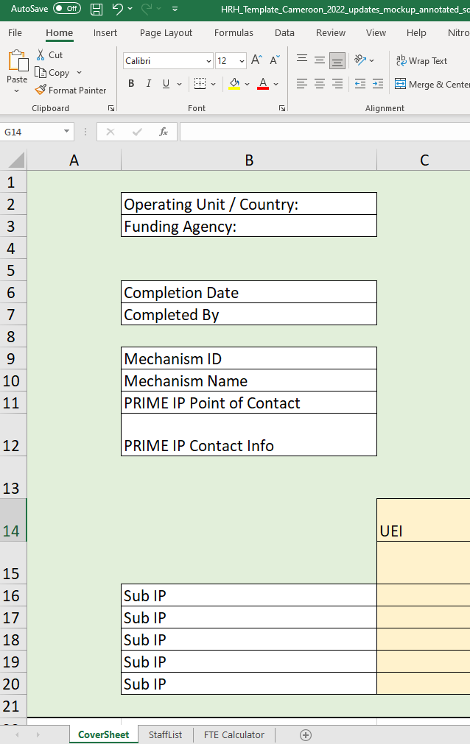
HRH Inventory Template
There are designated HRH Inventory Templates (Excel based) for each OU
Each Mechanism must download, complete, and submit one template to DATIM
This section will review key elements of the template
HRH Inventory Template has 3 Tabs:
Cover Sheet
Staff List
FTE Calculator
Notes:
Risa

Slide 19

HRH Inventory Template
The template contains three main sections:
Cover sheet - contains background/general questions about the operating unit, funding agency, and implementing mechanisms
Staff list - includes detailed list of questions for each individual staff member including title, mode of hire, FTE, and staffing expenditure
FTE calculator - contains a user-friendly Excel tool that calculates the average FTE per month for each staff member (to be used in the ‘Staff list’ tab)

Slide 20
HRH Inventory Template
Note: we will mainly focus on describing the data elements within the Staff List tab in this deck
Cover sheet - contains background/general questions about the operating unit, funding agency, and implementing mechanisms
Staff list - includes detailed list of questions for each individual staff member including title, mode of hire, FTE, and staffing expenditure
FTE calculator - contains a user-friendly Excel tool that calculates the average FTE per month for each staff member (to be used in the ‘Staff list’ tab)

Slide 21
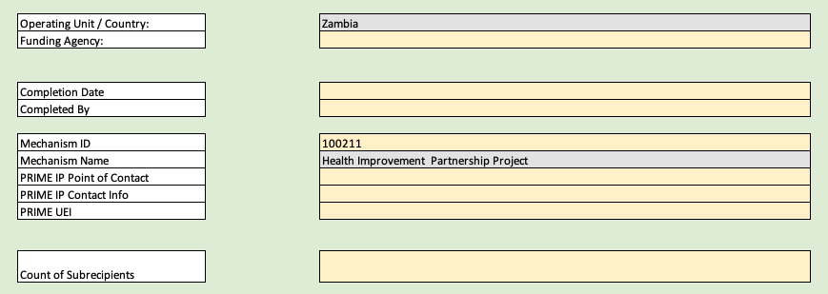
Overview of template: Cover sheet tab
The first tab contains data fields asking for:
Unique information about the IM, such as name and mechanism ID
Name of the prime partner organization
Name of the person at the prime IP who can be contacted for follow-up questions regarding the data submitted
The prime partner’s unique entity identifier (UEI). Users should add "111111111" if not known, and enter "99999999" if the IP is not required to have one
Complete list of sub IPs that were contracted by the prime partner organization
These elements must be completed by the Prime for the final template submission to the DATIM app. Sub recipients may choose to complete this tab, but only the consolidated template with Prime information will be submitted into DATIM

Slide 22
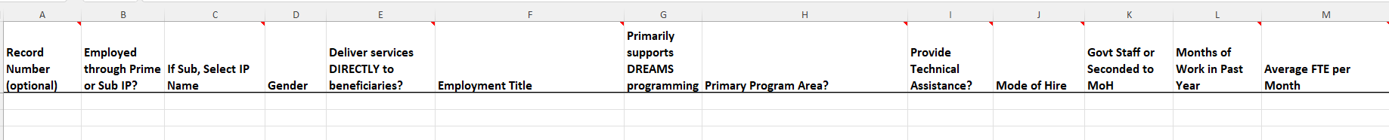
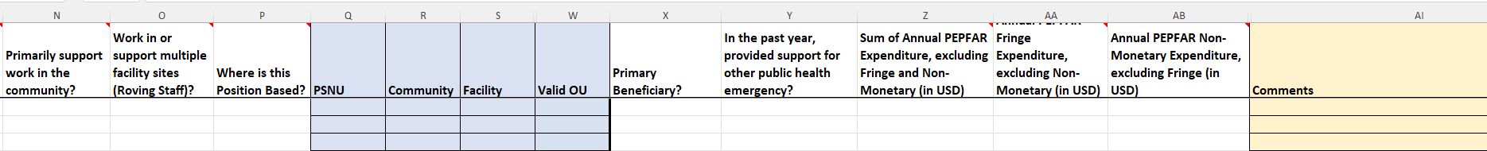
Overview of template: Staff list tab
The second tab is where data on individual staff is entered:
One row entry per staff member
Must complete all fields (with the possible exception of DATIM hierarchy (blue), record number, and comments - see later slides)
Only choose from drop downs, do not write in text
Do not modify the template

Slide 23
Order of questions and corresponding data elements on the staff list tab
Legend
Record Number - optional
Employed through Prime or Sub IP
If Sub, Select IP Name
Gender
Does this staff member deliver services DIRECTLY to beneficiaries?
Employment Title
Primarily supports DREAMS Programming?
What PEPFAR Program Area does the staff member PRIMARILY support?
Does this staff primarily provide technical assistance?
Mode of Hire
Govt Staff or Seconded to MOH
Month of work in the past year
Average FTE per Month
Does this staff primarily support work in the community?
Does this staff member work in/support multiple sites (Roving Staff)?
Where is this position based?
DATIM Hierarchy columns (i.e. geography)
Who is the primary beneficiary that is being supported by this staff member?
In the past year, has this Staff Member provided support for other public health emergencies?
Sum of Annual PEPFAR Expenditure for Staff Member: Salary, Contract, Stipend (USD)?
Expenditure on Annual Fringe from PEPFAR, if any (USD)?
Expenditure on Non-Monetary Costs, excluding fringe?
NEW
EXPANDED
REFINED
REORDERED
UNCHANGED

Slide 24
What has changed in the HRH Inventory Template for FY24?
EXPANDED Employment Titles to include
  Other: Provincial/ District Coordinator
  Other: Program Manager/ Officer
  Other: Program Coordinator/ Assistant
NEW Primarily supports DREAMS Programming, with Yes/ No options
REFINED Primary Program Area IP Program Management definition has been updated to include only staff who work on the management of the award/ mechanism, to match the ER definition
EXPANDED Govt Staff or Seconded to MOH
EXPANDED Where is this position based?
REFINED Primary beneficiary options updated to match FY24 updated ER options

Slide 25
Template data elements: Record number, Prime/sub, Sub-IP, Gender
Question | Description | Notes
Record number (Optional) | This is an optional, alphanumeric field that can be assigned to staff entered in the reporting template | USAID does not recommend completing this field
Employed through Prime or Sub IP | Indicate whether the Prime or Subrecipient IP hired the PEPFAR-supported worker | If the individual is working for both the Prime and a Subrecipient IP, select their PRIMARY employer
If Sub, Select IP Name | If employed through a subrecipient, then please select the IP name from the dropdown
Gender | Select the recognized gender of the PEPFAR-supported worker | Options: Male, Female, Transgender, Non-binary, Other, Don’t Know
Legend
UNCHANGED
Notes:
Handbook contains a definition for all employment titles
And a mapping for Supply Chain Titles

Slide 26
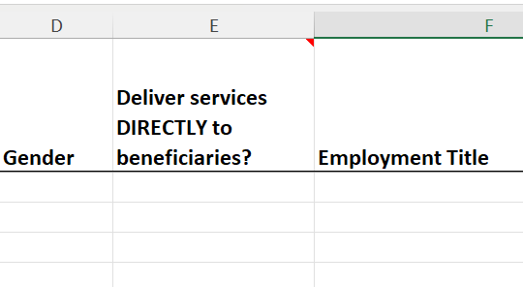
Template data element: Service and Non service Delivery (SD/NSD)
Select whether the individual directly provides services to beneficiaries or supports non-service delivery activities:
  Direct Service Delivery (SD): Program activities involving direct interaction with the beneficiary are defined as service delivery.
    Interactions may be in person, or through other mediums, such as telehealth.
    Only employment titles of clinical and ancillary staff
  Non-Service Delivery (NSD): Program activities that support, facilitate, or strengthen the facility, site, service providers, or subnational unit or national system are defined as non-service delivery.
    Applicable to program management staff and other staff
    All above-site programs areas are, by definition, non-service delivery.
There may be instances where staff provide both service-delivery and non-service delivery. For reporting, please select the type of interaction that the worker provides most often.
Legend
UNCHANGED
Note: All employment titles have a suggested category for SD/NSD in the HRH Inventory handbook here

Slide 27
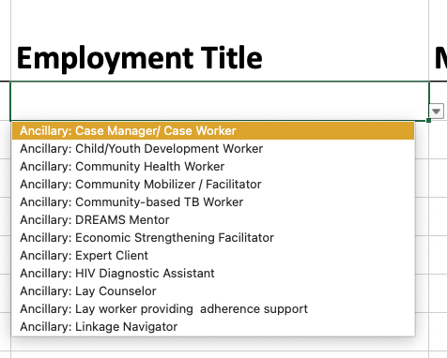
Template data element: Employment Titles
Select the employment title that primarily captures the role of each individual
Please note: The job titles may not exactly match the official job title of the individual. Select the employment title that best describes the official role and responsibilities of the individual
Each staff member should be represented in one row only
Dropdown list of alphabetical titles
All titles are defined in the HRH inventory handbook
Legend
EXPANDED
Notes:
Handbook contains a definition for all employment titles
And a mapping for Supply Chain Titles

Slide 28

Template data element: How to determine Employment Title
Employment title should reflect the work being done, NOT training or qualifications
Example: A nurse who primarily provides facility management / administration and not nursing services should be reported in the template as a Facility Administrator, not as a nurse
Notes:
Handbook contains a definition for all employment titles
And a mapping for Supply Chain Titles

Slide 29
Organization of Employment Titles
Full List of Employment Titles Under Each ER Cost Category
HCW: Clinical | HCW: Ancillary | Other Staff
-Doctor -Clinical Officer -Medical Assistant -Nurse -Auxiliary Nurse -Nursing Assistant -Midwife -Auxiliary Midwife -Clinical Social Worker -Clinical/Retention Case Manager -Testing and Counseling Provider -Laboratory Technologist/Technician -Laboratory Assistant/Phlebotomist -Pharmacy Assistant -Pharmacy Technician -Pharmacist -Psychologist -Psychiatrist -Psychology Assistant -Other clinical provider not listed | -Peer Educator -Peer Navigator -Expert Client -DREAMS mentor -Economic Strengthening Facilitator -Prevention of HIV and Sexual Abuse Facilitator -Community Mobilizer / Facilitator -Lay Counselor -Linkage Navigator -HIV Diagnostic Assistant -Lay worker providing adherence support -CHW -Mother Mentor -Community based TB worker -Social Worker -Social Welfare Assistant -Case Manager or case worker -Child/Youth Development Worker -Other community-based cadre | -IP Program Management Accounting Workers -IP Program Management Administrative Staff -IP Program Management Finance Workers -IP Program Management Legal Staff -IP Program Management: Procurement Staff -IP Program Management: Grants Management Staff -IP Program Management: Other Program Management Staff -IP Program Management: Senior Leadership -Facility Administrator -Laboratory Manager -Pharmacy Manager -Human Resource Manager -Cleaner / Janitor -Maintenance -Security Guard -Transportation staff for personnel -Transportation staff for commodities and patient samples -Central / regional warehouse worker -Other supportive staff not listed (example, receptionist) -Biostatistician -Information Systems Worker -M&E Officer / Advisor -Data Officer -Data Clerk -Data Managers -Other: DREAMS -Trainer -Technical Advisor -Logistics Manager -Supply Chain Advisor -Epidemiologist -Other Professional Staff -Provincial/ District Coordinator -Program Manager/ Officer -Program Coordinator/ Assistant
For full list of definitions of employment titles, please refer to the HRH Inventory handbook here
-Three new Other: Employment Titles
May replace “Other Program Management” or “Other Professional Staff”
Notes:
Handbook contains a definition for all employment titles
And a mapping for Supply Chain Titles

Slide 30
Organization of Employment Titles
Full List of Employment Titles Under Each ER Cost Category
HCW: Clinical | HCW: Ancillary | Other Staff
-Doctor -Clinical Officer -Medical Assistant -Nurse -Auxiliary Nurse -Nursing Assistant -Midwife -Auxiliary Midwife -Clinical Social Worker -Clinical/Retention Case Manager -Testing and Counseling Provider -Laboratory Technologist/Technician -Laboratory Assistant/Phlebotomist -Pharmacy Assistant -Pharmacy Technician -Pharmacist -Psychologist -Psychiatrist -Psychology Assistant -Other clinical provider not listed | -Peer Educator -Peer Navigator -Expert Client -DREAMS mentor -Economic Strengthening Facilitator -Prevention of HIV and Sexual Abuse Facilitator -Community Mobilizer / Facilitator -Lay Counselor -Linkage Navigator -HIV Diagnostic Assistant -Lay worker providing adherence support -CHW -Mother Mentor -Community based TB worker -Social Worker -Social Welfare Assistant -Case Manager or case worker -Child/Youth Development Worker -Other community-based cadre | -IP Program Management Accounting Workers -IP Program Management Administrative Staff -IP Program Management Finance Workers -IP Program Management Legal Staff -IP Program Management: Procurement Staff -IP Program Management: Grants Management Staff -IP Program Management: Other Program Management Staff -IP Program Management: Senior Leadership -Facility Administrator -Laboratory Manager -Pharmacy Manager -Human Resource Manager -Cleaner / Janitor -Maintenance -Security Guard -Transportation staff for personnel -Transportation staff for commodities and patient samples -Central / regional warehouse worker -Other supportive staff not listed (example, receptionist) -Biostatistician -Information Systems Worker -M&E Officer / Advisor -Data Officer -Data Clerk -Data Managers -Trainer -Technical Advisor -Logistics Manager -Supply Chain Advisor -Epidemiologist -Other Professional Staff -Provincial/ District Coordinator -Program Manager/ Officer -Program Coordinator/ Assistant
For full list of definitions of employment titles, please refer to the HRH Inventory handbook here
-Please only select the ‘Other’ staff titles as a LAST RESORT
-Select Other Clinical Provider, Other Community-based Cadre, Other Program Management Staff, Other Supportive Staff, or Other Professional Staff ONLY IF none of the other employment titles fit
Notes:
Handbook contains a definition for all employment titles
And a mapping for Supply Chain Titles

Slide 31
Knowledge Check
You have a medical doctor by training, but they are working for your program as a Technical Advisor for HIV care and treatment. Should you select “Doctor” or “Technical Advisor” as their employment title?
Doctor
Technical Advisor
Response: Technical Advisor. You should select an employment title based on the job the person is hired to do - not based on their education level or qualifications.

Slide 32
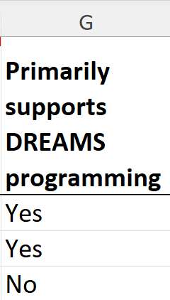
Tracking DREAMS staffing footprint
NEW DREAMS Column for FY24:
“Primarily supports DREAMS programming”
Yes/ No answer options
Select “Yes” if the majority of the individual’s time is spent on DREAMS programming
This column replaces the “Other: DREAMS” Employment Title.
  Choose the Employment Title that best describes the individual’s role and responsibilities.
If the mechanism does not support any DREAMS programming, or there is no DREAMS program in your OU, select “No” for all staff.
It is no longer necessary to specify “DREAMS” in the comments column.
Legend
NEW
Notes:
Handbook contains a definition for all employment titles
And a mapping for Supply Chain Titles

Slide 33
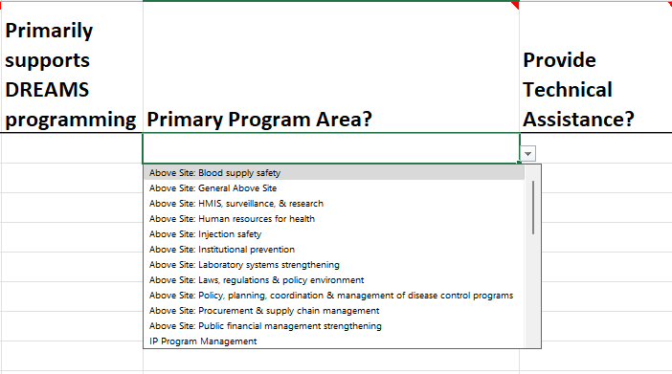
Template data elements: Primary Program Area
Select the primary PEPFAR program area that the individual staff supports.
If the individual supports multiple program areas, please select the one that occupies the majority of their time.
    If the individual supports two areas equally, please select one to report. The other may be listed in the comments section, if desired
Only workers who support work at a community or facility (including rovers) can select a Site Level program area. All others must select an Above Site program area.
Legend
REFINED
For full list of definitions of program areas, please refer to the HRH Inventory handbook here

Slide 34
Primary Program Area: IP Program Management
Primary Program Area “Program Management” should only be selected for staff whose work primarily supports Implementing Partner Program Management (IP PM), i.e. the management of the mechanism for the purpose of planning, coordinating, and managing the programmatic work of the federal award to an IP.
Excludes site-level staff who manage or supervise services.
  IP PM staff are those who primarily perform mechanism management and support staff assigned exclusively to the PEPFAR award in question (e.g. senior leadership, and administrative, finance/accounting, and legal staff). Health care workers, technical advisors, data entry staff, and program implementation staff for site-level program areas should not be reported as Program Management.
Please note: Only workers who support work at a community or facility (including rovers) can select a Site Level program area, as per the Financial Classifications definition of Site Level. All others must select an Above Site program area.
This update brings the HRH IP Program Management definition into alignment with the Financial Classifications Guide.

Slide 35
Overview of Program Area Options
Site Level |  |  |  | Above Site
Prevention (PREV) | Socioeconomic (SE) | Testing (HTS) | Care and Treatment (C&T)
Comm. mobilization, behavior & norms change | Case Management | Community-based testing | HIV Clinical Services | Blood supply safety | Policy, planning, coordination & management of disease control programs
Condom & Lubricant Programming | Economic Strengthening | Facility-based testing | HIV Drugs | HMIS, surveillance, and research | Procurement & supply chain management
Medication assisted treatment | Education Assistance | General HTS | HIV Laboratory Services | Human resources for health | Public financial management strengthening
PrEP | Food and nutrition |  | General C&T | Injection safety | Laws, regulation, and policy environment
Primary prevention of HIV and sexual violence | Legal, human rights & protection |  | HIV/TB | Laboratory systems strengthening | General above site
VMMC | Psychosocial support
 | General socioeconomic
IP Program Management
Refers to clinical services related to integrated HIV/TB care

Slide 36
Overview of Program Area Options
Site Level |  |  |  | Above Site
Prevention (PREV) | Socioeconomic (SE) | Testing (HTS) | Care and Treatment (C&T)
Comm. mobilization, behavior & norms change | Case Management | Community-based testing | HIV Clinical Services | Blood supply safety | Policy, planning, coordination & management of disease control programs
Condom & Lubricant Programming | Economic Strengthening | Facility-based testing | HIV Drugs | HMIS, surveillance, and research | Procurement & supply chain management
Medication assisted treatment | Education Assistance | General HTS | HIV Laboratory Services | Human resources for health | Public financial management strengthening
PrEP | Food and nutrition |  | General C&T | Injection safety | Laws, regulation, and policy environment
Primary prevention of HIV and sexual violence | Legal, human rights & protection |  | HIV/TB | Laboratory systems strengthening | General above site
VMMC | Psychosocial support
 | General socioeconomic
IP Program Management
ASP or above site program activities refer to technical assistance activities aimed at strengthening specific areas of the health system

Slide 37
Overview of Program Area Options
Site Level |  |  |  | Above Site
Prevention (PREV) | Socioeconomic (SE) | Testing (HTS) | Care and Treatment (C&T)
Comm. mobilization, behavior & norms change | Case Management | Community-based testing | HIV Clinical Services | Blood supply safety | Policy, planning, coordination & management of disease control programs
Condom & Lubricant Programming | Economic Strengthening | Facility-based testing | HIV Drugs | HMIS, surveillance, and research | Procurement & supply chain management
Medication assisted treatment | Education Assistance | General HTS | HIV Laboratory Services | Human resources for health | Public financial management strengthening
PrEP | Food and nutrition |  | General C&T | Injection safety | Laws, regulation, and policy environment
Primary prevention of HIV and sexual violence | Legal, human rights & protection |  | HIV/TB | Laboratory systems strengthening | General above site
VMMC | Psychosocial support
 | General socioeconomic
IP Program Management
IP program management refers to administrative and planning activities for implementing the technical work of the award. This includes planning/coordination of the award/ mechanism, financial administration of the award, and other related overhead activities

Slide 38
IMPORTANT Note about Primary Program Area
If the PEPFAR-supported worker works on more than one program area you must:
Choose a primary program area
Report FTE and Expenditure ($$) for the entire worker, not just for the primary program area
Example: You are reporting a full-time nurse who spends ¾ of her time on HIV care and treatment services, and ¼ of her time on HIV testing. Total annual expenditure is $2,500.
You would report this worker on one line in the template:
Primary Program Area = General C&T
FTE = 1
Expenditure = $2,500

Slide 39
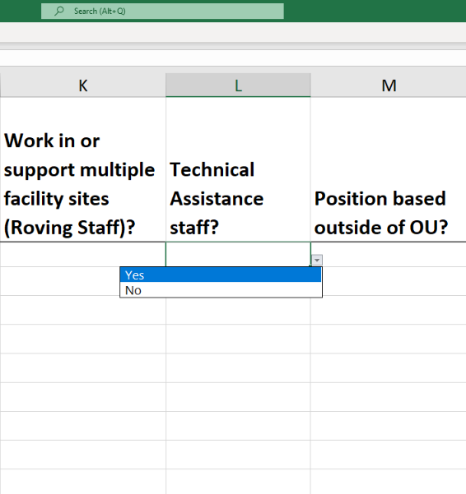
Template data element: Technical assistance staff
Definition: Technical Assistance (TA) staff primarily support/improve the delivery of services, but do not directly interact with patients or beneficiaries in response to their health care needs
Examples of TA activities can include:
  Conducting training workshops to improve technical capacity of staff
  Provide expert guidance on specific topics (e.g. monitoring and evaluation, supply chain management, health financing, etc.)
All above-site individuals that primarily facilitate or strengthen service delivery providers should select “Yes” in answer to this question
Ex. Monitoring and Evaluation (M&E) Advisors, Supply Chain Advisors, Health Financing Advisors/Specialists, Health Systems Strengthening Advisor, etc.
Legend
UNCHANGED
Notes:
Risa

Slide 40
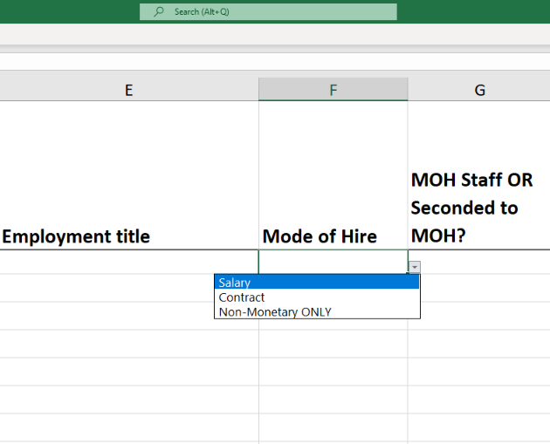
Template data elements: Mode of Hiring
Indicate the mode or how the individual is hired. Select the option that best reflects the primary mode of hire for each staff.
Salary is defined as PEPFAR-funded compensation for workers who are employed by an IP and receive a salary or wage. Salaried staff must enter both salary and fringe amounts (see later slides)
Contract is defined as PEPFAR-funded compensation through contract(s) for a worker who is not directly employed by an IP, but contracted to perform services. Note: This includes PEPFAR-supported workers that receive stipends.
Non-Monetary ONLY
  Defined as PEPFAR-funded compensation for workers that is provided in the form of non-monetary compensation
  This can include purchased goods (e.g. household goods, clothing, etc.), or air time (e.g. phone cards) for personal use
  Non-monetary DOES NOT include supplies or other resources required for fulfilling job duties
Please note that these are mutually-exclusive fields. For example, if an individual receives both a salary and non-monetary compensation, select Salary as the mode of hire.
Legend
UNCHANGED
Notes:
-

Slide 41
Template data element: MOH staff
Question | Description
MOH Staff or seconded to MOH | Indicate if the individual supported by the IM is a) officially designated as a government MOH staff, b) seconded by PEPFAR to serve in that capacity, or c) none of the above
Govt Staff or Seconded to MoH | Dropdown Options: No Yes- MOH Staff Yes- Seconded to MOH Yes- Other non-MoH Government Staff Indicate if the individual supported by the IM is officially designated as a MOH staff, an individual seconded by PEPFAR to serve in that capacity, or non-MoH government staff receiving PEPFAR support. All MOH staff that receive compensation from PEPFAR in addition to their government salary should select ‘YES-MOH Staff’. Any staff member who is employed through an IP but placed in government offices as a secondment should select ‘YES-Seconded to MOH’. NonMOH government staff (i.e., staff from Ministry of Finance, Ministry of Education, Ministry of Defense or other government entities) that receive compensation from PEPFAR in addition to their government salary should select ‘Yes- Other Non-MOH Government Staff.’
OLD
NEW
Legend
EXPANDED
Notes:
Note: Staff that are employed by an IP and work in health facilities to deliver health
services alongside government staff are generally not considered seconded staff—
seconded staff are most often seconded to national and regional government offices rather than health facilities.

Slide 42
Template data element: Months of work
Question | Description | Notes
Months of work in the past year | Indicate the total number of months the PEPFAR-supported worker worked during the last USG fiscal year (October 1 – September 30) in this role | If the worker worked for part of a month, count the number of weeks worked in the partial month (no need to count the number of days), and include as a decimal For example, if a doctor worked 3 weeks in one month, that would be counted as 0.75. It is not necessary to subtract regular leave days when calculating (count paid leave days as work)
Legend
UNCHANGED
Notes:
Handbook contains a definition for all employment titles
And a mapping for Supply Chain Titles

Slide 43
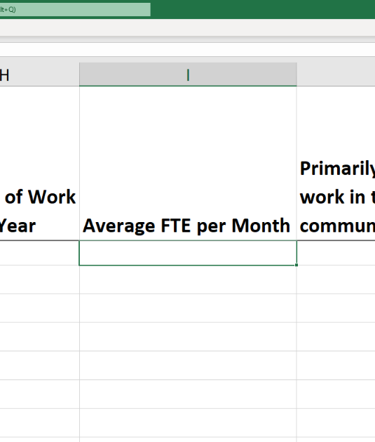
Template data element: Average Full Time Equivalents (FTE) per Month
Full-Time Equivalent (FTE): A way to understand and measure staffing size when the number of hours worked vary by worker
Enter the average percent of full-time equivalent (FTE) worked by the individual staff per month.
Enter free text, value 0 - 1.0
Reported as a decimal, where 0 = no work on average per month, and 1 = full time work per month.
Only enter the FTE supported by PEPFAR on the IM being reported. Do not report FTE supported by MOH or other entities.
Legend
UNCHANGED
Notes:
-

Slide 44
FTE Calculator Examples
For staff that work less than full-time, please utilize the FTE Calculator to assist in entering average FTE field.
FTE Calculator Option | Example | Average Monthly FTE
1. The PEPFAR worker’s hours generally remain constant per week | A nurse works 20 hours per week each week all year | 0.5
2. The PEPFAR worker’s hours generally remain constant per month | A case manager works 50 hours every month all year | 0.289
3. PEPFAR worker’s hours differ per week in a month | A data clerk works 40 hours for three weeks and 20 hours the last week of each month | 0.875
4. PEPFAR worker’s hours vary month to month | A community health care worker works 40 hours per month from Jan-Mar, but does not work the rest of the year | 0.059
*These examples assume a full time work week is 40 hours, this can be adjusted using line 4 in the FTE calculator
Notes:
-

Slide 45
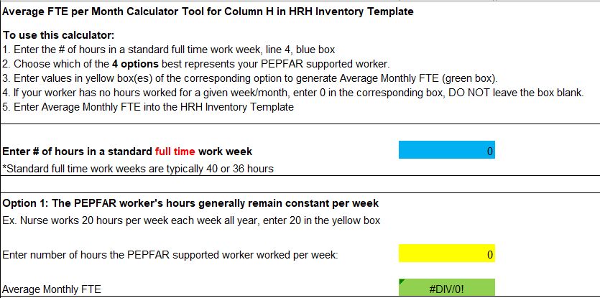
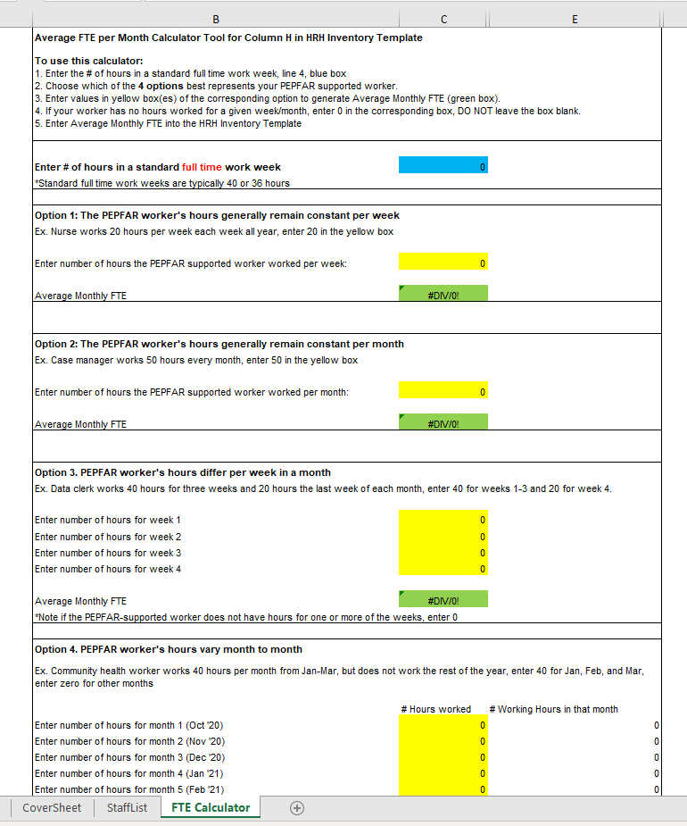
Overview of the FTE Calculator
Notes:
Switch to Demo

Slide 46
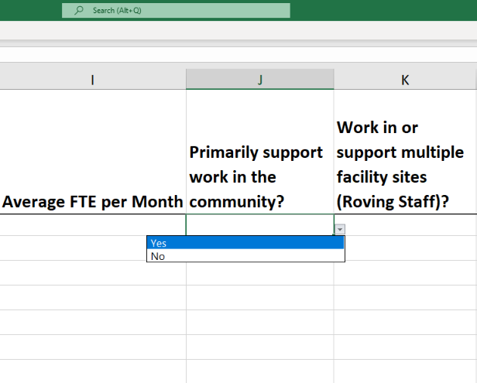
Template data element: Primarily support work in the community
This primarily refers to ancillary staff delivering or supporting the delivery of non-facility based activities at the community level (e.g. social mobilization, health education, etc.)
Some examples of community-level staff can include:
  Community health worker
  Peer educator
  Peer navigator
  DREAMS mentor
  Community mobilizer / facilitator
  Case manager / case worker
See full list of potential community-based roles in the HRH handbook
Beginning in FY24, individuals who primarily support work in the community who are attached to a facility may be reported as linked to the facility
Legend
UNCHANGED
Notes:
-

Slide 47
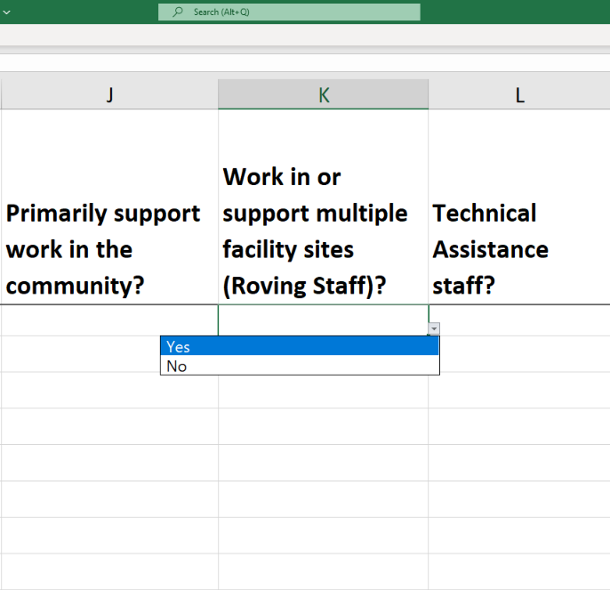
Template data element: Work in Multiple Sites (Roving Staff)
Roving Staff Definition: PEPFAR-supported worker who provides services at multiple facility sites on a regular basis
Enter yes/ no for each individual staff:
  NO: Individual staff do not provide work at multiple facility sites. This includes workers that occasionally or rarely provide services to more than one site - since the worker does not provide services to more than one site on a regular basis
  YES: Individual staff does work at multiple facility sites.
Roving Staff are only associated w/ site level program areas, and will need to be reported at the community level (i.e. working in multiple facilities in a community)
Ex. Nurse providing care and treatment services in multiple health facilities on a regular basis.
Legend
UNCHANGED
Notes:
Note: This chart is for OUs with a combined PSNU/Community column, the guidance document contains a chart for OUs with separate PSNU and community columns and for regional OUs

Slide 48
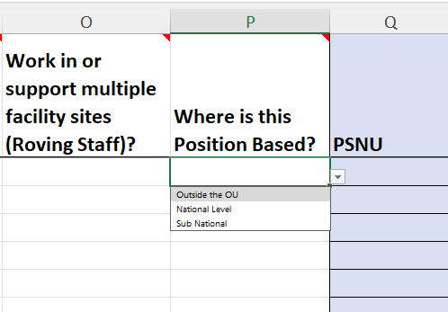
Template data element: Where is this Position Based?
Replaces - Is this position based outside of the OU?
Please indicate whether this position is primarily based
  Outside of the operating unit (OU)
  At the National Level
  At the Subnational Level
Any INTERNATIONAL WORKERS, such as U.S. based staff that spend a portion of their time supporting the project/mechanism, should leave all geographic hierarchy columns blank. For regional programs (not country programs), please select the country in SNU1 (Column N).
  Staff that work in a position based outside of the OU should select Above Site or Program Management as their program area
  Ex. An M&E Advisor based in Washington DC that provides technical assistance support to a PEPFAR project in South Africa
National Level staff work at the national or SNU-level supporting national level activities.
  Select the SNU1 where the majority of the work is performed (e.g. the SNU where the capital or administrative capital is located)
  National level workers cannot be considered “Site Level” staff. Must be Above Site or PM.
Sub-National Level: Includes community and facility level staff
Legend
EXPANDED
Notes:
Jason

Slide 49
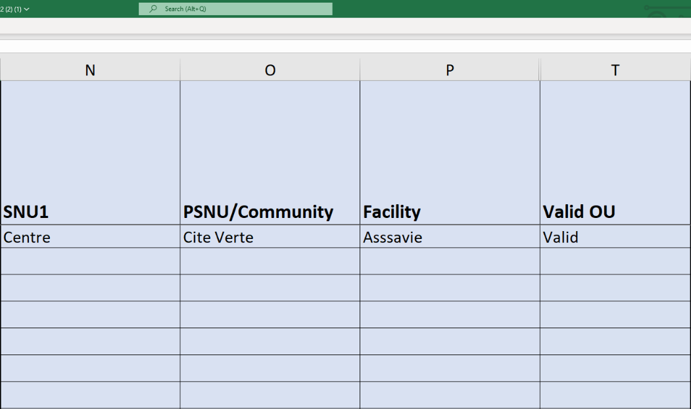
Template data element: DATIM Geographic Hierarchy
Select the DATIM Geographic Hierarchy component that corresponds to the primary location where work was performed.
In instances where individuals work in multiple locations, indicate where the majority of work was performed. If work is split evenly, choose one.
Note: You must fill out the template from largest geographic area (left most column) to smallest (see next slides to determine how to report each type of staff)
Hierarchy components on all templates (there are three types templates (see later slides))
OU (Regional Only)
SNU1
PSNU
Community (Select templates only)
Facility
Legend
UNCHANGED

Slide 50
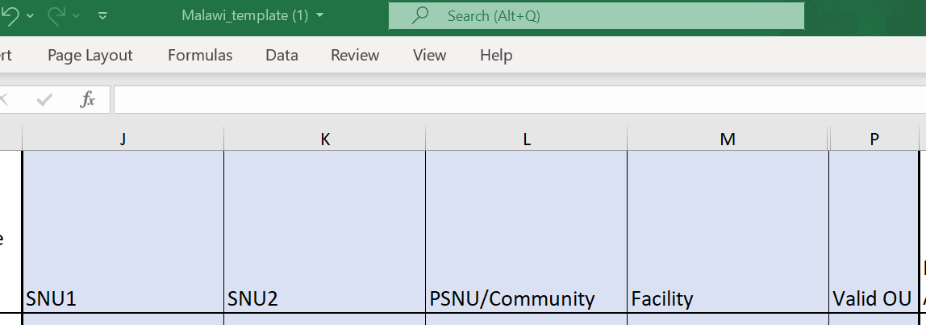
Template data element: DATIM Hierarchy Example - Malawi
Key Definitions
OU - Operating Unit. Either a Country or Region.
SNU - Sub-National unit. A smaller geographic area than the OU. (SNU1 is larger than SNU2, etc.)
  PSNU - Priority SNU. The geographic unit/level at which PEPFAR program targets are set
  Community - A geographic area/unit higher than the facility level, sometimes equivalent to the PSNU
  Facility - lowest SNU in the DATIM hierarchy
OU
-Malawi
SNU1
SNU2
SNU3
-PSNU/Community
Template columns are labeled with PSNU, Community, and Facility Designations (except for regional templates)
SNU4
-Facility

Slide 51
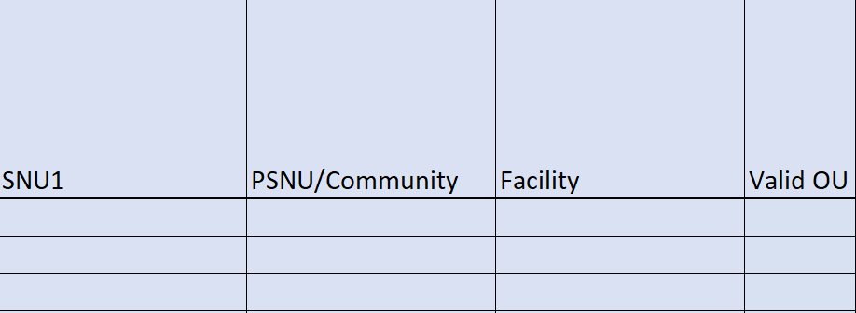
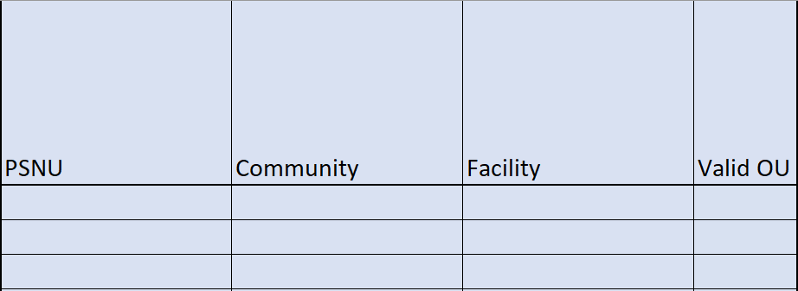
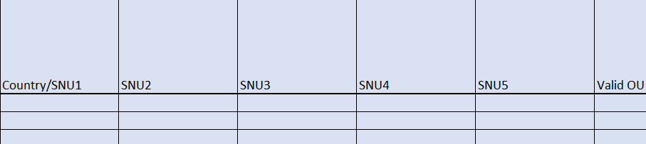
Template data element: DATIM Hierarchy
Three are three different types of HRH data collection templates:
Botswana
Cameroon
DRC
Ethiopia
Malawi
Mozambique
Namibia
Ukraine
Zambia
Zimbabwe
DATIM Template #1:
(Combined PSNU and Community columns)
Angola
Burundi
Côte d’Ivoire
Eswatini
Haiti
Nigeria
Rwanda
S. Africa
S. Sudan
Tanzania
Kenya
Lesotho
Uganda
Vietnam
DATIM Template #2:
(Separate PSNU and Community columns)
DATIM Template #3:
(Regional template showing SNU columns only)
Asia Regional
Western Hemisphere Region
West Africa Region

Slide 52
Locations of workers
Each entry must complete the DATIM Hierarchy down to the appropriate level
The appropriate level is based on the location of the worker
The location of work is defined as where the individual performs their work
Notes:
Staff that have a desk at the IP’s office, but spends the majority of their
time working in other areas of the country, should report to the location where work
is performed, rather than the location of the IP’s office.

Slide 53
DATIM Hierarchy option 1: OUs with PSNU/Community Level
OUs with combined PSNU/Community Columns
Location of Work | Work in or support multiple sites (Roving Staff)? | SNU1 | PSNU/Community | Facility
Outside of OU | No | No | No | No
National and Military | No | Yes | No | No
Above Site Workers | No | Any valid combination of Geographical Selections Above Facility |  | No
Community | No | Yes | Yes | Yes or No
Roving Across Facilities | Yes | Yes | Yes | No
Facility/ TA at one facility | No | Yes | Yes | Yes
Botswana
Cameroon
DRC
Ethiopia
Malawi
Mozambique
Namibia
Ukraine
Zambia
Zimbabwe

Slide 54
DATIM Hierarchy option 2: OUs with separate PSNU and Community Levels
OUs with separate PSNU and Community Columns
Location of Work | Work in or support multiple sites (Roving Staff)? | SNU1 | PSNU | Community | Facility
Outside of OU | No | No | No | No | No
National and Military | No | Yes | No | No | No
Above Site Workers | No | Any valid combination of Geographical Selections Above Facility |  |  | No
Community | No | Yes | Yes | Yes | Yes or No
Roving Across Facilities | Yes | Yes | Yes | Yes | No
Facility / TA at one facility | No | Yes | Yes | Yes* | Yes
Angola
Burundi
Côte d’Ivoire
Eswatini
Haiti
Nigeria
Rwanda
S. Africa
S. Sudan
Tanzania
Kenya
Lesotho
Uganda
Vietnam
*If community is not known, choose the same value as the PSNU

Slide 55
DATIM Hierarchy option 3: OUs using Regional Level Templates
Regional Hierarchy Columns
Location of Work | Work in or support multiple sites (Roving Staff)? | Country/SNU1 | Any valid combination of Geographical selections above Facility Level | Any valid combination of Geographical Selections Stopping at and including PSNU | Any valid combination of Geographical Selections down to the Facility Level
International | No | Yes | -- | -- | --
National, Military | No | Yes | Yes | -- | --
Above Site Workers | No | Yes | Yes | -- | --
Community | No | Yes | -- | Yes | --
Roving Across Facilities | Yes | Yes | -- | Yes | --
Facility / TA at one facility | No | Yes | -- | -- | Yes
Asia Regional
Western Hemisphere Region
West Africa Region

Slide 56
Knowledge Check
For community workers not attached to specific facilities, how would you answer the question “does staff work in or support multiple sites”?
Yes
No
Response: b) No Staff that are working only at the community and are not attached to any facilities should answer no. This question is intended to capture facility-based workers that move across multiple facility sites.

Slide 57
Summary of Locations of Work and Program Area
Location of Work | Primary Program Area
Above Site | Above Site (ASP) or IP Program Management
Community | Site Level (C&T, HTS, SE, Prev.)
Roving Staff
Facility
Reminder! You have already determined location of work in the DATIM Hierarchy section

Slide 58
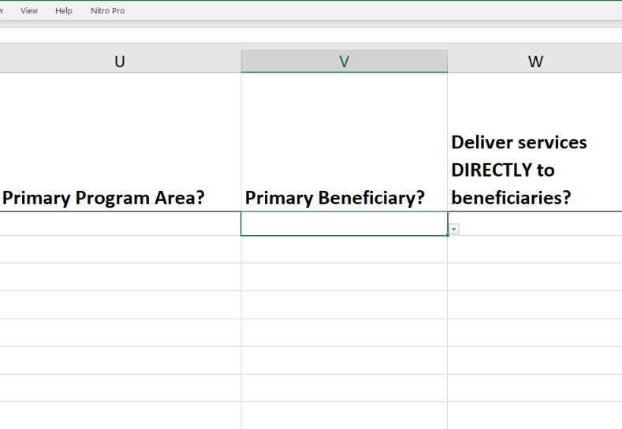
Template data element: Primary beneficiary
Please indicate the primary beneficiary of services provided/supported by this staff member:
Non-targeted populations
Children
Adolescent Girls and Young Women (AGYW)
Key Populations
Orphans and Vulnerable Children (OVC)
Pregnant and Breastfeeding Women (PBFW)
Military
Primary Beneficiary options have been updated for FY24 to match FY24 updated ER options
See detailed guidance on each primary beneficiary in the PEPFAR HRH Inventory Handbook
Legend
REFINED

Slide 59
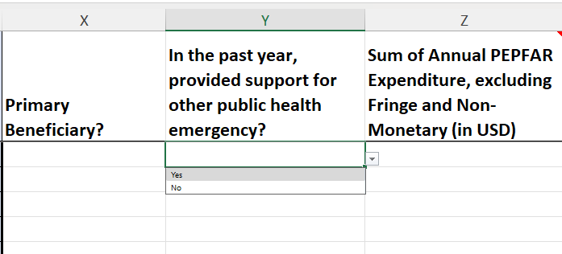
Template data elements: Public Health Emergency
Indicate whether the individual supported delivery specific services in response to a Public Health Emergency at any point during the reporting period
Supporting a public health emergency response may include service delivery, and can also include administrative support, such as funds disbursement for public health emergency response
Public health emergencies may include: response activities related to COVID-19, Ebola outbreak response, Cholera, and other related infectious disease outbreaks
Legend
UNCHANGED

Slide 60
Template data elements: Expenditure
The HRH Inventory collects Expenditure, which is the same as ER
Expenditure is how much was spent in the last fiscal year on the PEPFAR-supported worker
The HRH Inventory does not collect annual salary
The HRH Inventory collects Expenditure in three columns
Sum of Annual PEPFAR Expenditure, excluding Fringe and non-monetary expenses
Annual PEPFAR Fringe Expenditure
Annual Non-Monetary Expenditure, excluding Fringe
Important: Connecting HRH to ER

Slide 61
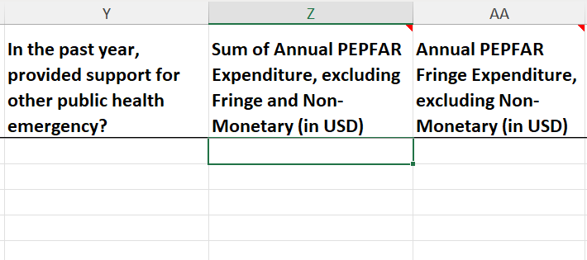
Template data elements: Sum of Annual PEPFAR Expenditure, excluding Fringe
Enter the total amount expended on the individual staff’s compensation, excluding fringe and non-monetary expenditure, over the past fiscal year
Free text, numeric
All salary, wage, contract fees, stipends, and other financial payments made to staff should be entered here
All PEPFAR expenditure data must be reported in United States dollars (USD)
Include expenditures from October 1, 2023 to September 30, 2024
Legend
UNCHANGED
Important: Connecting HRH to ER

Slide 62
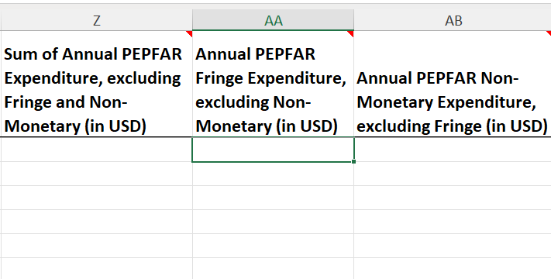
Template data elements: Annual PEPFAR Fringe Expenditure
Enter the total amount expended on individual staff’s fringe benefits (in USD)
Free text, numeric
Fringe should include the cost of employer’s share and should exclude any fringe benefits that are included as part of an approved indirect cost rate
Include expenditures from October 1, 2023 to September 30, 2024
Note: Salary, stipends, wages should NOT be entered here - only the cost of fringe benefits should be included
Legend
UNCHANGED
Important: Connecting HRH to ER

Slide 63
Overview of Annual PEPFAR Fringe Expenditure
Included Costs | Excluded Costs
Fringe benefits in the form of regular compensation paid to employees during periods of authorized absences from the job, such as vacation, sick leave, military leave. Fringe benefits in the form of employer contributions or expenses for social security, employee insurance, workmen's compensation insurance, pension plan costs, etc. Other allowable costs for fringe benefits (see OMB Circular A-122), such as housing assistance and rural housing allowance. | Stipends, cash awards, bonuses or performance-based pay should all be entered in the “Sum of annual PEPFAR Expenditure, excluding fringe.” PEPFAR funding for the construction or renovation of housing for healthcare workers, even if in place of providing a housing allowance to obtain housing on the market, should not be included in the HRH Inventory. Costs of fringe benefits that were classified as indirect

Slide 64
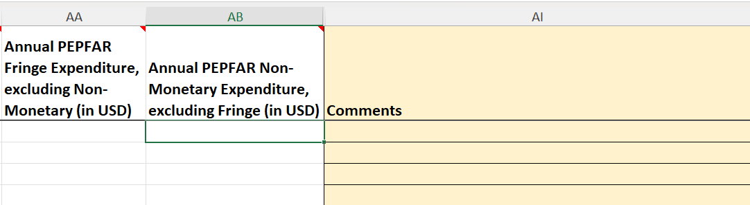
Template data elements: Annual PEPFAR Non-Monetary Expenditure, excluding Fringe (USD$)
Enter the total amount expended on non-monetary expenditure, excluding Fringe (in USD)
This field aims to better capture individuals that PEPFAR is relying upon for implementing program activities, but are not receiving monetary compensation (i.e. salary or stipend)
This may include unpaid staff such as volunteers that do not receive a salary/stipend, but instead receive household goods, phone cards, clothing, etc. for personal use
This does NOT include supplies, equipment, or other resources required for fulfilling job duties
Legend
UNCHANGED
Important: Connecting HRH to ER

Slide 65
Summary of Mode of Hiring and Expenditure (USD$) for Salaried Workers
Staffing Scenario Examples |  | Mode of Hiring (column F) | Sum of Annual PEPFAR Expenditure, excluding Fringe (column Y) | Annual PEPFAR Fringe Expenditure (column Z) | Annual PEPFAR Non-Monetary Expenditure (column AA)
1 | Salaried Worker | Salary* | Salary Expenditure | Fringe Expenditure | …
2 | Salaried Worker receiving an additional smaller stipend |  | Salary Expenditure + additional stipend expenditure | Fringe Expenditure | …
3 | Salaried Worker receiving an additional non-monetary amount |  | Salary Expenditure | Fringe Expenditure | Non-monetary compensation estimate
* All Salaried workers must enter an amount for fringe, if the worker does not receive fringe, enter zero

Slide 66
Summary of Mode of Hiring and Expenditure (USD$) for Contract Workers
Staffing Scenario Examples |  | Mode of Hiring (column F) | Sum of Annual PEPFAR Expenditure, excluding Fringe (column Y) | Annual PEPFAR Fringe Expenditure (column Z) | Annual PEPFAR non-monetary expenditure (column AA)
1 | Contract Worker | Contract | Contract Expenditure | … | …
2 | Stipend Worker |  | Stipend Expenditure | … | …
3 | Contract Worker receiving fringe benefits |  | Contract Expenditure | Fringe Expenditure | …
4 | Stipend Worker receiving non-monetary compensation |  | Stipend Expenditure | … | Non-monetary compensation estimate

Slide 67
Summary of Mode of Hiring and Expenditure (USD$) for Non-monetary ONLY
Staffing Scenario Examples |  | Mode of Hiring (column F) | Sum of Annual PEPFAR Expenditure, excluding Fringe (column Y) | Annual PEPFAR Fringe Expenditure (column Z) | Annual PEPFAR non-monetary Expenditure (column AA)
1 | Non-monetary only worker | Non-monetary ONLY | … | … | Non-monetary compensation estimate

Slide 68
Q&A
Moderator: Risa Griffin, Jerilyn Hoover, and Kyle Borces, Health Workforce Branch

Slide 69
HRH Inventory Template Demo w/ Staffing Examples
Presenter: Risa Griffin, Health Workforce Branch
Notes:
Note: this session will be recorded

Slide 70
Staffing Scenarios
Scenario A
Direct Service Delivery at a single facility
Scenario B
Direct Service Delivery at multiple facilities
Scenario C
Direct Service Delivery within a community but not facility-based
Scenario D
HRH Advisor seconded to the Ministry of Health
Scenario E
Project manager providing project management/coordination support
Scenario F
Part-time volunteer that received non-monetary compensation
Scenario G
Finance manager providing financial administration

Slide 71
Staffing Scenarios
HRH_Inventory Column Heading | Response
Employed through Prime or sub IP | Prime
Gender | Female
Deliver services DIRECTLY to beneficiaries? | Direct Service Delivery
Employment Title | Clinical: Nurse
Primarily supports DREAMS programming? | No
Primary Program Area? | Site Level: C&T: General C&T
Provides Technical Assistance? | No
Mode of hire | Salary
Govt Staff or Seconded to MoH | No
Months of Work in Past Year | 12
Average FTE per month | 1.0
Primarily support work in the community | No
Work in or support multiple sites (Roving Staff) | No
Scenario A: Direct Service Delivery at a single facility
A female nurse works full-time throughout the entire year at an IP-supported facility. She was hired at the start of the year to provide general HIV care and treatment services and is paid her salary directly by the prime implementing partner. In the past year, she was asked to divert some of her time to focus on COVID-19 testing. Her total salary expenditure over the 12 months was $11,000, and her annual fringe expenditure totaled $1,820.

Slide 72
Staffing Scenarios
Scenario A: Direct Service Delivery at a single facility
HRH_Inventory Column Heading | Response
Where is this Position Based? | Sub-National Level
SNU Level to Report | All SNUs (down to, and including, FACILITY)
Primary beneficiary | Non-targeted population
In past year provided support for other public health emergencies? | Yes
Sum of Annual PEPFAR Expenditure, excluding Fringe and non-monetary expenses | $11,000
Annual PEPFAR Fringe Expenditure | $1,820
Annual PEPFAR non-monetary expenditure, excluding Fringe | $0
A female nurse works full-time throughout the entire year at an IP-supported facility. She was hired at the start of the year to provide general HIV care and treatment services and is paid her salary directly by the prime implementing partner. In the past year, she was asked to divert some of her time to focus on COVID-19 testing. Her total salary expenditure over the 12 months was $11,000, and her annual fringe expenditure totaled $1,820.

Slide 73
Staffing Scenarios
HRH_Inventory Column Heading | Response
Employed through Prime or sub IP | Prime
Gender | Female
Deliver Services DIRECTLY to beneficiaries | Direct Service Delivery
Employment Title | Clinical: Nurse
Primarily supports DREAMS programming? | No
Primary Program Area | Site Level: C&T: HIV clinical services
Provides Technical Assistance? | No
Mode of hire | Salary
Govt Staff or Seconded to MoH | No
Months of Work in Past Year | 6
Average FTE per month | 1.0
Primarily support work in the community | No
Work in or support multiple sites (Roving Staff) | Yes
Scenario B: Direct Service Delivery at multiple facilities
A female nurse provides HIV clinical services primarily for pregnant & breastfeeding women, and works full-time supporting multiple facilities. She was hired halfway through the year. Her salary is paid directly by the prime implementing partner. In the past year, she helped screen and test clients for COVID-19 with part of her time. Her total salary expenditure over the period she worked was $5,500, and her fringe expenditure totaled $935.

Slide 74
Staffing Scenarios
Scenario B: Direct Service Delivery at multiple facilities
HRH_Inventory Column Heading | Response
Where is this Position Based? | Sub-National Level
SNU Level to Report | All SNUs down to ‘Community’
Primary beneficiary | Pregnant & breastfeeding women
In past year provided support for other public health emergencies? | Yes
Sum of Annual PEPFAR Expenditure, excluding Fringe and non-monetary expenses | $5,500
Annual PEPFAR Fringe Expenditure | $935
Annual PEPFAR non-monetary expenditure, excluding Fringe | $0
A female nurse provides HIV clinical services primarily for pregnant & breastfeeding women, and works full-time supporting multiple facilities. She was hired halfway through the year. Her salary is paid directly by the prime implementing partner. In the past year, she helped screen and test clients for COVID-19 with part of her time. Her total salary expenditure over the period she worked was $5,500, and her fringe expenditure totaled $935.

Slide 75
Staffing Scenarios
HRH_Inventory Column Heading | Response
Employed through Prime or sub IP | Sub IP
If sub, select IP name | [Sub IP Name]
Gender | Male for male staff rows, Female for female staff rows
Deliver services DIRECTLY to beneficiaries? | Direct Service Delivery
Employment Title | Ancillary: Lay Counselor
Primarily supports DREAMS programming? | No
Primary Program Area | Site Level: HTS: Community-based testing
Provides Technical Assistance? | No
Mode of Hire | Contract
Govt Staff or Seconded to MoH | No
Months of Work in Past Year | 6
Average FTE per month | 1.0
Primarily support work in the community | Yes
Work in or support multiple sites (Roving Staff) | No
Scenario C: Direct Service Delivery within a community but not facility based
A subrecipient IP provides pretest counseling, testing, and post-test counseling services for young women through mobile community-based testing
The sub-IP hires 10 lay counselors composed of 5 men and 5 women. Each of the 10 staff are hired through contracts that pay them $2,850 each for six months of full-time work. There is no fringe with this contract.

Slide 76
Staffing Scenarios
Scenario C: Direct Service Delivery within a community but not facility based
HRH_Inventory Column Heading | Response
Where is this Position Based? | Sub-National Level
SNU Level to Report | All SNUs down to ‘Community’ Column
Primary beneficiary | Adolescent Girls and Young Women (AGYW)
In past year provided support for other public health emergencies? | No
Sum of Annual PEPFAR Expenditure, excluding Fringe and non-monetary expenses | $2,850
Annual PEPFAR Fringe Expenditure | $0
Annual PEPFAR non-monetary expenditure, excluding Fringe | $0
A subrecipient IP provides pretest counseling, testing, and post-test counseling services for young women through mobile community-based testing
The sub-IP hires 10 lay counselors composed of 5 men and 5 women. Each of the 10 staff are hired through contracts that pay them $2,850 each for six months of full-time work. There is no fringe with this contract.

Slide 77
Staffing Scenarios
HRH_Inventory Column Heading | Response
Employed through prime or sub-IP | Prime
If sub, select IP name
Gender | Female
Deliver Services DIRECTLY to beneficiaries | Non-service Delivery
Employment Title | Other: Technical Advisor
Primarily supports DREAMS programming? | No
Primary Program Area | Above Site: Human resources for health
Provides Technical Assistance? | Yes
Mode of Hire | Salary
Govt Staff or Seconded to MoH | Yes - Seconded to MoH
Months of Work in Past Year | 12
Average FTE per month | 1.0
Primarily support work in the community | No
Work in or support multiple sites (Roving Staff) | No
Scenario D: HRH Advisor seconded to MOH
A female HRH Advisor is employed through a prime partner and seconded to the Ministry of Health to support the development of a new national HRH strategy. She works at the Ministry of Health office in the capital city. She worked full-time for the entire year, and her salary expenditure was $31,400. Her fringe expenditure totaled $5,430.

Slide 78
Staffing Scenarios
Scenario D: HRH Advisor seconded to MOH
HRH_Inventory Column Heading | Response
Where is this Position Based? | Sub-National Level
SNU Level to Report | SNU 1
Prime beneficiary | Non-targeted population
In past year provided support for other public health emergencies? | No
Sum of Annual PEPFAR Expenditure, excluding Fringe and non-monetary expenses | $31,400
Annual PEPFAR Fringe Expenditure | $5,430
Annual PEPFAR non-monetary expenditure, excluding Fringe | $0
A female HRH Advisor is employed through a prime partner and seconded to the Ministry of Health to support the development of a new national HRH strategy. She works at the Ministry of Health office in the capital city. She worked full-time for the entire year, and her salary expenditure was $31,400. Her fringe expenditure totaled $5,430.

Slide 79
Staffing Scenarios
HRH_Inventory Column Heading | Response
Employed through prime or sub-IP | Sub
If sub, select IP name | [Sub IP Name]
Gender | Male
Deliver Services DIRECTLY to beneficiaries | Non-service Delivery
Employment Title | Other Professional Staff: Program Manager/ Officer
Primarily supports DREAMS programming? | No
Primary Program Area | Above Site: General Above Site
Provides Technical Assistance? | No
Mode of Hire | Salary
Govt Staff or Seconded to MoH | No
Months of Work in Past Year | 12
Average FTE per month | 1.0
Primarily support work in the community | No
Work in or support multiple sites (Roving Staff) | No
Scenario E: Program Manager providing project coordination and project management support
A Project Manager for a subrecipient partner is based in Nairobi and provides project oversight of technical activities focused on improving coverage of community-based HIV testing among key populations across Nairobi County in Kenya, while also managing project work plans and milestones. This male Project Manager worked full-time for the entire year with a salary expenditure of $30,000 and fringe expenditure of $4,500.

Slide 80
Staffing Scenarios
Scenario E: Program Manager providing project coordination and project management support
HRH_Inventory Column Heading | Response
Where is this Position Based? | Sub-National Level
SNU Level to Report | PSNU
Prime beneficiary | Key populations
In past year provided support for other public health emergencies? | No
Sum of Annual PEPFAR Expenditure, excluding Fringe and non-monetary expenses | $30,000
Annual PEPFAR Fringe Expenditure | $4,500
Annual PEPFAR non-monetary expenditure, excluding Fringe | $0
A Project Manager for a subrecipient partner is based in Nairobi and provides project oversight of technical activities focused on improving coverage of community-based HIV testing among key populations across Nairobi County in Kenya, while also managing project work plans and milestones. This male Project Manager worked full-time for the entire year with a salary expenditure of $30,000 and fringe expenditure of $4,500.

Slide 81
Staffing Scenarios
HRH_Inventory Column Heading | Response
Employed through prime or sub-IP | Prime
If sub, select IP name
Gender | Female
Deliver Services DIRECTLY to beneficiaries | Service delivery
Employment Title | Ancillary: Community Health Worker
Primarily supports DREAMS programming? | Yes
Primary Program Area | Site Level: PREV: Comm. mobilization, behavior & norms change
Provides Technical Assistance? | No
Mode of Hire | Non-monetary only
Govt Staff or Seconded to MoH | No
Months of Work in Past Year | 4
Average FTE per month | 0.5
Primarily support work in the community | Yes
Work in or support multiple sites (Roving Staff) | No
Scenario F: Part-time volunteer that received non-monetary compensation
A female community health worker is recruited through a prime partner to educate and mobilize local community members (young women and adolescents) for HIV testing and counseling services. She is a volunteer worker that does not receive any monetary compensation, but receives phone cards and other household goods valued at $500 for her participation in the program. She only worked for four months during the year at about two weeks per month.

Slide 82
Staffing Scenarios
Scenario F: Part-time volunteer that received non-monetary compensation
HRH_Inventory Column Heading | Response
Where is this Position Based? | Sub-National Level
SNU Level to Report | All SNUs down to ‘Community’ level
Prime beneficiary | Adolescent Girls and Young Women (AGYW)
In past year provided support for other public health emergencies? | No
Sum of Annual PEPFAR Expenditure, excluding Fringe and non-monetary expenses | $0
Annual PEPFAR Fringe Expenditure | $0
Annual PEPFAR non-monetary expenditure, excluding Fringe | $500
A female community health worker is recruited through a prime partner to educate and mobilize local community members (young women and adolescents) for HIV testing and counseling services. She is a volunteer worker that does not receive any monetary compensation, but receives phone cards and other household goods valued at $500 for her participation in the program. She only worked for four months during the year at about two weeks per month.

Slide 83
Staffing Scenarios
HRH_Inventory Column Heading | Response
Employed through prime or sub-IP | Prime
If sub, select IP name
Gender | Male
Deliver Services DIRECTLY to beneficiaries | Non-service Delivery
Employment Title | IP Prg Mgmt: Finance Staff
Primarily supports DREAMS programming? | Yes
Primary Program Area | IP Program Management
Provides Technical Assistance? | No
Mode of Hire | Salary
Govt Staff or Seconded to MoH | No
Months of Work in Past Year | 12
Average FTE per month | 1.0
Primarily support work in the community | No
Work in or support multiple sites (Roving Staff) | No
Scenario G: Finance Manager providing financial administration support to the award/project
A full-time, male Finance Manager for a prime partner providing financial administration by approving expense reimbursements, processing monthly salary payments, and management of financial work plan development for a program that targets adolescent girls and young women. This Finance Manager is primarily based outside of the OU and worked for the entire year with a salary expenditure of $24,500 and fringe expenditure of $4,000.

Slide 84
Staffing Scenarios
Scenario G: Finance Manager providing financial administration support to the award/project
HRH_Inventory Column Heading | Response
Position based outside of OU | Yes
SNU Level to Report | Leave blank
Prime beneficiary | Adolescent Girls and Young Women (AGYW)
In past year provided support for other public health emergencies? | No
Sum of Annual PEPFAR Expenditure, excluding Fringe and non-monetary expenses | $24,500
Annual PEPFAR Fringe Expenditure | $4,000
Annual PEPFAR non-monetary expenditure, excluding Fringe | $0
A full-time, male Finance Manager for a prime partner providing financial administration by approving expense reimbursements, processing monthly salary payments, and management of financial work plan development for a program that targets adolescent girls and young women. This Finance Manager is primarily based outside of the OU and worked for the entire year with a salary expenditure of $24,500 and fringe expenditure of $4,000.

Slide 85
Staffing Scenarios
For INTERNATIONAL WORKERS, such as U.S. based staff that spend a portion of their time supporting the IM, and for NATIONAL LEVEL WORKERS, such as staff who work Above Site supporting programmatic work or technical advising across an entire country, leave all geographic hierarchy columns blank.
For REGIONS, the SNU1 level is the country where the worker performs their work.
For MILITARY, select the military SNU. Leave all other geographic hierarchy columns blank.
Roving staff should select geographies to the community level.
Community workers should select geographies to the community level or the facility level, if working out of a specific facility.
Above Site workers must leave the facility level blank (at minimum)
Staff assigned to a facility that spend a portion of their time in the community should be entered at the facility to which they are assigned.

Slide 86
Knowledge Check
You employ a facility administrator who supervises staff and manages workflow but does not see clients directly. Would this person be reported as service delivery or non-service delivery?
Service delivery
Non-service delivery
Response: b) Non-service delivery This person is not directly providing services to clients.

Slide 87
Q&A
Moderator: Risa Griffin, Jerilyn Hoover, and Kyle Borces, Health Workforce Branch

Slide 88
Overview of Reporting in DATIM
Presenter: Risa Griffin, Health Workforce Branch
Notes:
Note: this session will be recorded

Slide 89
HRH Reporting FY24 Timeline
Date | Owner | HRH Reporting
Prior to 10/1 | Partner | DATIM users (prime partners only) request accounts or reactivate expired accounts for HRH. FY24 Templates are already available for download.
Oct 1 | Partner | DATIM OPEN: The soonest IPs can upload FY24 HRH templates. Two-step submission process: (1) Upload template, and (2) Submit template.
Nov 15 |  | FY24 Q4 DATIM Submission Deadline
Dec 2 | Partner | DATIM open for IP cleaning and re-upload of FY24 HRH reporting
Dec 13 |  | FY24 Q4 DATIM Data Cleaning/Resubmission Deadline

Slide 90
Steps to HRH inventory reporting for partners
Request an HRH DATIM account at register.datim.org
  Must use Okta Verify
Log into DATIM.org and download your OU-specific template
Complete the template
Use the HRH Processor app in DATIM and upload the template
Correct any errors as indicated upon upload
Use the Data Approval app and click “Submit” to fully submit the template for DATIM and USAID approval
Await template approval, or make any revisions as requested

Slide 91
Requesting a HRH DATIM account
HRH Inventory Processor is an application and data stream within DATIM that was created to support HRH Inventory Uploads in FY21.
In order to submit, approve, or interact with the HRH Inventory application, existing DATIM user accounts will need to be updated or new accounts created
  All DATIM users must create Okta Verify account to login to DATIM
Request a new account or reactivate account now.
  You can request an account after October 1st if necessary
See the following slides for how to:
  Register for a new account, including HRH access
  Update your current DATIM account to obtain HRH access

Slide 92
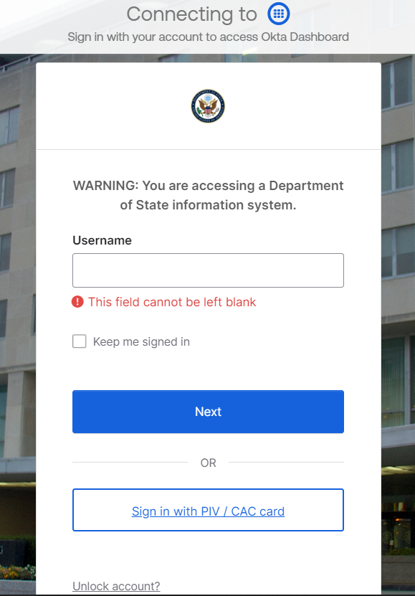
Okta & DATIM Accounts
As of June 18, 2024, DATIM now requires Okta Single Sign On (SSO) and Multi-Factor Authentication (MFA).
You are now only able to access DATIM using an Okta account through state.okta.com. If you are an active DATIM user, you should have received an email from Okta/SE-ICAM that guides you through the Okta account and Okta Verify registration and setup.
If you did not receive an Okta activation email (and after checking your junk or spam folder), please submit a help desk ticket: https://ghsddatasystems.zendesk.com/hc/en-us/requests/new

Slide 93

Okta & DATIM Accounts
At least one person from each prime partner organization will need to have a registered DATIM.org account in order to successfully upload and submit an HRH Inventory template in DATIM
If you have logged into DATIM the past 95 days:
  Access will be granted to DATIM automatically as your account has not been deactivated due to lack of activity
If you have not logged into DATIM the past 95 days, your account has been deactivated, and you will need to contact your DATIM User Administrator here to start the reactivation process:
Go to register.datim.org
Select “Contact my DATIM user administrator about something else”
In the “Message to User Administrator” section request account reactivation, making sure to include your DATIM username.
Once activated, you will be directed to migrate your account to Okta upon attempted login
If you have not logged into DATIM at all:
  Users without existing DATIM accounts will need to request a new account.
    Register at https://register.datim.org/

Slide 94
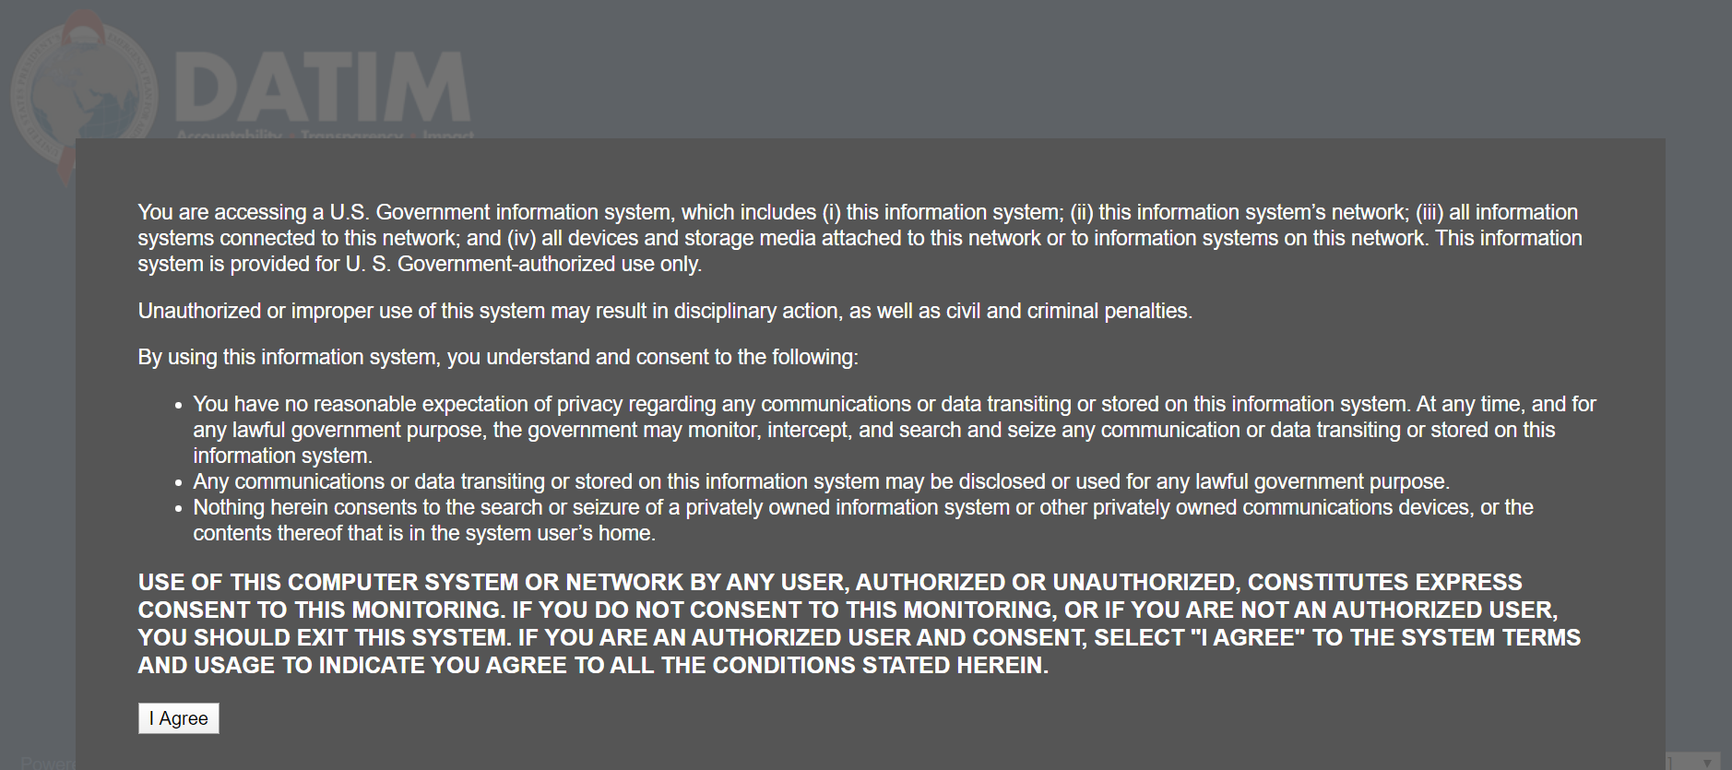
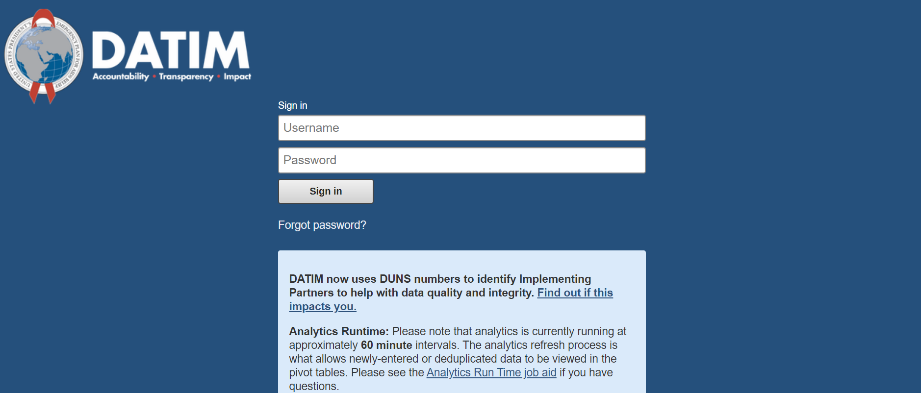
Downloading and Uploading the HRH template
STEP 1: Log in to DATIM–https://www.datim.org using two-factor authentication with Okta

Slide 95
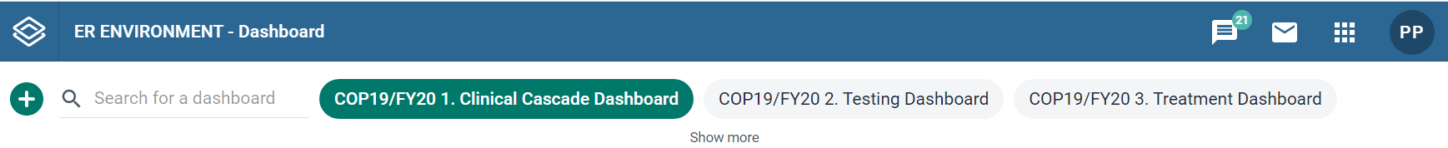
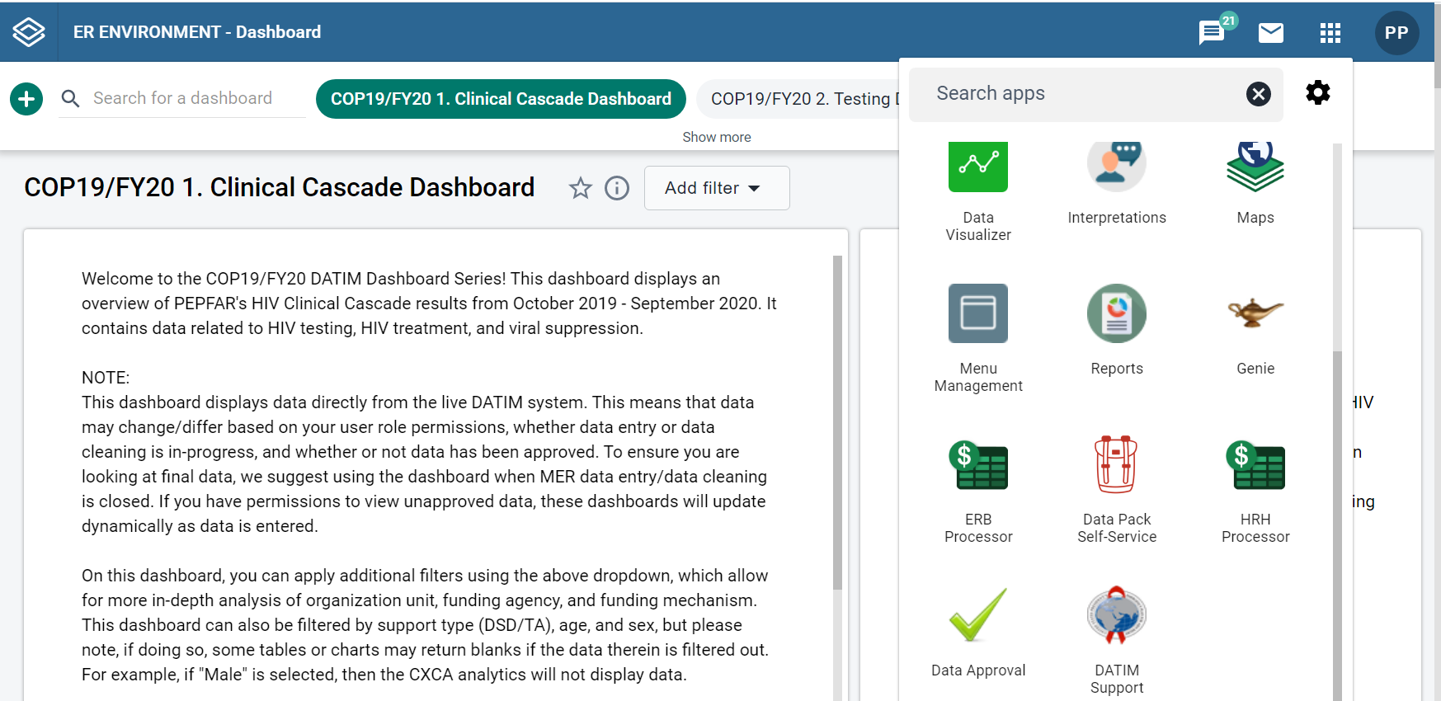
Downloading and Uploading the HRH template
STEP 2: Navigate to HRH Processor App
On the top right hand corner of the screen, select the apps menu
Navigate to HRH Processor App
Within the apps menu, select the HRH Processor app

Slide 96
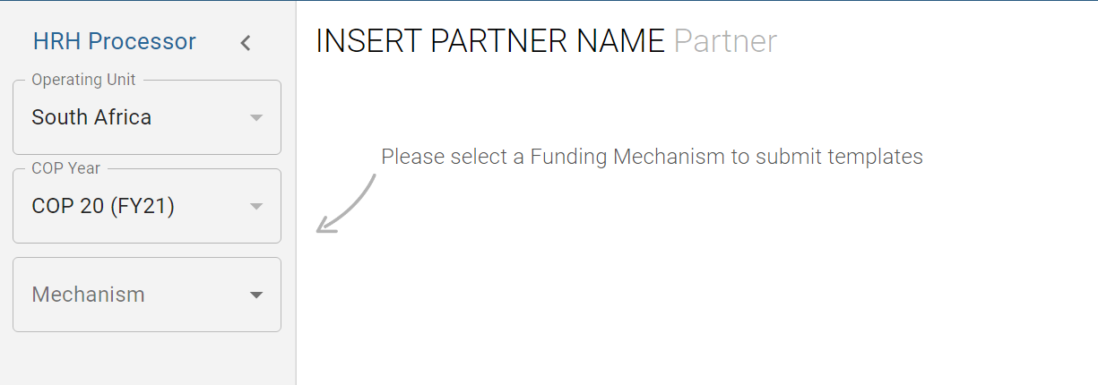
Downloading and Uploading the HRH Template
STEP 3: HRH Processor
Partner Upload of Template
COP 22 (FY23)
Use the HRH Processor app to select:
  OU
  COP Year (COP22)
  Funding Mechanism
Request HRH template
Upload HRH template

Slide 97
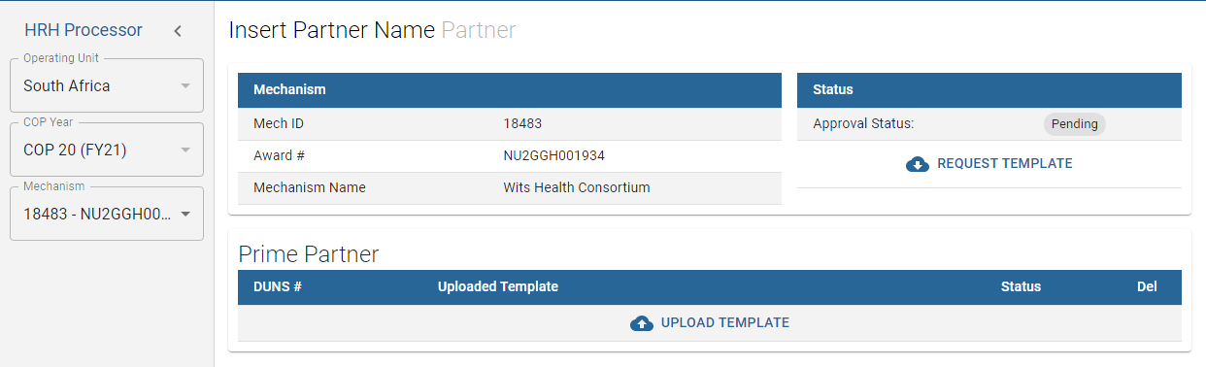
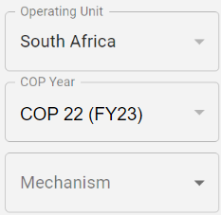

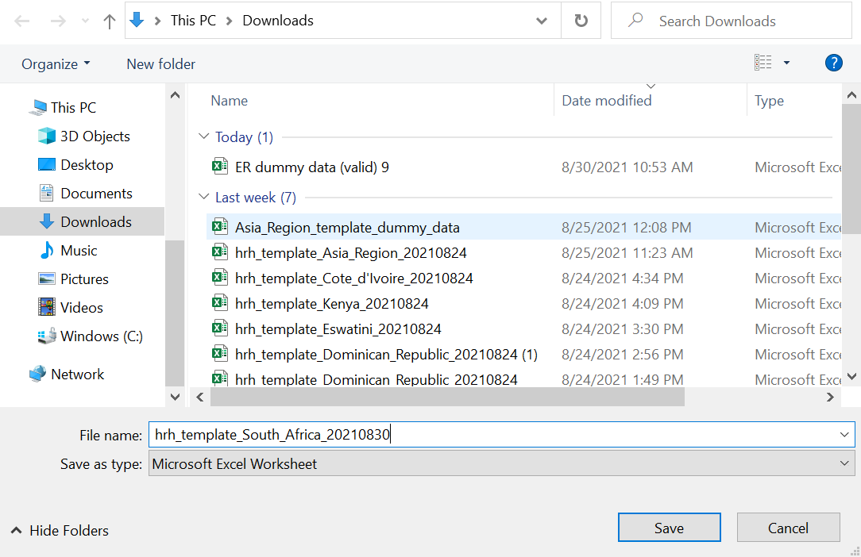

Downloading and Uploading the HRH Template
STEP 4: Partner Download Template
Partner Request Template
Click the Request Template icon under the Status field
Save template to your computer

Slide 98
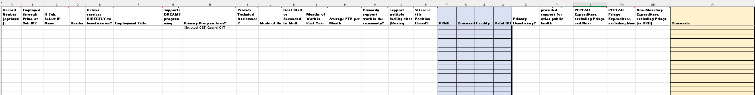
Downloading and Uploading the HRH Template
STEP 5: Complete the template
Remember! Complete the first two tabs (Cover Sheet and Staff List)
To complete the template follow the instructions outlined earlier in this presentation and in the HRH Inventory Handbook
Submit one template per mechanism
  Consolidate Subrecipient staffing data and Prime staffing data together into the staff list tab

Slide 99
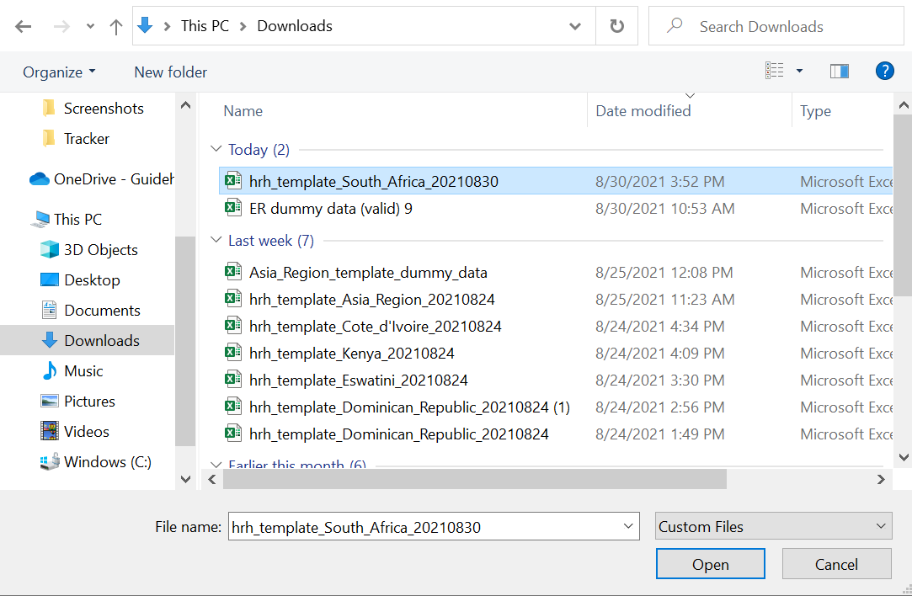
Downloading and Uploading the HRH Template
STEP 6: Partner Upload Template
Click the Upload Template icon in the Prime Partner upload field
Select the template document and wait for file to upload
Click Upload HRH template
Assess Upload Status

Slide 100
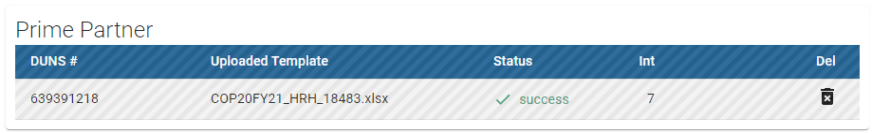
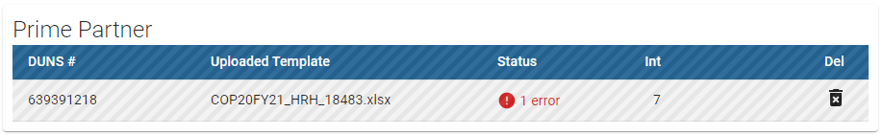
Assessing Template Upload Status
If your template is successfully uploaded, you will see the following status:
If there is an error in your uploaded template, you will see the following error status:

Slide 101
Navigating Upload Errors
Data Validations in DATIM HRH App
Data quality validations are processed upon upload to DATIM
These checks are logical or value checks
The template can be uploaded as many times as needed to correct errors
We recommend uploading the template early and often to catch errors and to ensure they are corrected well before the November 14th deadline
The template must fully pass all validations before the IP is able to successfully submit

Slide 102
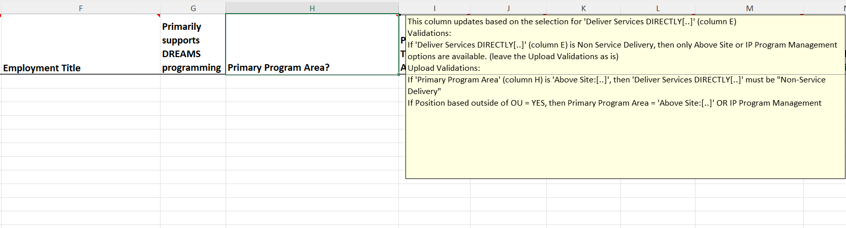
Navigating Upload Errors
Data Validation notes in Excel Template

Slide 103
Completing a Final Quality Check Before Submission and Avoiding Upload Errors
Prior to uploading the template into the DATIM HRH App, it is important to conduct a data quality check. The template has been designed to minimize data entry errors through the inclusion of drop-down lists. However, a number of issues will trigger data entry error messages. To minimize the number of identified errors, perform the following check on the template prior to upload:
Check for completeness: Incomplete fields will trigger an error message.
  Ensure that all required fields in the Cover Sheet and Staff List Tabs are complete, consistent with each other and valid entries.
  Ensure that all started rows are completed.
Check for logic: Use the error messages checks listed in the Definitions table as your guide to ensure each entry makes sense.
  Ensure all staff have been categorized and entered consistently (work location, roving, program area, employment title, etc.)
Check for duplicates:
  If you are using record numbers, ensure that each one is unique.
  Ensure that the same staff person is not entered more than once
Check for extreme values:
  Check the compensation ranges in Sum of Annual PEPFAR Expenditure, excluding Fringe; and in Annual PEPFAR Fringe Expenditure and flag those that seem to be extreme values.
  Ensure values are added in USD
Check the geography
  Check the “Valid OU” column in the template. This column will say “Valid” if a valid hierarchy of locations have been entered. For all that are not Valid, review selections to identify any overwriting of the dropdown fields.

Slide 104
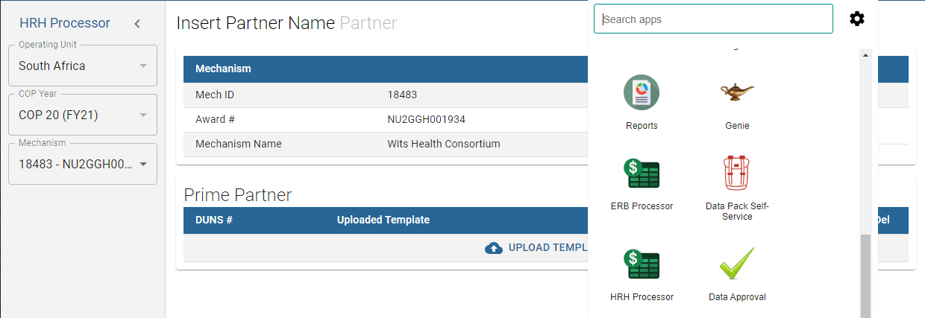


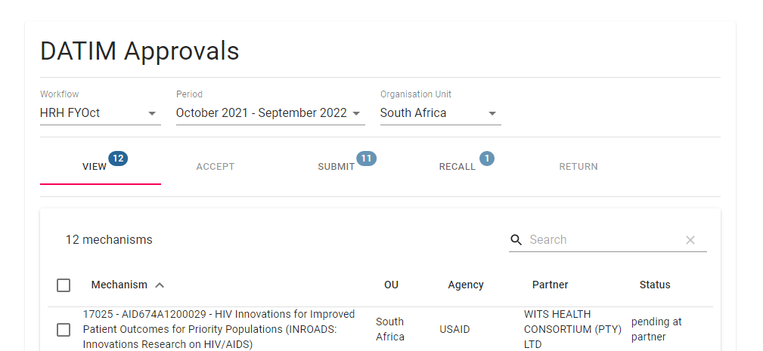
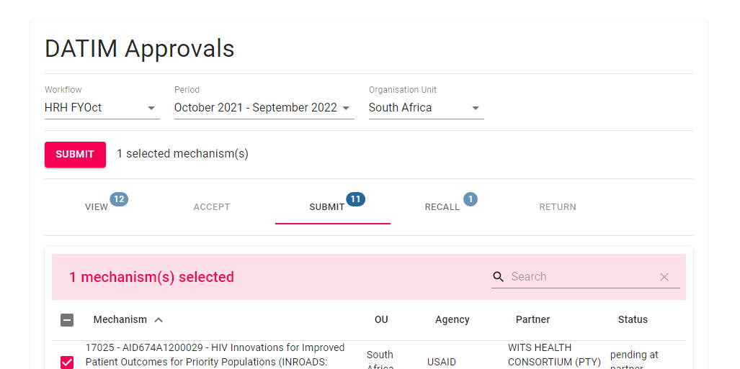
Downloading and Uploading the HRH Template
STEP 7: Final Template Submission
Use the Data Approval app to select:
  Data Set
  Period
Use the “View” tab to see the successfully uploaded template
Use the “Submit” tab to officially submit the data.

Slide 105
Knowledge Check
When will you see error messages if something in the HRH inventory template is incorrectly entered?
Immediately as you enter the data in the template- errors will appear in red
When you attempt to upload to DATIM app- you will see an error message
You will only be notified of errors after the submission has been reviewed by agency staff
Response: b) When you attempt to upload to DATIM app You will see an error message if there are any corrections needed for the template to be accepted.

Slide 106
Knowledge Check
Will DATIM accept a template if there are outstanding error messages?
Yes
No
Response: b) No - All error messages must be addressed by making changes to the data in the template before DATIM will accept the submission.

Slide 107
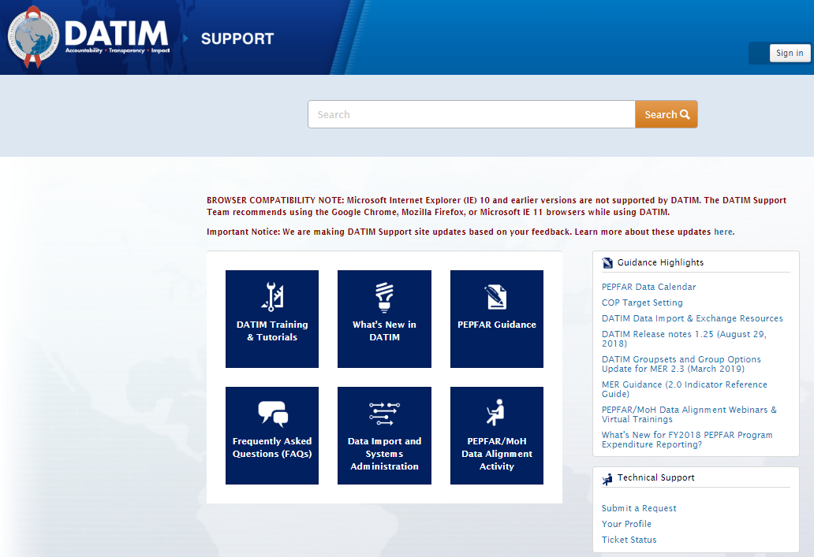
Accessing GHSD Guidance and Instructions
All guidance and instructions related to submitting HRH in DATIM can be found at https://datim.zendesk.com.
2 key places to find guidance and instructions
Technical support available!

Slide 108


Accessing Guidance and Instructions cont’d
Intro to PEPFAR HRH Inventory
HRH Definitions
HRH Inventory Handbook
HRH Inventory Template (within DATIM app)
Checklists Before Submitting and Approving HRH Inventory Template
FAQ
Job Aids
HRH FTE Calculator
User Administration: Creating New HRH User Accounts
DATIM Data Approval Level Statuses and Actions HRH
***Please check back regularly on DATIM Zendesk as the above FY24 materials will be posted on a rolling basis. If a link doesn’t work, it’s because this material has not been posted yet, but it will be forthcoming.

Slide 109
Next Steps
Presenter: Risa Griffin, Health Workforce Branch
Notes:
Note: this session will be recorded

Slide 110
Next Steps
Prior to October 1st, set up Okta account
  If new to DATIM, submit form at register.datim.org to obtain an HRH DATIM account and access to final HRH template
Review template and guidance materials (this presentation and recording will be sent out via email )
Direct questions about the training to: hrh-reporting-helpdesk@usaid.gov
Direct mechanism specific questions to A/CORs, Activity Managers and Mission HRH POCs
USAID will be circulating an FAQ we will update throughout the reporting period and distribute to Mission POCs. Questions you have will help others.
Begin collating data needed to complete the inventory *Recommend upload prior to November 15th submission deadline to give ample time to respond to any errors

Slide 111
Q&A
Moderator: Risa Griffin and Kyle Borces, Health Workforce Branch

Slide 112
Thank You!
Questions?

