Slide 1




TRAINING ON BUSINESS DEVELOPMENT:
FUNDING OPPORTUNITIES FROM USG
Presenter:
Date: Month XX, 202X
Notes:
Slide #1

Slide 2
AGENDA
ADD LOCAL TIME | MODULES/TOPICS
DAY 1: | WELCOME AND AGENDA ITEMS
 | OVERVIEW OF ASAP II AND THE BUSINESS DEVELOPMENT TRAINING MANUAL
 | MODULE 1: TRAINING OPENING/INTRODUCTION
 | MODULE 2: OVERVIEW OF BUSINESS DEVELOPMENT
 | MODULE 3: PRE-SOLICITATION PREPARATION
DAY 2: | MODULE 4: LIVE PROPOSAL KICK OFF
 | MODULE 5: PROJECT DESIGN AND TECHNICAL AND BUDGET PROPOSAL DEVELOPMENT
 | MODULE 6: POST-SUBMISSION PHASE
Notes:
Slide #2
Briefly walk through the agenda, pointing out the daily start and stop times as well as the schedule for breaks and meals.

Slide 3
ASAPII OVERVIEW
ASAP I
LOP: April 1, 2019, to May 30, 2022
Budget Ceiling: $38,500,000
ASAP II
LOP: May 31, 2022 – July 30, 2024
Budget Ceiling: $16,023,445.06
PURPOSE
Rapidly prepare Local Partners to have the capabilities and resources to serve as Prime Partners for USAID/PEPFAR programming, in compliance
with USAID and PEPFAR procedures, for PEPFAR program implementation.
70% of USAID PEPFAR funding to local prime partners.
Strengthen Local Partners as they transition to receive PEPFAR funding as a USAID Prime Partner to comply with regulations.
Prepare Local Partners to directly manage, implement, and monitor PEPFAR programs, and maintain consistent PEPFAR program achievement and quality.
STRATEGIC
OBJECTIVES
Notes:
Slide #3

Slide 4
KEY TERMS
BD | Business Development
LIP | Local Implementing Partner
MEL | Monitoring, Evaluation and Learning
EOI | Expression of Interest
LLD | Locally Led Development
NOFO | Notice of Funding Opportunity
PEPFAR | President’s Emergency Plan for AIDS Relief
LCS | Local Capacity Strengthening
PPR | Past Performance Report
PTA | Pre-Teaming Agreement
RFA | Request for Application
RFI | Request for Information
RFP | Request for Proposals
SOW | Scope of Work
PAD | Project Appraisal Document
ToC | Theory of Change
UEI | Unique Entity Identifier
Notes:
Slide #4

Slide 5
MODULE 1:
TRAINING OPENING/INTRODUCTION
Notes:
Slide M 1. /#1
A simple welcome by the facilitator
Start by having in-person participants create name tags to wear (on stickers) or place on the table in front of where they sit (on folded paperboard); ask online participants to make sure their name and preferred pronouns are displayed and have them turn on their cameras.
The facilitator introduces himself/herself first, modeling the way that each participant will then do the same.
Ask each participant to introduce themselves (name, preferred pronouns, title, organization, and country) one at a time, then summarize their BD experience (beginner, average, advanced), and briefly explain what they want to get out of the training (i.e., key skills/knowledge they would like to acquire and/or top priority topics they would like covered).
While they list expectations, the facilitator captures them on the flipchart paper (if it is an in-person training), or if a virtual training use the available whiteboard or note taker. Remember to retain this list, as it’ll be shared on the last day, for the participants to assess the extent to which their expectations were met.

Slide 6

1.1 OVERALL LEARNING OBJECTIVES
Overall Learning Objectives:
By the end of this training, participants will have:
Increased their awareness of how the United States Government (USG) announces and solicits proposals or applications for funding opportunities, with a focus on the United States Agency for International Development (USAID) and the President’s Emergency Fund for AIDS Relief (PEPFAR);
Improved their understanding of the proposal development process from pre-solicitation (capture) to post-submission (donor feedback and after-action reviews) – with a focus on solicitations from USG funding agencies such as USAID; and
Strengthened their knowledge of key considerations, components, and criteria of successful proposals for USG-funded international development programming.
Notes:
Slide M 1.1/#2
Explain that this training is based on The Business Development Training Manual produced by the USAID/PEPFAR-funded ASAP II.
Summarize the Training Objectives.
Refer to the hopes/expectations that the participants just expressed, pointing out those that will definitely be covered, those that are outside of the training’s scope and therefore are not feasible to be tackled by this training, and those that might be covered or partially covered (depending on time, etc.)
In conclusion, state that: “Ultimately, this training should better position your organization to successfully pursue opportunities for funding from USG Agencies such as USAID. The ultimate goal is to advance locally-led development (LLD) and increase the amount of USG development funding going to LIPs like you. We hope to see you all becoming USG Prime Recipients with stable and diversified funding streams for the long-term sustainability of your organization.”
Ask with enthusiasm, “How does that sound to you?!” Try to garner up some clapping, positive emojis/GIFs (for online participants), and enthusiastic energy among the participants, to get them excited for the training and mentally committed to actively participating in all upcoming sessions.
You can also use this opportunity to ask a few people to share their concerns and major challenges vis- à-vis BD. This can be helpful as an initial needs assessment; it also sets the stage for participants to know that this is a safe and supportive place where questions are welcomed, and everyone is here to learn.

Slide 7
1.2 TRAINING CURRICULUM OUTLINE
INTRODUCTION
Overview of ASAP II & Business Development Training Manual
This section briefly introduces ASAP II, and the purpose, audience, structure, and content of the Business Development Training Manual.
MODULE 1
Training Opening/Introduction
This module lays out the preparatory measures, ground rules, training delivery methods, training objectives, organization of manual and training curriculum, and participant assessment.
MODULE 2
Overview of Business Development
This module focuses on business/proposal development in the context of USG funding and the mechanism/process for issuing USG funds.
MODULE 3
MODULE 3
Pre-solicitation Preparation
This module revolves around ways to identify funding opportunities, decide whether to pursue and then capture the opportunity, and form a winning consortium.
Notes:
Slide M 1.2/#3

Slide 8
TRAINING CURRICULUM OUTLINE (CONT.)
MODULE 4
Live Proposal Kick-Off
This module provides a step-by-step guide for all processes of a winning proposal, from getting organized to understanding the donor and requirements of the solicitation, proposal kick-off meeting, preliminary steps before winning the proposal to gathering the necessary information.
MODULE 5
Project Design and Technical and Budget Proposal Development
This module covers the project design and proposal development process, from developing technical and cost proposals to providing tips and considerations for strong and compliant proposal packages, proposal review, editing, finalization, and submission, to discussing the theory of change, logic model, and results framework, root cause analysis, management and staffing plan, monitoring, evaluation, and learning (MEL) plan, organizational capacity, history of performance, and budget.
MODULE 6
Post-submission
This module elaborates on the post-proposal submission actions, including the need to revise the proposal or answer donor questions, analyze any feedback obtained from partners and donors, and learn from the proposal development experience for future proposal development.
Notes:
Slide M 1.2/#4

Slide 9
PRE-TEST
Notes:
Slide M 1.3/#5
Pre-test Assessment
To assess learning outcomes resulting from the completion of this training, trainers can compare pre-test and post-test results. They can also examine the participants’ feedback in the post-course survey.
The pre-test is included in the annex and can be administered online (via Survey Monkey or Google Forms) at the onset of the course or in paper handouts at the start of a face-to-face training workshop. The pre-test should cover all sections of the BD training. Have participants quietly and independently answer the question for approximately 10 minutes; be sure each participant specifies their name, organization, and country on the test.

Slide 10
MODULE 2:
OVERVIEW OF BUSINESS DEVELOPMENT
Notes:
Slide M 2. /#1

Slide 11
2.0 OVERVIEW OF BUSINESS DEVELOPMENT
Learning Objectives:
Acquire a basic knowledge of key terms and concepts around BD and proposal development;
Understand the types of funding opportunities that PEPFAR/USAID and other USG agencies tend to release that are eligible for LIPs; and
Be aware of the main phases in the solicitation/proposal development process.
This module covers:
Business Development/Proposal Development in the Context of USG Funding for LIPs, and
2) Overview of Mechanism and Process for Issuing USG Funding.
Notes:
Slide M 2.0/#2
Conduct an online poll (in MS Teams, Zoom, etc. for virtual participants) or ask in-person participants to raise their hands to indicate which LIPs are attending the training:
Have been or are currently prime recipients of USG funding?
Have been or are currently subrecipients of USG-funded awards (for instance, a project with an INGO as prime recipient)?
Have applied directly for USG funding via a competitive procurement process?
Ask participants what their impressions are of the current funding landscape for LIPs. Probe about whether they have noticed increased funding going to LIPs in their country, what LLD means to them and how it has been affecting them (if at all), and the extent to which they are familiar with USAID’s relatively new Local Capacity Strengthening (LCS) Policy, the previous PEPFAR localization targets, and the USG LLD agenda. (The aim is simply to get a bit of a conversation going, set the stage for this training, get the participants engaged, and gauge their understanding of the current context of USG funding priorities.)
In facilitating that conversation, use Slide M 2.1/#3 as a guide to offer complementary information on USG funding opportunities for LIPs, if needed depending on what points are raised in the plenary.

Slide 12

2.1 PROPOSAL DEVELOPMENT FOR USG FUNDING
USG funding opportunities for LIPs
The USG’s relatively new Local Capacity Strengthening (LCS) Policy and Locally-Led Development (LLD) agenda aim to increase the proportion of funding going directly to local organizations.
There is therefore greater opportunity for local organizations to become Prime Recipients of USAID and other USG funding agencies than in the past.
Strengthening your Business Development (BD) skills and systems will better position you for such opportunities.
Notes:
Slide M 2.1/#3
Point out that participants may hear many different terms that are related and generally refer to the same basic concepts: Business Development, Resource Mobilization, Fundraising, Proposal Development, etc. Ask for a few volunteers to share their thoughts on how to define these terms and what the slight differences might be.
In responding, you can point out that BD, resource mobilization and fundraising generally refer to the same thing. Proceed to present Slide M 2.1/#4, which explains the definition of BD.

Slide 13
WHAT IS BUSINESS DEVELOPMENT (BD)?
BD is the process of implementing partnership strategies and pursuing funding opportunities across your organization to promote growth and boost revenue. It involves:
  identifying new prospects for maintaining and growing an organization’s presence and portfolio;
  establishing both long-term strategic partnerships and project/proposal-specific partnerships;
  converting contacts and leads into donors or partners; and
  pursuing projects and programs that enable your organization to deliver on its mission and vision.
BD is a critical first step of PEPFAR/USAID program development and implementation.
Notes:
Slide M 2.1/#4
BD supports organizations to maintain and grow their presence and impact in addressing critical challenges. It is also critical to USAID and other USG funding agencies for program development and implementation, as the proposal process helps donor agencies identify strong implementing partners.
Then point out that proposal development is certainly related to BD, yet it is less broad. It is a BD method, among other methods.

Slide 14
PROPOSAL DEVELOPMENT
Proposal development is a key component of Business Development. It entails:
  Identifying potential opportunities and tracking them;
  Conducting pre-positioning/capture efforts to prepare for a notification of a funding opportunity (NOFO) to be released by the donor;
  Designing the project, developing the proposal, and submitting the package; and
  Debriefing on the proposal process (post-action review) as well as the feedback from the donor (whether it was a win or loss).
BD is broader than proposal development. This training focuses mainly on the latter, with an emphasis on USAID/PEPFAR funding opportunities.
Notes:
Slide M 2.1/#5
RE point #2, remind the participants that BD can entail developing an organizational strategy and business plan, establishing and strengthening strategic partnerships (not just proposal-related consortium partners), and an entire system for maintaining and developing your presence and portfolio in a country or region.
If a participant enquires about other BD methods (apart from proposal development), you can toss the question back to the participants to offer their ideas and give examples of other methods their organization might have used to maintain and grow their organization. If needed, you can share examples such as: income-generating activities (IGAs) that are reinvested in the organization, fee-based services (e.g., consulting/contracting work), strategic partnerships that lead to business, non-competitive opportunities, proactive preparation and submission of concept notes, etc.

Slide 15
2.2 OVERVIEW OF MECHANISMS AND PROCESS FOR ISSUING USG FUNDING
Non-Competitive
Transition awards:
A bridge between subaward and prime awards.
An existing Prime partner will support a subaward and include capacity strengthening with a gradual transfer of resources and responsibilities.
Competitive
There are various stages and types based on the selection of the award mechanism.
Multi stages:
Request for Information (RFI)
Expression of Interest (EOI)
Notice of Opportunity for Funding
Request for Proposal (RFP)
Request for Applications (RFA)
Notes:
Slide M 2.2/#6
Purpose:
To get a common understanding of key terms and processes.
To introduce the main phases of the process, pointing out that this training is organized by those phases and will go into more detail on each of them during the subsequent modules (transition to the third core module).
Content:
Different kinds of solicitations for funding e.g., Notice of Funding Opportunities (NOFOs), Request for Applications (RFA) and a Request for Proposals (RFPs).
Overview of the main phases of the procurement process.
Delivery mode/activities:
Present each point in Slide M 2.2/#6 one-by- one.
Ask participants if they have been involved in a Transition Award and what their experiences were?

Slide 16
REQUEST FOR INFORMATION
RFIs are typically used when USAID is in the early stages of planning procurement and wants to gather information to help define its requirements or understand what solutions are available.​ RFIs:
  Enable the donor to gauge the pool of valid candidates;
  Provide the donor with ideas and information that will inform the design of the final RFA/RFP; and
  Result in an initial shortlisting of applicants that will be invited to respond to the final NOFO.
  Responding to an RFI does not constitute a bid or proposal. Instead, it allows vendors to provide information about their offerings and capabilities, which may inform the agency's decision-making process.​
Notes:
Slide M 2.2/#7

Slide 17
EXPRESSION OF INTEREST
An Expression of Interest (EOI) is an opportunity to showcase your qualifications.
It contains:
  General Information and Contact Person
  Type of organization
  Brief information that describes your organization's capability and interest in implementing the USAID activity to achieve the objectives
  Past Performance:
  Describe your experience working in this subject area and working with relevant stakeholders.
  Duration of past activities and scale of projects/budget
  Information on the populations reached in activities.
Notes:
Slide M 2.2/#8
Expression of Interests are often included in an RFI

Slide 18
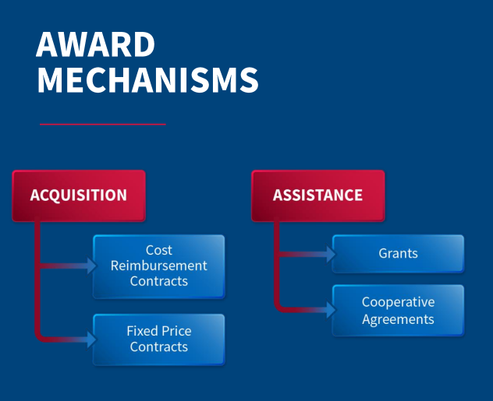
COMPETITIVE PROCESS FOR ISSUING USG FUNDING
Notices of Funding Opportunities (NOFOs) are formal requests for proposals from donors based on the type of award to be issued.
Request for Applications (RFA)
A call for proposals that will result in a grant or cooperative agreement, an assistance award.
Request for Proposals (RFP)
A call for proposals that will result in a contract; in other words, a bid for an acquisition award.
Source: WorkwithUSAID
Notes:
Slide M 2.2/#9
Purpose:
To get a common understanding of key terms and processes.
To introduce the main phases of the process, pointing out that this training is organized by those phases and will go into more detail on each of them during the subsequent modules (transition to the third core module).
Content:
Different kinds of solicitations for funding e.g., Notice of Funding Opportunities (NOFOs), Request for Applications (RFA) and a Request for Proposals (RFPs).
Overview of the main phases of the procurement process.
Delivery mode/activities:
Present each point in Slide M 2.2/#6 one-by- one.
After bullet #2: Ask volunteers to explain what they understand the difference to be between a Request for Information (RFI), Request for Applications (RFA) and a Request for Proposals (RFPs).

Slide 19
REQUEST FOR PROPOSAL
An RFP is a formal solicitation document used by a government agency to solicit proposals from potential vendors or contractors for a specific project or requirement.​
RFPs typically include detailed specifications, requirements, evaluation criteria, and instructions for submitting proposals.​
Vendors or contractors respond to an RFP by submitting a formal proposal that outlines how they would meet the agency's requirements, including technical approaches, pricing, schedules, and other relevant information.​
The agency evaluates the proposals based on the criteria specified in the RFP and selects the proposal that offers the best value or meets its needs.​
Notes:
Slide M 2.2/#10

Slide 20
REQUEST FOR APPLICATIONS
An RFA is a type of solicitation used primarily by grant-making agencies to invite organizations or individuals to apply for funding to support specific projects or initiatives.​
RFAs typically outline the objectives of the funding opportunity, eligibility criteria, application requirements, funding amounts, and evaluation criteria.​
Applicants respond to an RFA by submitting a formal application that describes their proposed project or program, how it aligns with the objectives of the funding opportunity, budget details, and other relevant information.​
The agency reviews the applications based on the criteria specified in the RFA and awards funding to the applicants whose proposals best meet the agency's goals and priorities.
Notes:
Slide M 2.2/#11

Slide 21
THE SOLICITATION/PROPOSAL DEVELOPMENT PROCESS
The solicitation/proposal development process occurs as follows:
  Pre-solicitation Preparation (Module 3)
  Live Proposal Kick-Off (Module 4)
  Project Design and Technical and Budget Proposal Development (Module 5)
  Post-submission Phase (Module 6)
Each module consists of multiple steps explained in detail in subsequent slides.
Notes:
Slide M 2.2/#12
PRE-SOLICITATION PREPARATION
Opportunity Identification
Deciding Whether to Pursue the Opportunity
Pre-Positioning/Capture Work
Forming a Winning Consortium
LIVE PROPOSAL KICK-OFF
Getting Organized
Understanding Donor and Requirements of Solicitation
Proposal Kick-off Meeting
Preliminary Steps before Writing the Proposal
PROJECT DESIGN AND TECHNICAL AND BUDGET PROPOSAL DEVELOPMENT
Project Design and Proposal Development
Technical Proposal
Cost Proposal
Tips and Considerations for Strong and Compliant Proposal Package
Proposal Review and Editing
Proposal Finalization and Submission
POST-SUBMISSION PHASE
Post-Submission Actions
Wrap-up

Slide 22
MODULE 3:
PRE-SOLICITATION PREPARATION
Notes:
Slide M 3. /#1

Slide 23
3.0 PRE-SOLICITATION/ PREPARATORY PHASE
Learning Objectives:
Be aware of various sources of funding and be able to access existing USG resources to identify opportunities;
Understand the key considerations for “go/no-go” decision-making;
Appreciate the need for early preparation for solicitations and how pre-positioning/capture work can increase your chances of a successful proposal (at the next stage); and
Be better positioned to form a winning consortium.
This module covers:
Funding Opportunity Identification,
Deciding whether to Pursue the Opportunity,
Pre-positioning/Capture Work, and
Forming a Winning Consortium.
Notes:
Slide M 3.0/#2

Slide 24
3.1 OPPORTUNITY IDENTIFICATION
There are multiple ways to identify potential funding opportunities from USAID, and other USG agencies and donors: formal and informal
Formal:
Check https://www.workwithusaid.gov/ and https://www.sam.gov for funding opportunities.
Check www.grants.gov for grant and cooperative agreement (assistance) opportunities.
Follow the USAID Business Forecast at https://www.usaid.gov/business-forecast.
Visit websites or other media platforms of donors, foundations, corporations, INGOs, and other sources of funding/partnerships
Become familiar with USAID’s Country Development Cooperation Strategy (CDCS) for your country accessible at https://www.usaid.gov/results-and-data/planning/country-strategies-cdcs.
Informal
Find out about opportunities via word-of-mouth within your networks (colleagues, donors, stakeholders, etc.).
Visit professional colleagues’ Facebook or LinkedIn accounts.
Notes:
Slide M 3.1/#3
Brainstorm sources of opportunity information:
For in-person participants: Quickly pair them up with the person sitting next to them and give them a few minutes to jot down ideas on where/how they could find out about potential funding opportunities from USAID and other USG Agencies (CDC, DOD, BHA, etc.).
For virtual participants: Ask them to type into the online White Board (using the Annotate tool in MS Teams, for instance) their individual ideas on where/how they could find out about potential funding opportunities from USAID and other USG Agencies (CDC, DOD, BHA, etc.). Tell them to only post ideas that others haven’t already posted (except of course for inevitable concurrent/cross-postings).
Encourage the LIPs to subscribe (if applicable) and monitor these sites on a regular basis (daily, as every day matters when a proposal goes live!).
If possible, go directly to the websites (rather than just projecting those slides, given that the font is quite small) and do a quick demonstration of how to find the relevant information and subscribe to the business digest emails.

Slide 25
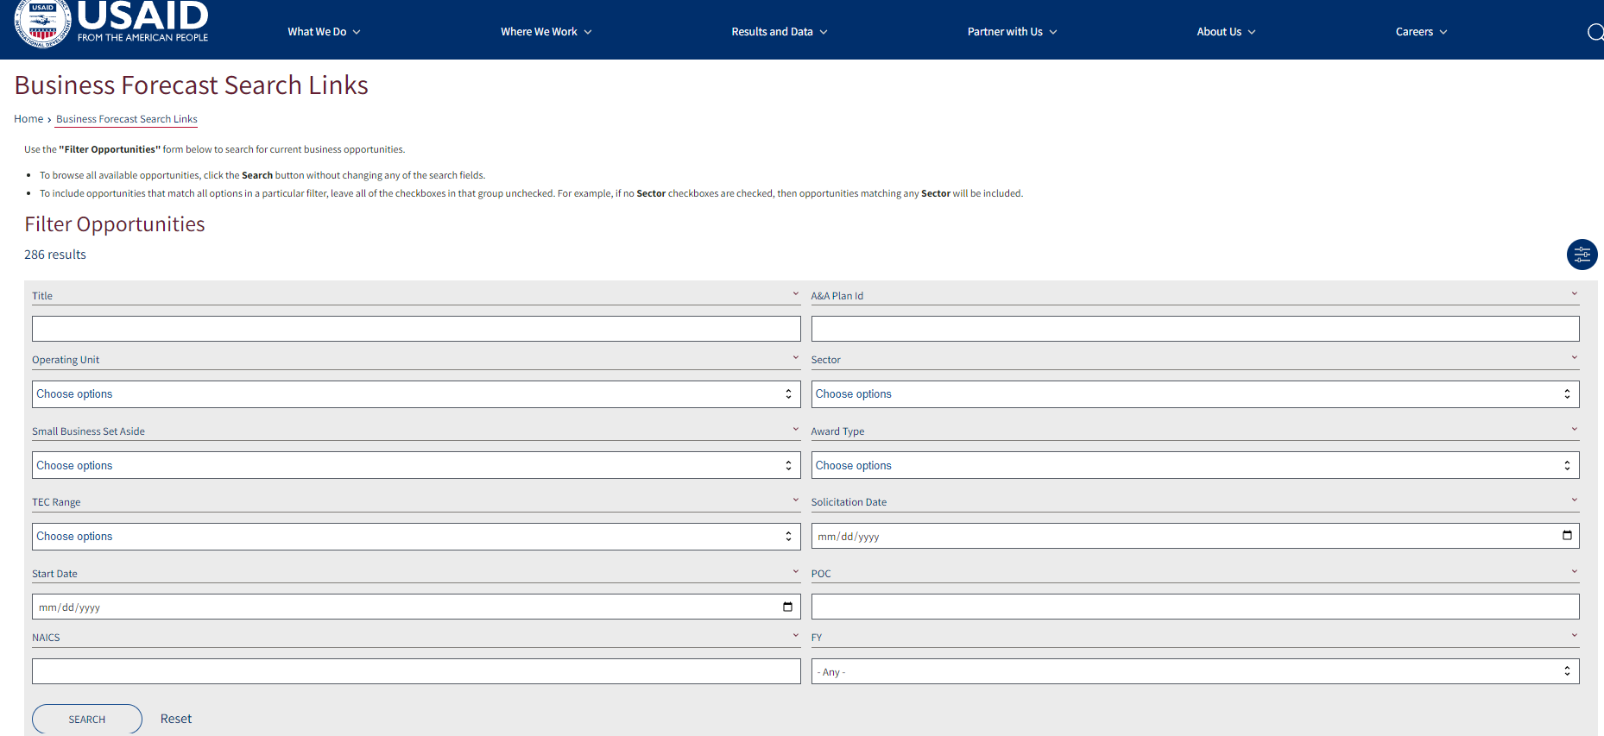
FOLLOW THE USAID BUSINESS FORECAST (1)
Notes:
Slide M 3.1/#4

Slide 26
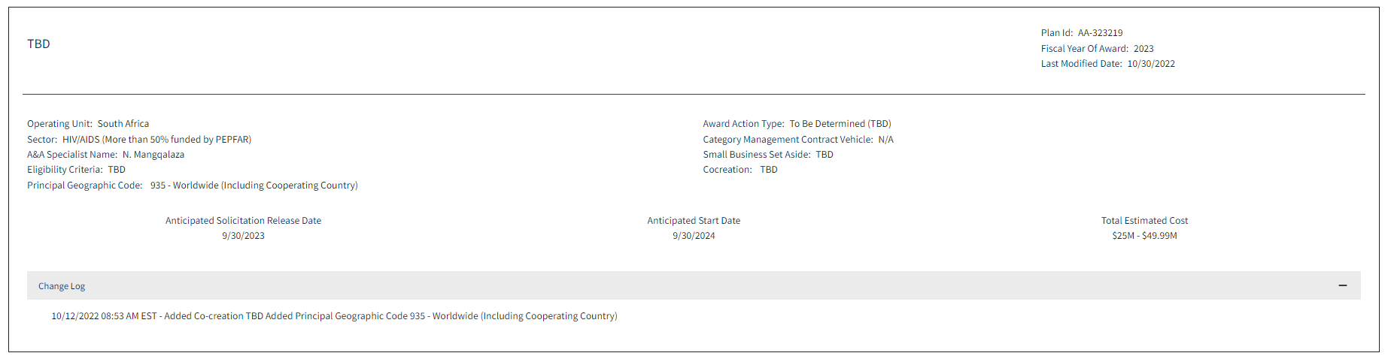
FOLLOW THE USAID BUSINESS FORECAST (2)
Notes:
Slide M 3.1/#5

Slide 27
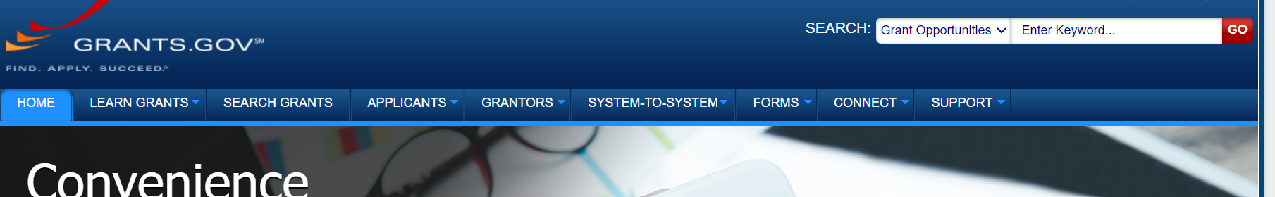
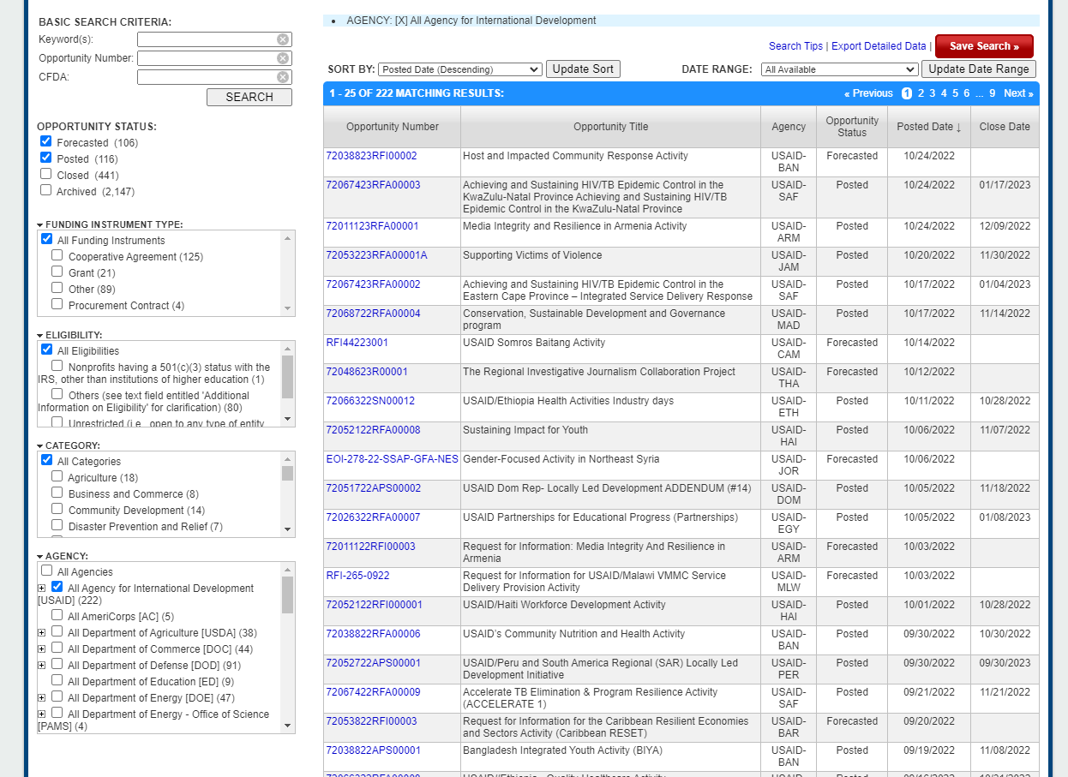
CHECK GRANTS.GOV
Notes:
Slide M 3.1/#6
Hands-on practice using USG online platforms:
If time allows and if all participants have access to the internet, divide up the groups (having in-person participants work a different table with 3-4 team members or using “breakout groups” in online apps such as MS Teams, Google Meet, or Zoom for virtual participants). Assign a group the task of searching the USAID Business Forecast to find potential opportunities of interest in their country; and assign another group the task of searching www.grants.gov, and a third group to exploring www.sam.gov.
Don’t take time to do group-by-group plenary debriefs (that would be time-consuming), yet you could ask a few volunteers to share some observations about what they found and/or how helpful they feel these platforms are.

Slide 28

UIE NUMBER
You won’t be able to receive USG funding without a unique entity identifier (UEI).
If your organization doesn’t already have a 12-digit UEI number, visit https://sam.gov/content/home, an official website of the USG that new LIPs can use to register.
Notes:
Slide M 3.1/#7

Slide 29
ELIGIBILITY CONSIDERATIONS
USG funding opportunities can be open to all kinds of organizations, or they might be restricted to INGOs or local organizations. (The NOFO will specify.)
  Be sure to confirm your eligibility and only track/pursue opportunities that you qualify for.
Often, even if an opportunity is open to all kinds of organizations (INGOs and local organizations), extra points will be awarded to LIPs.
  In cases where the scoring/evaluation criteria favor LIPs, you will have an advantage over INGOs.
Notes:
Slide M 3.1/#8
Briefly discuss eligibility – i.e., the fact that all USG solicitations will specify what kind of organizations can apply; and they should only spend their time tracking and pursuing opportunities for which they qualify and ones that they have a strong chance of winning.
Also point out the requirement of getting a unique entity identifier (UEI) number via SAM.gov.

Slide 30
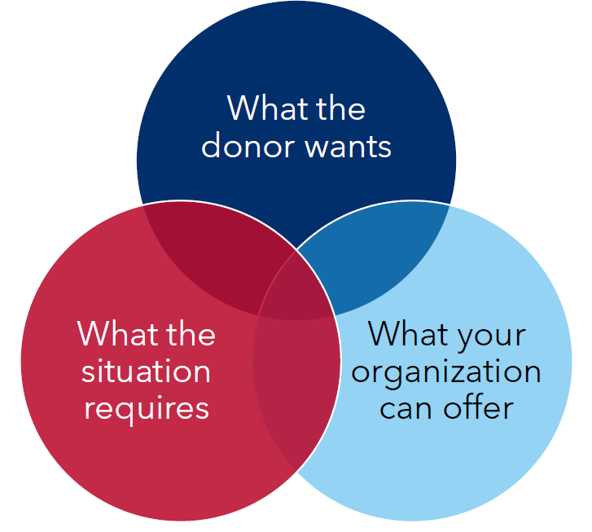
3.2 DECIDING TO PURSUE THE OPPORTUNITY
Importance of prioritization
It is not feasible, nor a good use of your organization’s resources, to pursue every opportunity you qualify for.
It takes precious resources (especially staff time) to pursue an opportunity, so the potential return on investment (ROI) must be worth the effort.
Be strategic when deciding which opportunities to pursue; only go after those:
  That align with your mission, vision, and values;
  For which you have a strong chance of winning;
  For which you have the capacity (i.e., adequate resources and
  availability) to deliver a quality proposal.
Notes:
Slide M 3.2/#9
Emphasize the importance of prioritizing which opportunities an organization pursues:
You could start (before projecting the slide) by prompting some reflection and initial discussion in plenary by asking the group:
Let’s say you identified several opportunities in the USAID Business Forecast that your organization qualifies for and that will be released around the same time. Great news! But will you be able to pursue all of them? Does it make sense to pursue all of them?
After taking a few answers, make the following point: Although it may be tempting to try to go after all of them (especially if you’re seeking to diversify funding sources and expand your portfolio) – but you need to be realistic about under what conditions you can produce a high-quality proposal that is likely to win.
Then share the key take-aways from the PowerPoint (PPT) slide.

Slide 31
KEY CONSIDERATIONS TO MAKE A “GO” OR “NO GO” DECISION
Is the opportunity:
Within your experience/expertise? If there are any gaps in your expertise, geographic presence, etc., are there partners you can work with to fill them?
Strategic for the growth/expansion of your organization and its mission?
Being awarded through a mechanism that your organization can implement?
Presenting any risks? If so, can those risks be mitigated?
Feasible and realistic to secure? In other words, does your organization have adequate time and resources to pull together a high-quality proposal? And is there a good chance of winning?
If the answer is YES move to the next phase…
If the answer is NO, consider approaching an organization which is applying to be a subpartner.
Notes:
Slide M 3.2/#10
Ask participants to share the experiences they had when deciding not to go for a proposal. What were the main factors? Ask participants to share the experiences they had when deciding when to move forward with submitting a proposal. What were the main factors?
Before projecting the next slide, ask the participants “Now that your organization has decided to go for a certain opportunity, what should you do next? Do you simply wait for the NOFO to be released?” Take a few answers in plenary. Then emphasize the points in the next slide (Slide M 3.3/#11)

Slide 32
3.3 PRE-POSITIONING/CAPTURE WORK
Importance of early preparation (pre-solicitation)
Early preparation for bids is key! It’s a critical factor for a successful proposal.
Usually, USAID will only give 30-45 days (4-6 weeks) to respond to an RFA/RFP from the date the NOFO is released.
Refer to the business forecast and any intel you can gather through your networks, to undertake preparatory work well in advance of the solicitation going live.
Pre-planning work can even start weeks, months, or even years in advance.
Notes:
Slide M 3.3/#11
Once the donor releases the call for applications/proposals, the clock starts ticking! Solicitations are typically open for only 30 to 45 days (4 to 6 weeks), so it is important for applicants to anticipate and prepare for the solicitation as much as possible before it goes “live.” USAID typically announces upcoming solicitations in its Business Forecast; and there are other ways to get information on forthcoming opportunities. LIPs should be ready to develop and submit their proposal when the funding opportunity is issued, having done some preparatory work in advance.
Then ask the participants, “Who has experience undertaking capture work, otherwise called pre-positioning” or “pre-planning”? For those who raise their hand, call on a couple to explain what it is or what key activities they have been involved in.

Slide 33
INTRODUCTION TO PRE-POSITIONING/CAPTURE
What is it? A process that starts once a “go decision” is made and continues until the opportunity is released (for competitive opportunities).
What does it consist of?
Thorough assessment of the opportunity and local needs/priorities
Analysis of the competition and potential partners
Assessment of your organization’s technical capabilities
To then inform and begin:
Development of your strategy to resource the proposal effort and identify your proposal team;
Development of your partnering strategy and beginning to form your consortium;
Development of your initial technical, management, and budgeting strategies;
Recruitment of your key personnel; and
Possibly also writing certain sections (e.g., country context/background, corporate capabilities statement, past performance records [PPR], etc.)
Notes:
Slide M 3.3/#12
Elaborate on the purpose and elements of pre-positioning/capture work, and how the information gathered will inform subsequent processes.

Slide 34
EXAMPLE OF PRE-POSITIONING/CAPTURE
If you know a USAID-funded, INGO-led cooperative agreement is scheduled to end in a year from now and you’ve heard that there will be a follow-on award that’s only eligible to local organizations as Prime recipients, start to position yourself to apply for the follow-on.
That can include:
  Seeking information on the key problem and priorities of the target population and zone;
  Finding out the strengths and weaknesses of the incumbent as well as what approaches were successful and should be maintained/scaled up in the follow-on;
  Getting intelligence on potential competitors and thinking about your competitive advantages and unique selling points ;
  Establishing or strengthening partnerships, including exploring options for consortium members and implementing partners/subrecipients;
  Starting to head-hunt for strong key personnel to consider for your project team.
Notes:
Slide M 3.3/#13
Early preparation for bids is key – usually, USAID will only give 4-6 weeks when the RFA is released to respond – so we have to ensure that we use as much time before that to prepare.
Either explain the example on the slide or ask the participants who have experience to share a couple of real examples. If time allows, it’s best to do the latter as it’s more engaging for the participants to be actively involved rather than lectured to.

Slide 35
3.4 FORMING A WINNING CONSORTIUM
Project Partnerships
Very few USG-funded projects are implemented by a single organization.
  Typically, the Prime recipient will be responsible for the overall management of the award yet will form a team of consortium partners who will collaboratively deliver the project.
  The Prime recipient may also select a set of subrecipients to support implementation for specific technical areas, target populations or geographic zones.
Usually a “one-team” approach is appreciated by USG (streamlined project org chart, shared project office space, project steering committee and/or senior management team with representation from all consortium members, etc.), as that approach has strong potential for effective coordination and greater cost efficiencies.
Notes:
Slide M 3.4/#14
Very few organizations can provide all the services required in a NOFO. Typically, a strong organization will decide to become a Prime and to start looking for other organizations to become sub partners in a consortium. The proposal will want to capture a “one team approach” and will need to demonstrate that in both the program areas and management structure. It is important not to have too many and to have clearly defined roles.

Slide 36
HOW TO IDENTIFY POTENTIAL PARTNERS?
        Research current implementers with USAID and other donors.
        Leverage your networks (employees, former colleagues).
        Attend industry-sponsored events (technical working groups [TWGs], project close-out events, etc.).
        WorkwithUSAID.org - a resource hub for new, current, and future local and international partners to navigate working with USAID.
        Be strategic about the number of partners you select.
        Weigh the cost and benefits, as a large number can be burdensome to manage/coordinate and may be an inefficient use of USG resources.
Notes:
Slide M 3.4/#15
Ask participants what important considerations are for choosing consortium members.

Slide 37
CONSIDERATIONS FOR PARTNER SELECTION
        Role on the project and value-add they will bring. Consider the partner type:
  Technical assistance (TA) provider
  Service delivery/implementing partner
  Resource partner (to occasionally call upon for niche support, but no formal commitment, subaward or consortium role)
        Complementary vs. overlapping skills/expertise (among all partners)
        Their reputation/credibility (especially from the donor’s perspective)
        Geographic coverage/presence
        Local experience and knowledge of the local terrain
        History of positive, relevant performance
        Strategic influence
Notes:
Slide M 3.4/#16
Ask participants what important considerations are for choosing consortium members.

Slide 38
PROCESS FOR FORMING THE PROJECT TEAM
        Identify the main sectors/programmatic areas of the anticipated project
        Determine which of those areas would benefit from partnerships (i.e., to complement your organization’s areas of expertise or geographic presence/experience, to strengthen the team’s reputation/credibility and ability to quickly deliver results)
        Hold an initial exploration meeting with current strategic partners and new partners:
  State that you are considering the opportunity and inquire about their interest/intentions to pursue it (and if yes, as prime or sub); the level of directness and subtlety will depend upon the relationship, level of trust, the possibility of competition, etc.
  If there is a mutual interest, exchange corporate capability statements. You want to “sell” your organization and consortium to them, as much as they may want to market themselves to you (as your competitors may also be courting them.)
        Conduct follow-up meetings to discuss the high-level Scope of Work (SOW) and roles; be careful not to reveal too much detail on your strategy, especially before the Non-Disclosure Agreement (NDA) is signed.
        Eventually sign a pre-teaming agreement (PTA) and/or a Teaming Agreement (TA) to formalize the partnership as it relates to this specific opportunity.
Notes:
Slide M 3.4/#17

Slide 39
DOCUMENTS/TOOLS USED IN PARTNERSHIP FORMATION
Capability Statement: Ask the potential consortium member to submit a Capability Statement based on their organizations’ experience in the technical and geographic areas in the proposal.
Pre-Teaming Agreement (PTA) and Teaming Agreement (TA): This document precedes the proposal release and articulates the intention of both parties. It is important to only use a pre-agreement as the final proposal may change.
Non-Disclosure Agreement (NDA): Ask the potential partner to sign an NDA that prevents them from using the information you share about proposal preparations with anyone else.
Scope of Work (SOW): Design a SOW that aligns with the proposal and the organization’s Capacity Statement.
Notes:
Slide M 3.4/#18
There are four important documents to request or develop as part of consortium building.

Slide 40
WHAT ARE PTAS AND TAS FOR COMPETITIVE PROPOSALS/BIDS?
Pre-Teaming Agreement (PTA):
  Executed before a NOFO is released and is subject to review/adjustment once the RFA/RFP is released.
  Contains draft SOW and NDA language so that organizations can work together before the final call for proposals/applications is issued.
Final Teaming Agreement (TA):
  Executed before once the solicitation is live.
  Offers an opportunity to make adjustments to the SOW and budget which reflect the final solicitation document from the donor (i.e., if different from what was expected or issued in an earlier RFI or EOI).
Notes:
Slide M 3.4/#19

Slide 41
MORE INFORMATION ON PTAS AND TAS
        They can be exclusive (i.e., an organization can only sign an agreement with your organization for this opportunity) or non-exclusive (i.e., an organization can sign agreements with more than one partner for this opportunity)
  If the former, normally the prime should offer a larger SOW/budget in exchange for exclusivity.
        Do not share any proprietary or competitive information before a signed teaming agreement (with NDA language) is in place!
        Sign PTAs/TAs as soon as possible, so that information exchange is not impeded and necessary details can be shared for proposal development.
        Once PTAs/TAs are in place, involve the consortium members in capture work, project design, and the proposal development process. The most effective proposals are developed via co-creation with inputs from all key players.
Notes:
Slide M 3.4/#20

Slide 42
HYPOTHETICAL SCENARIO
        An NGO named CareServices (CS) wants to prepare a proposal for a USAID solicitation named “Expanding HIV/AIDS Care and Treatment in (you can name the country where the training is being held). CS works in the capital and two other large cities. The proposal needs to include geographic coverage where they do not work. An NGO named EqualAccess is based in half of the districts in the country.
        Player 1: Executive Director for CS
        Wants EqualAccess to join the consortium and not sign up with another consortium.
        Player 2: Executive Director for EqualAccess
        Has other offers to join different consortiums. Wants to understand the scope of work and how CS manages sub-partners.
Notes:
Slide M 3.4/#21

Slide 43
MODULE 4:
LIVE PROPOSAL KICK-OFF
Notes:
Slide M 4. /#1

Slide 44
4.0 LIVE PROPOSAL KICK-OFF
Learning Objectives:
To be aware of the process and key tools for project design and proposal development;
To understand the requirements and best practices for developing a strong proposal package (technical and cost proposal); and
To appreciate the importance of conducting multiple, thorough reviews and edits as well as packaging and submitting the proposal on time.
This module covers:
Getting Organized,
Understanding Donor and Requirements of Solicitation,
Proposal Kick-off Meeting, and
Preliminary Steps before Writing the Proposal.
Notes:
Slide M 4.0/#2

Slide 45
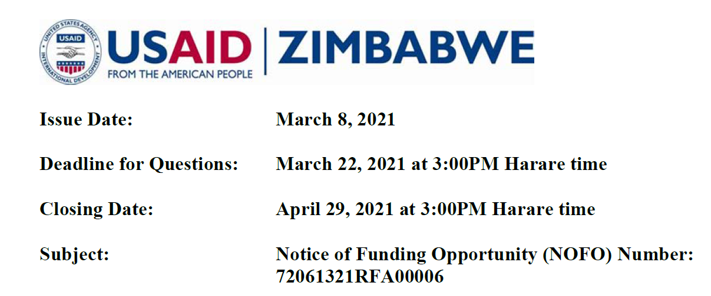

THE NOFO HAS BEEN RELEASED! WHAT NOW?!
AVAZALIA
Issue Date: March 8, 2021
Deadline for Questions: March 22, 2021, at 3:00 PM Local Time
Closing Date: April 29, 2021, at 3:00 PM Local Time
Subject: Notice of Funding Opportunity (NOFO)
Number 720663355RFA11112
Notes:
Slide M 4. /#3
You can also hand out or show them the image in the following slide, which is an example of a NOFO cover page, or you can share recent NOFO from the country where the training is happening.
Take a few people’s answers to the question “What now?!”

Slide 46
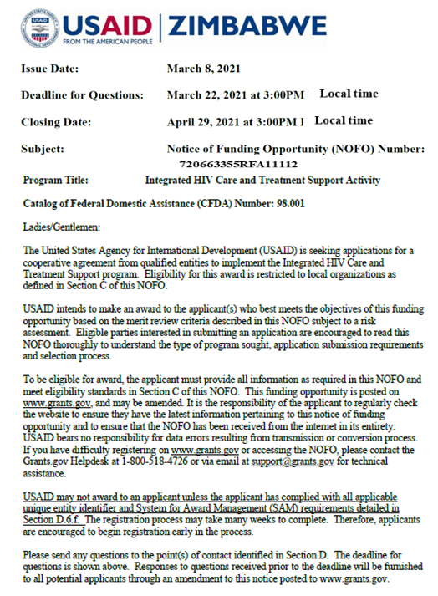
4.1 GETTING ORGANIZED
Act as quickly as possible!
        As soon as the NOFO is released, the clock starts ticking!
        Immediately take note of important dates:
  NOFO issue date
  Deadline for questions to the donor about the solicitation
  Submission due date and time (and time zone)
  Date of participation in the pre-application/pre-proposal conference organized by the USAID Country Mission (if applicable)
Notes:
Slide M 4.1/#4
Emphasize that the clock starts ticking as soon as the NOFO is released, so they should not lose any time.
Immediately, the assigned proposal manager needs to get organized and mobilize the proposal team as well as communicate key information to partners and reviewers so that everyone will be ready to take on their assigned role. As indicated in Slide M 4.1/#4, emphasize that the proposal manager should first and foremost make note of important dates/deadlines.
Ask participants to quickly brainstorm a few ideas on what other key factors for successful proposal development are.
F2F participants can write their ideas on Post-It Notes (one idea per sticky note) and post them on a piece of flip chart paper at the front of the room.
Virtual participants can either write their ideas into the chat box or type them into an online white board (available in Microsoft Teams, Google Meet, and Zoom).

Slide 47
KEY FACTORS OF SUCCESS
Act as quickly as possible!
        Establish a system for managing time and tasks, keeping all files organized, ensuring version control, etc.
        Allocate the proper resources for project design/proposal development.
        Plan for quality and compliance reviews.
        Streamline coordination and communication; Keep partners, proposal team members, and reviewers informed.
        Post job advertisements for positions in the bid.
Notes:
Slide M 4.1/#5
Point out that what we have identified are the most critical factors based on extensive experience. Note that they are mostly related to good organization and management of the process, so having a proposal manager/coordinator is critical.

Slide 48
PROPOSAL TEAM MOBILIZATION
        Identify/reconfirm your proposal team members and reviewers
        Define the roles that are critical for success and how your staff can fill them.
        Key functions for the proposal development team:
  Coordination (organization, communication, partnership negotiations, etc.)
  Technical
  Monitoring and Evaluation
  Financial/Budgeting
  Management and Staffing Plan + HR/Recruitment
        Reviewers (technical, budget/cost, compliance):
  Choose reviewers wisely
  Should be separate from the proposal team
Notes:
Slide M 4.1/#6
Explain that an urgent task once the proposal goes live is to mobilize the proposal team. The members and reviewers would’ve ideally been identified in advance (during the Capture stage), but it’ll be important to confirm their availability and immediately inform them of all key deadlines.
Emphasize the most critical vs. nice-to-have functions.
Focus on functions instead of roles – Organizing/Coordination, Technical, Management/HR, Financial.

Slide 49
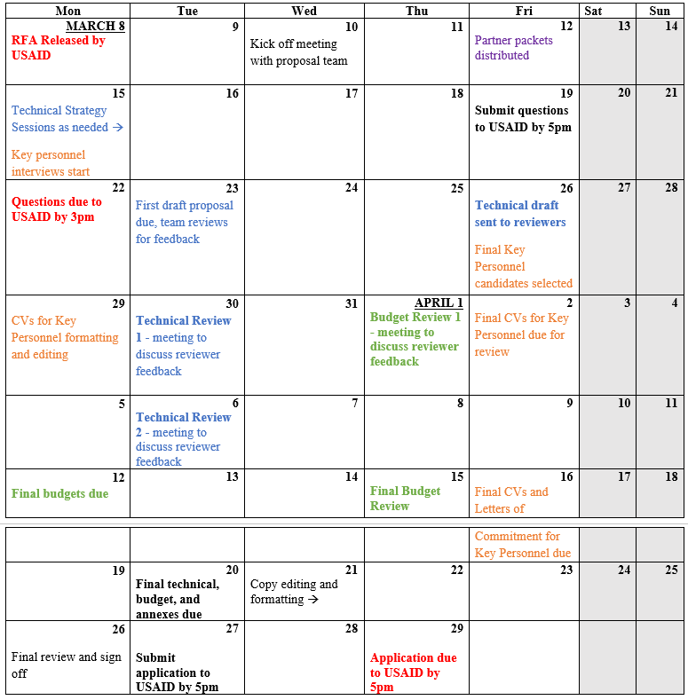
PROPOSAL DEVELOPMENT CALENDAR
        Create the proposal development calendar, based on deadlines in the NOFO.
        It should be a simple, clear visual to see major deadlines, not details.
        Allocate adequate time for reviews and incorporating feedback… as well as editing, packaging, and final approval/sign-off (as these tend to be underestimated).
        Recommend regular meetings, once or twice per week
Notes:
Slide M 4.1/#7
Show participants the example of a real proposal calendar – distribute it as a handout to F2F participants or send it to online participants.
Ask them to take a couple of minutes to individually look it over and jot down any notable observations. Did anything that surprised them or raised questions? Is there anything that they learned from this example? They might, for instance, point out that the proposal is planned to be submitted 2 days before the donor’s deadline and not understand why; or they might be surprised at how much time is allocated to review/editing, leaving a tight timeframe for proposal design and writing.
Emphasize the importance of developing a calendar for once or twice a week meetings during the Proposal Development process which takes into account the deadlines in the NOFO.
The meetings should ensure technical components are aligned with staffing and management plans, budgets, and M&E plans.
There should be a sufficient “cushion” for unexpected events and allocate adequate time for review, editing, packaging, and final approval/sign-off (as those tasks tend to take much longer than one might expect).
Before projecting the next slide (Slide M 4.2/#8), say to the group – that your proposal team is now formed, and your proposal calendar is done. Are you ready to jump right into proposal writing now?
In response to those who say “no,” ask them what they think needs to happen next. What is the most critical next step?
Share the answer by projecting the next slide (Slide M 4.2/#8): It’s reading, and re-reading, the entire solicitation document carefully and thoroughly!

Slide 50
4.2 UNDERSTANDING THE SOLICITATION
        The most critical step
If you jump in with your technical approach, you will miss the most crucial step in the proposal-writing process: reading the entire solicitation (e.g., the NOFO, RFA, or RFP) carefully and thoroughly.
This step is critical because you need to comply with the donor’s requirements and deadlines.
It is also important to understand how they frame the issue in their program description, statement of work (SOW), and project’s theory of change (TOC).
Notes:
Slide M 4.2/#8
The answer is reading, and re-reading, the entire solicitation document carefully and thoroughly!
Point out that:
The best-designed, well-written proposal can be disqualified simply because it has more pages than the allowable limit or because it was submitted one minute after the deadline. So, understanding the requirements of the solicitation and complying with them is absolutely critical!
It’s not just about compliance with the format, deadlines, and basic instructions. It’s also about making sure your proposed project is responsive to what the donor wants, so align it to their priorities and desired approaches, use their jargon so that you’re speaking the language they will understand, and do everything possible to score all possible points (per the evaluation criteria) – for instance, clearly demonstrate how your Key Personnel meet their minimum requirements.

Slide 51
BE PARTICULARLY ATTENTIVE TO…
Eligibility (Do you still qualify?)
Evaluation criteria (What sections or traits carry the most weight?)
Instructions (electronic or hard copy submission) and deadlines (for questions and submission)
The terminology the donor uses for discussing the topic (which you should mirror in your proposal)
The types of approaches the donor seeks
Required components/sections and supplementary materials
Notes:
Slide M 4.2/#9
For example: In a particular proposal, USAID provided the following evaluation criteria for the technical proposal, which is quite typical of the way they weigh the different elements:
The technical approach (50 points)
Management and staffing (30 points)
Organizational capacity (20 points)

Slide 52
EVALUATION CRITERIA
Review your proposal to see how you might score:
Typical Evaluation Criteria:
Technical Approach: 50 points
Management and Staffing: 30 points
Organizational Capacity: 20 points
Notes:
Slide M 4.2/#10
In a particular proposal, USAID provided the above evaluation criteria for the technical proposal, which is quite typical of the way they weigh the different elements.

Slide 53
NOTES ON REQUIRED COMPONENTS/SUPPLEMENTAL MATERIALS (1)
A typical USAID proposal includes sections such as:
  Cover letter from the President (PCA) or Executive Director
  List of Acronyms and Table of Contents
  Executive Summary
  Technical approach for completing the scope of work (SOW)
  Management approach and staffing plan, plus CVs of key personnel
  Cost proposal, including summary and detailed budget; for contracts, a fee schedule and milestone plan
  Summary of relevant experience, including corporate capabilities statement and past performance references for similar work
  Representations and certifications
  Letters of commitment from sub-partners
Notes:
Slide M 4.2/#11
Have them pair up (or use virtual breakout rooms to create small groups) and give them just a few minutes to list every key section of a typical USAID proposal as well as the supplementary materials required in the Annexes. Once most of them have completed their list, have them check their own understanding by comparing what they wrote with the list on the slide.

Slide 54
NOTES ON REQUIRED COMPONENTS/SUPPLEMENTAL MATERIALS (2)
The following may be required now or at the award stage:
  Activity Monitoring, Evaluation and Learning Plan (MELP)
  Gender Equality and Social Inclusion (GESI) plan
  Environmental Mitigation and Management Plan (EMMP)
  Branding and Marking Plan
Resources to help with these components can be found at WorkwithUSAID.org resource library, and answers to frequently asked questions about the proposal sections appear in the FAQ portion of the website.
Notes:
Slide M 4.2/#12
Some participants may have listed these as part of the proposal, and they are not necessarily wrong. In some cases, these items are required at the proposal stage, whereas in other cases they are post-award deliverables.
Tell participants that it can be helpful to make a copy of the solicitation by hand or on a computer to track the key elements of the opportunity. Say that: Some organizations create a “crib sheet” that strips the solicitation down to its critical components, forming a kind of checklist to help the team ensure that they have all the required elements – a Compliance Matrix can serve this purpose.

Slide 55
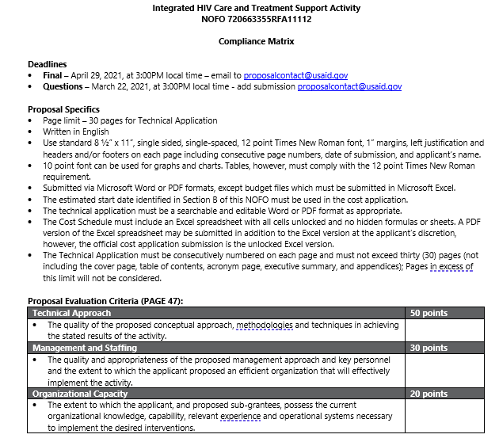
Compliance Matrix: to capture and communicate the most important information from the solicitation
COMPLIANCE MATRIX
Notes:
Slide M 4.2/#13
Mark up a copy of the solicitation by hand or on a computer, so that you can track the key elements of the opportunity.
Some organizations create a “crib sheet” that strips the solicitation down to its critical components, forming a kind of checklist to help the team ensure that they have all the required elements – the Compliance Matrix can serve this purpose.
Share your NOFO markup, or crib sheet, or compliance matrix with your full group of internal stakeholders and ask for their own contributions.

Slide 56
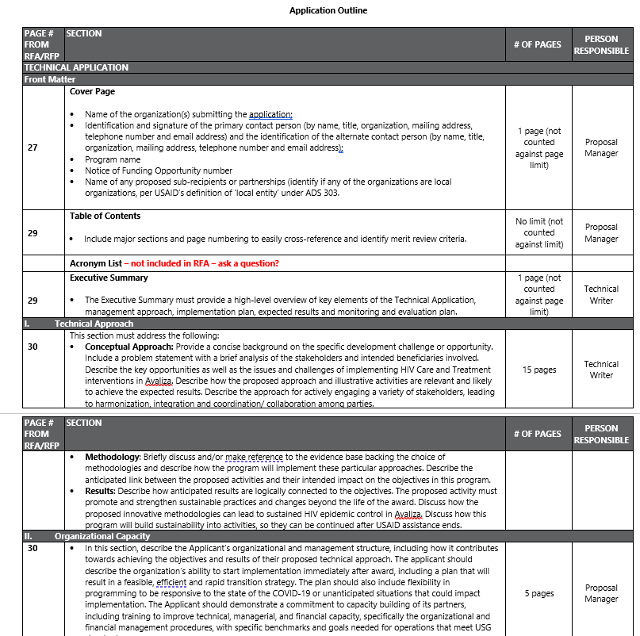
COMPLIANCE MATRIX
The Compliance Matrix is helpful because it:
Includes the proposal
specifications;
Describes the evaluation criteria that the UDAID team will use for your technical application;
Tells you how many pages are recommended for your technical application.
Notes:
Slide M 4.2/#14

Slide 57
ADDITIONAL APPROVALS TO MOVE AHEAD?
The context can change and/or the NOFO may be different than what the organization expected – so it is important to confirm if the organization still wants to pursue it.
Once your team has read the solicitation and has a good sense of the donor’s desired approach, your proposal manager should:
  Circulate the opportunity to the leadership and any other proposal decision-makers;
  Schedule a meeting with them to discuss why this opportunity is important to your organization and confirm their “go” decision.
  Estimate the cost of preparing the proposal
  Also consider a sub role with another bidder if you decide not to prime
Notes:
Slide M 4.2/#15
Highlight that many organizations will require a final “go decision” confirmation from leadership before the proposal team can proceed with project design and proposal development.

Slide 58
4.3 PROPOSAL KICK-OFF MEETING
        Kick-off Meeting with Proposal Team & Reviewers
Introduce the Proposal Team members/reviewers and their functions.
Recap the basics: proposal title, donor, geography, period of performance (POP), estimate award value, eligibility, etc.
Present the Proposal Calendar, pointing out important deadlines.
Go over the Compliance Matrix, emphasizing the proposal evaluation criteria, and discuss how your proposal will meet them; have an initial discussion on budget to ensure alignment.
Brainstorm relevant prior experience and how to build upon it to address the requirements of the solicitation.
Formulate a “win theme” for your proposal—an “earworm” that your team wants the donor to remember.
Identify knowledge gaps and plan how to fill them (desk research and/or outreach to your network).
Notes:
Slide M 4.3/#16
Ensure that roles/responsibilities and priorities are clear, communicated, and understood before concluding the meeting!
One way to undertake this session would be to simply present Slides M 4.3/#16-18, as they are quite straightforward. In doing so, you can ask volunteers to discuss their experiences with Kick-Off Meetings (if anyone has done them before).
But if the team has limited experience with this and if energy is low, another approach could be role play. You could divide the participants into groups, with everyone assigned a specific function on the proposal team (e.g., a proposal manager, a technical expert, an M&E expert, a finance/budgeting specialist, a program management staff) plus a few reviewers).
Give them a handout with the agenda items (SEE BELOW) and select a NOFO from a country as an example, then ask the person playing the role of Proposal Manager to facilitate the meeting.
In real life, it would take a couple of hours, but this could be done in a pretend for just 15 minutes or so. The aim is to get them familiar with the types of topics to be discussed in a way that is engaging and will reinforce retention of the content covered in this session.

Slide 59
ALSO DISCUSS: PARTNERSHIP CONFIGURATION
Review and confirm your partnership configuration:
  Identify experience and expertise gaps, discuss/finalize the partnership strategy, and plan for any necessary outreach to partners.
  It might be necessary to add or drop partners (if the latter, consider it very carefully and do it diplomatically and with sensitivity -- this risks harming future relations, especially if a PTA was signed).
  Revise SOWs and budgets, as appropriate.
  Execute “Teaming Agreements” to replace the PTAs.
  Keep partners informed and involved in the process
Notes:
Slide M 4.3/#17

Slide 60
ALSO DISCUSS: KEY PERSONNEL/RECRUITMENT
Review/reconfirm the availability of Key Personnel candidates and gear up to fill any gaps via rapid recruitment.
The staffing plan may change during/after project design, but Key Personnel are usually specified in the NOFO, and you will likely have initiated recruitment during the Capture phase – so this step should ideally involve confirming the availability of the candidates you’d previously identified and quickly starting to recruit to fill any gaps.
Notes:
Slide M 4.3/#18

Slide 61
4.4 INITIAL STEPS BEFORE PROPOSAL WRITING
        The preliminary steps before writing the proposal are:
        Fill in information gaps
In your kick-off meeting, your team may have identified some information gaps to address before your proposal can be formulated.
Begin that research immediately for the proposal to include recent, relevant, facts and figures and demonstrate a solid understanding of the subject matter. ​​
This is also the time for your organization to engage with the community and with stakeholders to ensure the sustainability and relevance of the proposed interventions and show the donor that you truly understand the context and specific needs of the project.
Consider asking consortium members to write different technical sections
Notes:
Slide M 4.4/#19
State the following in plenary: We have read and re-read the solicitation documents, we’ve gotten ourselves organized, and we’ve conducted the kick-off meeting. Now what? Are we finally ready to write the proposal? Raise your hand if you say YES. Raise your hand if you say NO. (At this point, it is likely that many participants will enthusiastically say YES!)
In response, tell them that there’s still a bit left to do before they can start writing. Yet point out that all the steps until this point should have taken place within a matter of hours or days after the NOFO was released – so even if the list of actions seems large, it is all happening quite fast. Even the “preliminary steps before writing the proposal” that will be presented now need to be completed as quickly as possible.

Slide 62
EXECUTE TEAMING AGREEMENTS (TAS)
Partnering with capable, respected organizations that have complementary expertise and/or relevant local experience strengthens your proposal and adds credibility.
You may want to develop a “teaming agreement” consortium partners, especially to convert any PTAs that were executed during Capture into TAs for the live proposal.
Notes:
Slide M 4.4/#20
Remind them what a Teaming Agreement is (referring to the Notes in the slide; it was discussed already, but a refresher can help).

Slide 63
PREPARE QUESTIONS TO THE DONOR
Most calls for proposals will offer a period during which potential applicants can submit questions. The answers will then be posted publicly.
You are strongly encouraged to submit any questions that your own organization has during the open question period. There is a designated point of contact for each opportunity listed within the proposal.
Be aware that all questions and answers are made public to ensure transparency and fair treatment.
Notes:
Slide M 4.4/#21

Slide 64
KEY CONSIDERATIONS FOR ASKING DONOR QUESTIONS
Frame the question in a way that the donor can easily and clearly answer
Will your question reveal (to competitors who will read the questions and answers) your technical approach or strategy?
Could the donor answer your question in a way that will not help you or may even benefit the competition?
Do you need to ask the question, or is it better to assume and proceed?
Notes:
Slide M 4.4/#22

Slide 65
FOLLOW THE OPPORTUNITY ON SAM.GOV AND GRANTS.GOV
USAID sometimes amends an opportunity based on questions they receive during the open-question period for an award.
Avoid missing a deadline extension or a change of requirements by visiting www.grants.gov or www.SAM.gov frequently to watch for any updates to the opportunity.
Notes:
Slide M 4.4/#23
As applicable – not all donors or even USG funding agencies use these. USAID does.

Slide 66
MODULE 5:
PROJECT DESIGN AND TECHNICAL AND BUDGET PROPOSAL DEVELOPMENT
Notes:
Slide M 5. /#1

Slide 67
5.0 PROJECT DESIGN AND TECHNICAL AND BUDGET PROPOSAL DEVELOPMENT
Learning Objectives:
To emphasize the importance of undertaking a participatory project design process prior to proposal writing and introduce or refresh participants to the aspects of the project design process;
To familiarize participants with what a typical USAID technical proposal looks like;
To provide information on what each key component of the technical proposal should consist of; and
To develop a budget that covers all program costs including direct and indirect costs.
This module covers:
The Project Design and Technical and Budget Proposal Development,
Tips and Considerations for Strong and Compliant Proposal,
Proposal Review and Editing, and
Proposal Finalization and Submission.
Notes:
Slide M 5.0/#2
Go through the bullets one by one to introduce this module. It’s important to emphasize that the Technical Approach is the most important section of any proposal and carries the most weight in USAID’s evaluation. Therefore, it is important for proposal teams to spend time on this together and make sure to get it right.

Slide 68
5.1.1 TECHNICAL APPROACH/PROPOSAL
The technical approach is usually the largest section of your technical proposal in terms of page allotment—and the one that carries the most weight based on the donor evaluation criteria (often as much as 50% of the points or valued as “most important”).
It describes your approach and your rationale for addressing the challenge or opportunity outlined in the solicitation. A strong technical approach often requires a lot of brainstorming on the many facets of the technical solution.
Develop and fine-tune the content before beginning to write.
Notes:
Slide M 5.1.1/#3
Remind the participants that the entire proposal is based on the design of the Technical Approach and should be well thought out to inform other decisions such as the budget, management and staffing plan, and the MEL Plan.
At the end of this slide, ask the participants if they have been involved in proposal writing and what they learned from the experience. Some responses to listen for or prompt are assembling the proposal team and partners for discussions, and compiling background information needed to conduct these design discussions.

Slide 69
IMPORTANCE OF PROJECT DESIGN
A strong proposal often requires a lot of brainstorming on the many facets of the technical solution. Develop and fine-tune the content before beginning to write.
Facilitate a thorough, participatory project design process, including:
  Analysis of the focal problem and its root causes
  Prioritization of which specific aspects of the problem the project will address
  Formulation of clear goals, objectives, and outputs (e.g., expected results)
  Identification of the set of activities that are necessary and sufficient to deliver the expected results
Notes:
Slide M 5.1.1/#4

Slide 70
MAIN COMPONENTS OF USG PROPOSALS
Technical proposal
Cost proposal (budget, budget narrative, etc.)
Annexes
Proposal Package
Intro.
Cost Proposal
Annexes
Technical Proposal
Notes:
Slide M 5.1.1/#5

Slide 71
DRAFTING THE WRITE-UPS
Draft a document with the sections you will need (outlined in the solicitation).
You may have a lead writer, possibly your proposal technical lead, or you may assign team members with the expertise to draft each section.
At time, you may need to have a staggered writing process, as some sections depend on others.
  For example, it might be necessary to finalize the technical approach before the staffing/management section.
Make sure that the writer or writing team continues to coordinate closely with the budget preparer developing the cost proposal.
Notes:
Slide M 5.1.1/#6

Slide 72
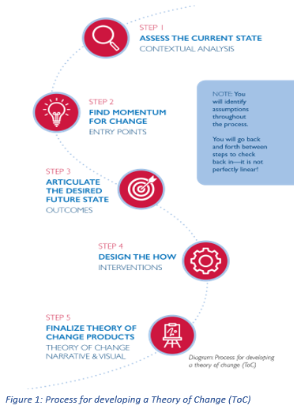
THEORY OF CHANGE
A theory of change (TOC) is a diagram or written description of the strategies, actions, conditions, and resources that facilitate change and achieve outcomes. The TOC is a road map. It’s the articulation of how and why a given set of interventions will lead to specific change. It follows a generally straightforward “if/then” logic — if the intervention occurs successfully then it will lead to the desired result. Of course, behind that logic is a set of beliefs and assumptions that support our expectations about how change will occur.
A complete TOC includes five components:
The context in which the development problem is situated;
If-then (causal) outcomes needed to achieve the desired change;
Major interventions that the project will undertake to catalyze these outcomes;
Key assumptions that underlie the success of this theory; and
Key indicators to monitor how progress unfolds during implementation.
Notes:
Slide M 5.1.1/#7
Emphasize that it’s essential to develop and fine-tune the Theory of Change, and programmatic activities to meet expected outcomes before beginning to write the 20 – 25 pages.
Pause here for a plenary discussion – ask participants if they have created TOC before, allow them to ask questions, and share lessons learned from developing TOC before. This is also a good way to gauge any challenges LIPs have faced in developing TOC.

Slide 73
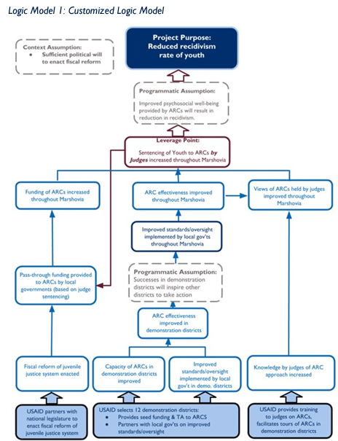
THEORY OF CHANGE – EXAMPLE
USAID’s theory of change is that if it can help break this vicious cycle through alternative sentencing of youth to Alternative Rehabilitation Centers (ARCs), then youth will develop the self-esteem and self-worth they need to resist negative influences and not return to a life of crime.
Notes:
Slide M 5.1.1/#8
Walk the participants through the examples and ask participants for any other examples or experiences they would like to share.

Slide 74
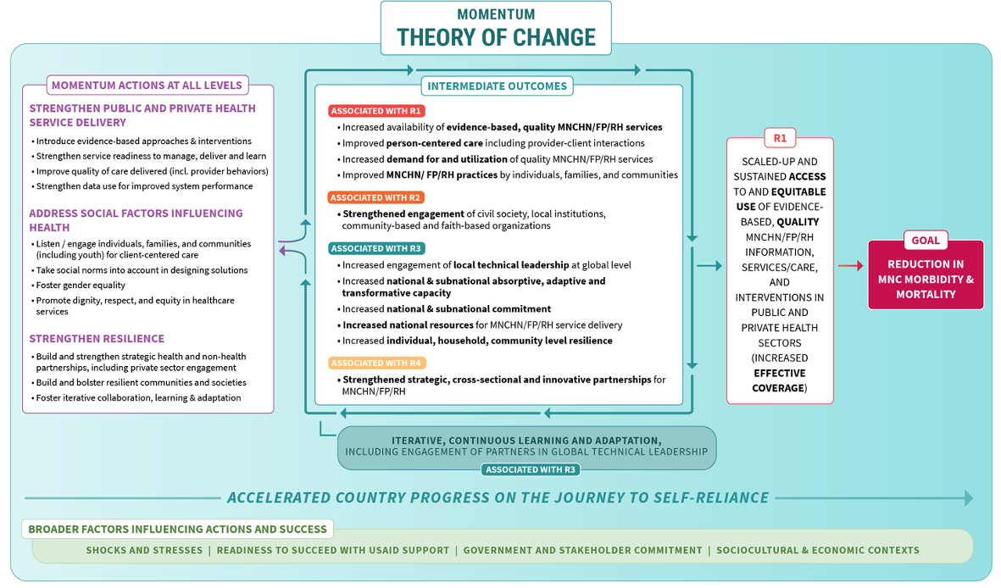
THEORY OF CHANGE - EXAMPLE
Notes:
Slide M 5.1.1/#9

Slide 75
LOGIC MODEL
A logic model is a graphic or visual depiction that summarizes key elements of a TOC, and it is often used as a facilitation tool during the design process. There are many types of logic models, including but not limited to logical frameworks (log frames), results chains, results frameworks, and local actor-oriented models, among others. The project logic model and its associated TOC are included in the Project Appraisal Document (PAD) that approves a project design (see ADS 201.3.3.13).
The logic model is a snapshot or approximation of this TOC; it is not an exact representation and often does not include all these elements. What is highlighted in the logic model will depend on its intended application and the degree of detail that the team opts to include in this summary presentation.
Notes:
Slide M 5.1.1/#10
Introduce the Logic Model explanation– provide an overview of what a logic model is and how it is used in the project design process. Most participants should be familiar with this.
Emphasize that a results framework is a type of logic model that USAID uses.

Slide 76
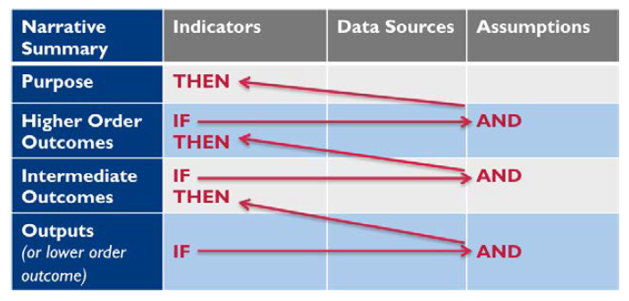
LOGIC MODEL - EXAMPLE
The logical framework, or log frame, is one of the principal tools used by the international development community to help design projects to achieve measurable outcomes. The log frame provides a simplified depiction of how a project is to function in the form of a linear chain of cause and effect. It establishes the “if-then” (causal) relationships between the elements of a project: if the outputs are achieved (and the assumptions hold true), then certain outcomes (or sub-purposes) can be expected; if the outcomes are achieved (and the assumptions hold true), then the purpose can be expected; and so on. Log frames are useful representations of projects where causal links are well known or can be determined with additional expertise, and stakeholders agree on the solution.
Notes:
Slide M 5.1.1/#11
Give the background of the logic model and how it relates to the TOC, using the graphic on the slide to show causation is demonstrated from the bottom up and uses if/then language like the TOC.

Slide 77
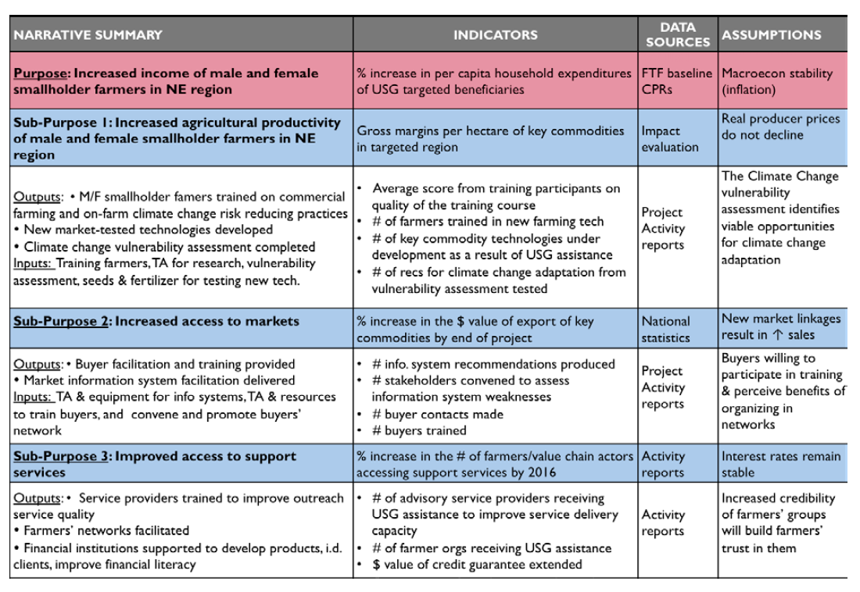
LOGIC MODEL - EXAMPLE
Notes:
Slide M 5.1.1/#12
Review the example logic model and note this is how it should look when it is final, reviewing each column – working from the bottom up to demonstrate that the sub-purposes and assumptions, if met, will result in the overall Purpose at the top.

Slide 78
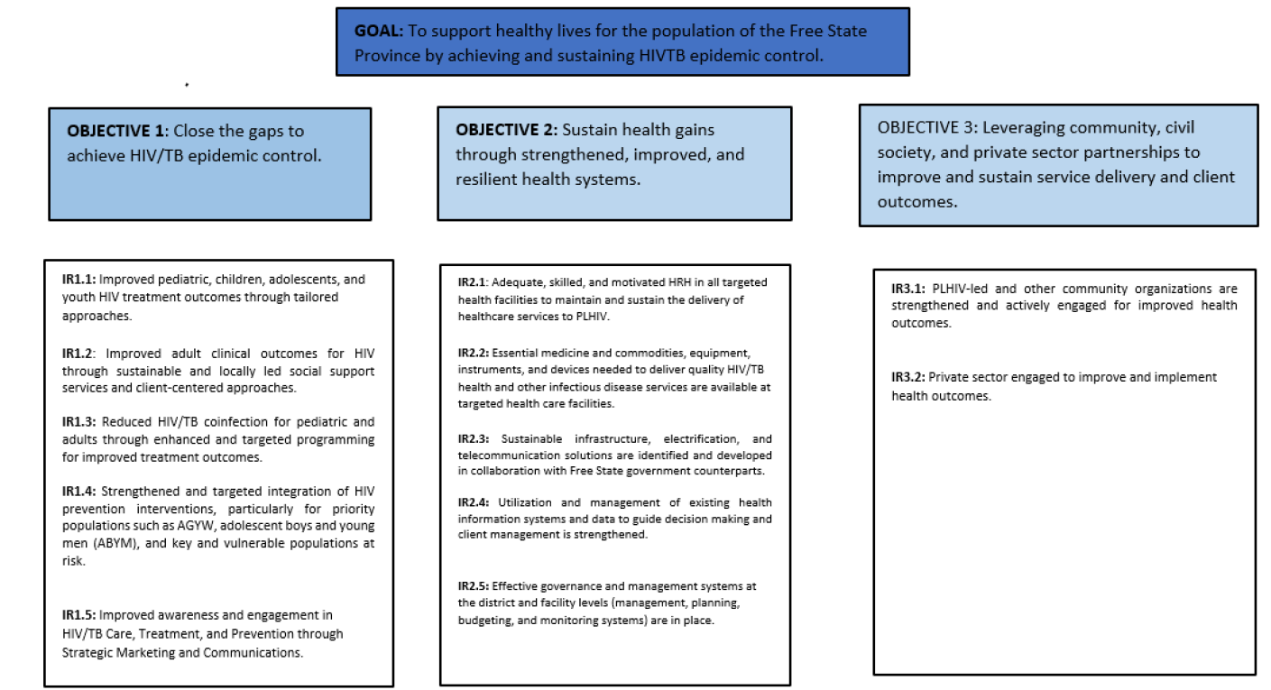
RESULTS FRAMEWORK - EXAMPLE
The results framework (RF) has been a key logic model for USAID for depicting the underlying logic behind USAID Mission strategies (i.e., CDCSs) since the 1990s. The RF can also be used at the project level. If an RF is selected to depict the project TOC, the team should use the relevant part of the parent RF in the CDCS as the starting point. As additional analysis is conducted during the project design process and more information is available about the root causes of the development problem, the team may opt to refine or reorganize the CDCS RF, as well as the underlying development hypothesis.
Notes:
Slide M 5.1.1/#13
Introduce the Results Framework (RF) and example on Slide M 5.1.1/#13. Highlight that USAID uses RFs in its Country Development Cooperation Strategy (CDCS) and in its solicitations. Go through each Objective and its Intermediate Result (IR) to show that achieving these will reach the overall project Goal.

Slide 79
DESIGN THE “HOW”
Facilitate a thorough, participatory project design process, that will help you formulate “how” to address and provide solutions to achieve the goal:
  Identify and analyze the problem(s)
  Understand and articulate the root cause(s) of the problem(s)
  Focus on which specific aspects of the problem(s) the project will address (some will be in scope and others will be out of scope)
  Formulate strategies that will provide solutions to the problem(s)
  Identify activities that are necessary to implement the strategies/solutions
  Achieve the objectives and long-term goal of the project
Notes:
Slide M 5.1.1/#14
Emphasize that there are several steps you must take before getting to that final if/then statement or logic model.

Slide 80
IDENTIFYING THE ROOT CAUSE(S) AND THEIR SOLUTIONS
Root Cause Analysis is a structured facilitated team process to identify the root causes of an event that resulted in an undesired outcome and develop corrective actions. Five steps of an RCA:
  Define the problem.
  Collect data.
  Identify causal factors.
  Identify root cause(s).
  Implement solutions.
Tools to use to identify root cause(s): Pareto Charts, Failure Mode and Effect Analysis (FMEA), 5 Whys, Ishikawa Fishbone Diagram, Fault Tree Analysis, 8D Report Template Checklist, DMAIC Template, Scatter Diagram
Materials needed to facilitate this discussion:
  In person: sticky notes, whiteboards, chart paper
  Virtually: Mural, Miro, virtual whiteboards in Zoom/Teams, Google Jamboard
Notes:
Slide M 5.1.1/#15
Give an overview of what a root cause is and how to identify them to develop solutions. Identifying the root cause(s) of the problems is the foundation of creating a TOC. This is likely where proposal teams will spend a lot of time brainstorming and drilling down to root causes and may need an outside facilitator to support these activities.
Highlight the different tools that teams can use to find root causes and discuss as a group ideas for how to facilitate these discussions, especially if they must have the debate virtually (with internal staff and partners).

Slide 81
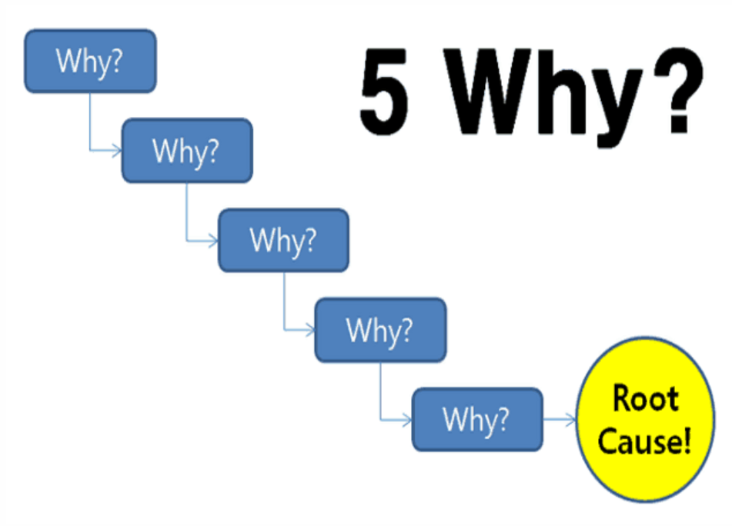
IDENTIFYING THE ROOT CAUSES (1)
Activity – Root Cause Analysis using 5 Whys - when a problem occurs, you drill down to its root cause by asking "Why?" five times. First, you look at a problem and ask why it happened. Once you answer the first question, you ask why that happened. Repeat this process five times in total and you will have typically found your true root cause.
Problem statement: The vehicle will not start.
Why 1: The battery is dead.
Why 2: The alternator is not functioning.
Why 3: The alternator belt is broken.
Why 4: The alternator belt was well beyond its useful service life and not replaced.
Why 5: The vehicle was not maintained according to the recommended service
Schedule.
Notes:
Slide M 5.1.1/#16
Divide participants into groups of four people. Give each group a different problem and instruct them to use the 5 Whys tool to identify the root problem. After 10 minutes, ask each group to report out the root cause for each original problem. Allow each group to use chart paper/sticky notes to complete the exercise. Problem prompts (these examples – feel free to make up your own): The internet at the office goes out often. An employee is late to the office every day. The patient didn’t attend their doctor’s appointment. The project team was late turning in the quarterly report.
At the end of the activity and everyone has reported out, continue the slide, and click through the 5 Whys example – the vehicle won’t start – going step by step.
Ask the groups for any feedback about the activity and if they have used other tools to conduct a Root Cause Analysis.

Slide 82
WHAT IS THE SOLUTION?
Root Cause: The vehicle was not maintained according to the recommended service schedule.
What is the solution (by “flipping” the root cause)?
  The vehicle needs to be serviced according to the recommended service schedule.
How will you implement the solution?
  John will take the vehicle to be serviced by Auto Service Plus in January and July of each year.
Who
What
Where
When
Frequency
Notes:
Slide M 5.1.1/#17
Bring the groups back in the plenary and recap what the root cause of the example 5 Whys exercise was. Then, show the participants how to “flip” the root cause to the solution, and then the last bullet demonstrates turning the solution into a clear activity (the who, what, how, when).

Slide 83
DESIGN THE “HOW”
EXAMPLE
  Identify and analyze the problem(s) – the vehicle won’t start.
  Understand and articulate the root cause(s) of the problem(s) – the battery is dead, the alternator is not functioning, the alternator belt broke, the alternator belt was well beyond its useful service life and not replaced, the vehicle was not maintained according to the recommended service schedule.
  Focus on which specific aspects of the problem(s) the project will address (some will be in scope and others will be out of scope) – the back tire is flat (this is not a contributing factor to why the vehicle won’t start, though it needs to be addressed to operate the vehicle)
  Formulate strategies that will provide solutions to the problem(s) – the vehicle needs to be repaired and serviced regularly to avoid future breakdowns
  Identify activities that are necessary to implement the strategies/solutions – identify a repair shop and technician to look at the vehicle and recommend needed repairs, make the needed repairs, and going forward ensure the vehicle is taken to the shop on the recommended schedule
  Achieve the objectives and long-term goal of the project – the vehicle starts and is in good working condition at all times
Notes:
Slide M 5.1.1/#18
Flag that this slide is a repeat of Slide M 5.1.1/#14.
Click through each bullet to show how the previous exercise about the vehicle matches these steps.
Take a pause after each bullet to ask the participants if they have any questions or anything to add, this is particularly necessary for bullet 3 as it shows how something is out of scope, even if it feels relevant.

Slide 84
DESCRIBING ACTIVITIES (SOLUTIONS)
What: What is the activity/task?
How: How will the activity/task be completed? What stakeholders or other factors need to be considered (target population, geographic area)?
Who: Which organization is leading the activity, will partners support in any way? What staff will work on this?
Where: Where will the activity geographically take place?
When: When will the activity occur, in Month 1 or Year 3?
Notes:
Slide M 5.1.1/#19
Emphasize on this slide that all this information is what needs to be answered for each activity you are planning as USAID will be looking for this in their evaluation of the proposal, and this information is essential to putting your management/staffing plan, MEL plan, and budget together. Without this information, you will have a lot of gaps in your proposal and USAID will have a lot of questions or will deem your proposal non-compliant.

Slide 85
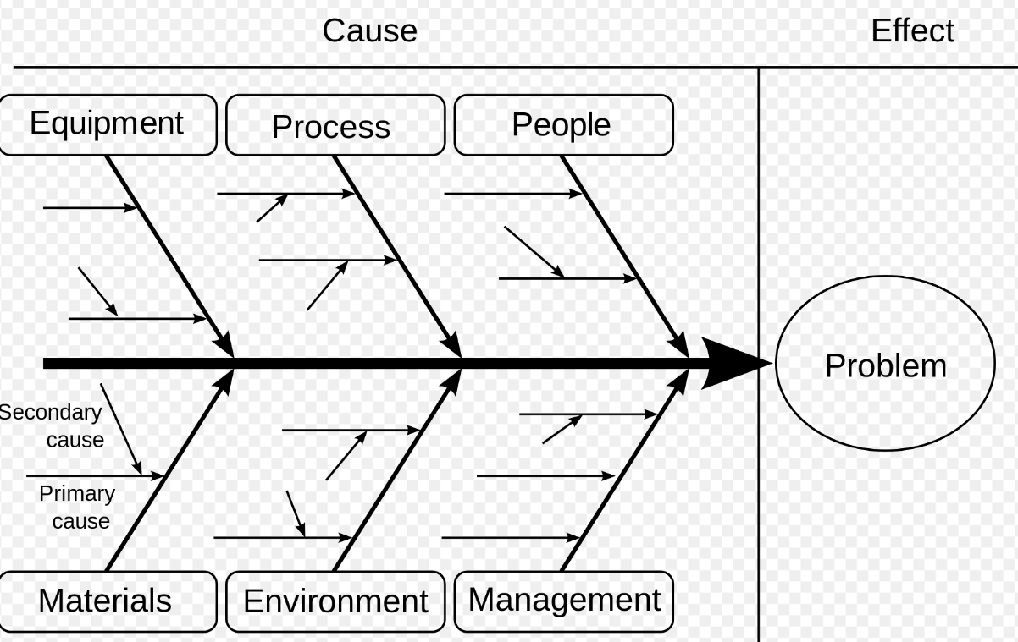
IDENTIFYING THE ROOT CAUSES (2)​
The Ishikawa diagram, also called the Fishbone diagram, is a tool used to identify problems in a system. It shows how causes and effects are linked and helps analyze what is going wrong with systems, processes, and products. The name comes from Japanese engineer Kaoru Ishikawa who developed the method in the 1960s.
Source: https://www.project-management-skills.com/fishbone-diagram.html
Notes:
Slide M 5.1.1/#20
Source link: https://www.project-management-skills.com/fishbone-diagram.html

Slide 86

ALIGN WITH COUNTRY DEVELOPMENT CORPORATION STRATEGY
CDCS is a five-year strategy at the country level that reflects USAID collaboration with other agencies to formulate country development cooperation strategies that are results-oriented and foster partnering with host countries to focus investment in key areas that shape countries' overall stability and prosperity.
Notes:
Slide M 5.1.1/#21
CDCS Link: https://www.usaid.gov/results-and-data/planning/country-strategies-cdcs

Slide 87


ALIGNING ACTIVITIES TO USAID'S POLICIES
2023 USAID Gender Equality and Women's Empowerment
2022 Youth in Development Policy
Notes:
Slide M 5.1.1/#22
Source Links:
https://www.usaid.gov/sites/default/files/2023-03/2023_Gender Policy_508.pdf
https://www.usaid.gov/sites/default/files/2022-12/USAID-Youth-in-Development-Policy-2022-Update-508.pdf

Slide 88


ALIGN PROPOSAL ACTIVITIES WITH USAID POLICIES
2020 USAID Policy on Promoting the Rights of Indigenous Peoples
2023 LGBTQI+ Inclusive Development
Notes:
Slide M 5.1.1/#23

Slide 89


ALIGN ACTIVITIES WITH PEPFAR
PEPFAR 2023 Country and Regional
Operational Plan (COP/ROP) Guidance
for all PEPFAR-Supported Countries
PEPFAR Five-year Strategy
Notes:
Slide M 5.1.1/#24
Source Links:
https://www.state.gov/pepfar-five-year-strategy-2022/
https://www.state.gov/wp-content/uploads/2023/02/PEPFAR-2023-Country-and-Regional-Operational-Plan.pdf

Slide 90
EVIDENCE-BASED SOLUTIONS
When presenting your solutions/activities – make sure you also provide evidence that this solution works or be clear that the activity is a pilot.
  Use USAID data whenever possible
  Include references to research papers that support your solution
  Reference results from previous projects that you or your partners have achieved, or results from other peer-implemented projects
Notes:
Slide M 5.1.1/#25
Use this slide as a reminder to participants that USAID wants to see evidence-based solutions in the technical approaches.

Slide 91
EVIDENCE SOURCES AND CLEARINGHOUSES
USAID Development Information and Analysis
Development Experience Clearinghouse: USAID program records and development information, USAID evaluation reports, peer-reviewed journal articles, and other analyses.
Development Data Library: USAID-funded machine-readable data
USAID Resource Portal: portal to a selection of USAID-funded knowledge management platforms and associated research
Country Roadmaps: visualization and trends of 17 third-party indicators curated by USAID to understand country self-reliance
International Data and Economic Analysis Portal (IDEA): Country-level data from multiple third-party sources simultaneously
Third-party Evidence Clearinghouses
3ie - International Initiative for Impact Evaluation: Evidence Hub with a database of individual impact evaluations, systematic reviews, and evidence gap maps
Cochrane Library: reviews of health evidence
Campbell Collaboration: international social science research network that produces evidence syntheses
Other Federal Agencies' Evidence Clearinghouses
HHS Administration of Children and Families Research and Evaluation Clearinghouses
Dept of Education's What Works Clearinghouse
Dept. of Labor Clearinghouse for Labor Evaluation and Research (CLEAR)
Notes:
Slide M 5.1.1/#26
This slide summarizes the different USAID sites that organizations can go to find data and information and reminds participants that all USAID-funded project reports should be publicly available and work with your MEL staff to find those key sources during the proposal development process.

Slide 92
LINKS TO RESOURCES
USAID Learning Lab Theory of Change: https://usaidlearninglab.org/resources/theory-change-workbook-step-step-process-developing-or-strengthening-theories-change
USAID Learning Lab Why is it Called Theory of Change: https://usaidlearninglab.org/community/blog/what-thing-called-theory-change
USAID Learning Lab How to Develop a Logic Model: https://usaidlearninglab.org/system/files/resource/files/project_logic_model_how_to_note_final_sep1.pdf
USAID Technical Note Developing a Results Framework: https://www.usaid.gov/sites/default/files/2022-05/_508_RF_Technical_Note_Final_2013_0722.pdf
Notes:
Slide M 5.1.1/#27
This slide provides links to all resources used in previous slides, many of which include examples, workbooks, etc. that the participants can use in future processes.

Slide 93

PROJECT DESIGN TIPS AND LESSONS LEARNED
What are some tips or lessons learned that you can share with the group around the project design process?
Notes:
Slide M 5.1.1/#28
You’ve just gone through a lot of information, pause here to allow the participants to ask questions, and share tips and lessons learned about project design (do’s, don’ts, feedback they’ve gotten from the donor, etc.). Once you’ve taken time to wrap up this part of the process, ask the participants if they are done. The answer is NO! They have only laid the foundation and now is the time to build the rest of the technical proposal pieces.

Slide 94
MANAGEMENT AND STAFFING PLAN
Based on the requirements of the solicitation for this section, you must:
Identify and describe your partners, including their scope of work;
Establish a presence and configure the different offices (as applicable) in the country;
Describe lines of authority, communication, and reporting among staff/teams, the donor, and other stakeholders;
Identify key and non-key personnel and how you’ll obtain additional technical expertise if needed. NOTE:
  CVs for key personnel are usually required and must describe and demonstrate qualifications and meeting of requirements.
  An organizational chart is usually required and must visually show the configuration of staff, reporting lines, which staff are “key”, and where the staff are located
  It can be helpful to include a matrix that shows the qualifications of each individual you propose for Key Personnel alongside the minimum requirements for each position stipulated in the call for proposals.
Notes:
Slide M 5.1.1/#29
This is usually the 2nd most important section of the proposal in terms of evaluation points.
Take the participants through this slide to provide them with an overview of what is usually included in the management and staffing plan required by USAID. And reiterate that the contents of this section are based on the technical approach/activities. This is the section that shows USAID how you’re going to operationalize the activities in your technical approach.

Slide 95
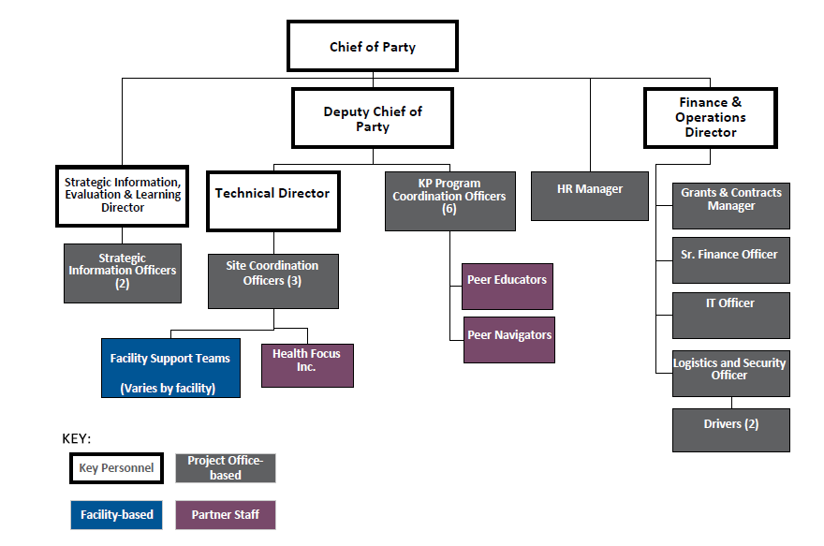
ORGANIZATIONAL CHART
Microsoft PowerPoint and Google Slides are good platforms to use for developing an organizational chart.
Develop your org chart as early as possible.
Cost it out to ensure you have a sufficient budget.
Show Key Personnel positions that will be held by both your organization and consortium partners.
Display in which office the staff will be based (using a color code).
Adjust the staffing configuration according to the type of project (service delivery vs. technical assistance).
Ensure that appropriate proportions of funding are going to staff vs. activities.
Notes:
Slide M 5.1.1/#30
The organizational chart is also a very important element of this section, as it is a visual representation of your staff, reporting lines, and how you’ll work with partners.
This slide includes best practices in putting together an org chart, including putting it together early and cost out the positions to ensure it fits the budget ceiling provided by USAID.
A potential activity for this section could be to break participants into pairs or groups and given the good and bad examples of org charts, have them discuss and report what makes a good or bad org chart and what to watch out for when creating them.

Slide 96
10 TIPS FOR PERFECT ORGANIZATIONAL CHARTS
Format the chart to fit on a single page
Group people with the same title into one box
Make all boxes the same size and space them evenly
Show assistants with a sidebar below the manager
Put the title of the position first, then the name of the person occupying it
Show managers with two titles as two different boxes in the chart
Use dotted lines sparingly
Draw your chart automatically by importing employee data
Hyperlink to more information
Break up large charts into multiple smaller linked charts
Source: https://www.smartdraw.com/organizational-chart/organizational-chart-tips.htm
Notes:
Slide M 5.1.1/#31
Whether you are using org chart software such as SmartDraw or some other tool, here are 10 tips to help you build the perfect diagram for your needs.
1. Format the chart to fit on a single page
Use a combination of a horizontal arrangement of boxes at the top of the chart, and vertical below to fit as many boxes on a single page as possible.
A combination of horizontal and vertical arrangement of boxes fits more boxes on a page.
Using only horizontal arrangements of boxes makes the chart wider.
2. Group people with the same title into one box
Putting all of the people with the same title into one box saves a considerable amount of space compared with assigning each person their own box.
3. Make all boxes the same size and space them evenly
Charts look much better if all of the boxes are the same size (except for multi-person boxes) and the spaces between boxes are the same.
Choose organizational chart software that does this automatically.
4. Show assistants with a side bar below the manager
Assistants should be shown with a box that comes off the line that connects the manager to his or her subordinates. This distinguishes the role of the assistant from other people that report to the manager.
5. Put the title of the position first, then the name of the person occupying it
The title of the position (the job title) should be shown above the name of the person occupying it because positions define the organizational structure, not the people who currently occupy them. You can change people's position without changing the structural arrangement of the chart.
6. Show managers with two titles as two different boxes in the chart
Particularly in smaller companies, one person may manage multiple parts of the organization. For example in this technology company, the CEO, Paul Smith, also acts as the VP of Engineering. Both the management team and the programmers report to him. The best way to show this is to include both positions in the chart and show Paul as occupying both of them. Remember, the organizational structure is based on positions; not the people that occupy them.
7. Use dotted lines sparingly
Sometimes it can be helpful to show relationships with a dotted line connecting the boxes of two positions. One common example is an assistant that works for three managers.
8. Draw your chart automatically by importing employee data
The best organizational chart software programs will create your chart automatically. This is accomplished by importing a data file that lists the title of each position, the name of the person assigned to it and the title of their manager in each row. You can create one of these in a spreadsheet program, such as Excel®:
You can use any application, not just Excel, to create a file formatted this way, including PeopleSoft® or SAP R/3®. Learn more.
9. Hyperlink to more information
Most people are familiar with printing organizational chart on paper, but distributing them online can be much more useful. Both let you see the structure of an organization and read the names and titles of the people that work in it, but only an online chart lets you interact with it.
10. Break up large charts in to multiple smaller linked charts
In any format, a very large chart is cumbersome to view. An org chart showing every employee of a large company like GE is impossibly too big and complex to be useful. A more manageable approach is to break the organization up into smaller groups, each with a reasonably-sized org chart, and then link them together.

Slide 97
MEL PLAN
In the proposal, a Draft Monitoring, Evaluation, And Learning (MEL) Plan is required to outline the following (based on the ToC and logical framework):
Identify program goals (impact), objectives (outcomes), and outputs.
Define the key indicators (at output and outcome levels) – Sometimes the donor lists a set of USAID standard indicators and custom indicators that are required, but it is good practice to add some of your own.
Describe the data collection methods, quality assurance processes, and timeline for MEL activities.
Identify key MEL roles and responsibilities.
Plan donor reporting and dissemination of results.
Notes:
Slide M 5.1.1/#32
Monitoring, Evaluation, and Learning (MEL) Plan is usually evaluated as part of the Technical Approach and should be based on your TOC/logical framework.
This slide provides an overview of the draft MEL Plan and its requirements.
The MEL Plan will track your progress toward achievement of outputs and outcomes that will go on to achieve the goal of the project. This is an important tool for successful project implementation.

Slide 98

MONITORING, EVALUATION AND REPORTING (MER)
PEPFAR and USAID have clear indicators for each program area:
PEPFAR FY23 MER Indicator Reference Guide
PEPFAR FY23 MER Indicator Infographic
PEPFAR FY23 MER Indicator Frequency Table
Training Resources
WorkwithUSAID Monitoring, Evaluation, and Learning Training
Notes:
Slide M 5.1.1/#33

Slide 99
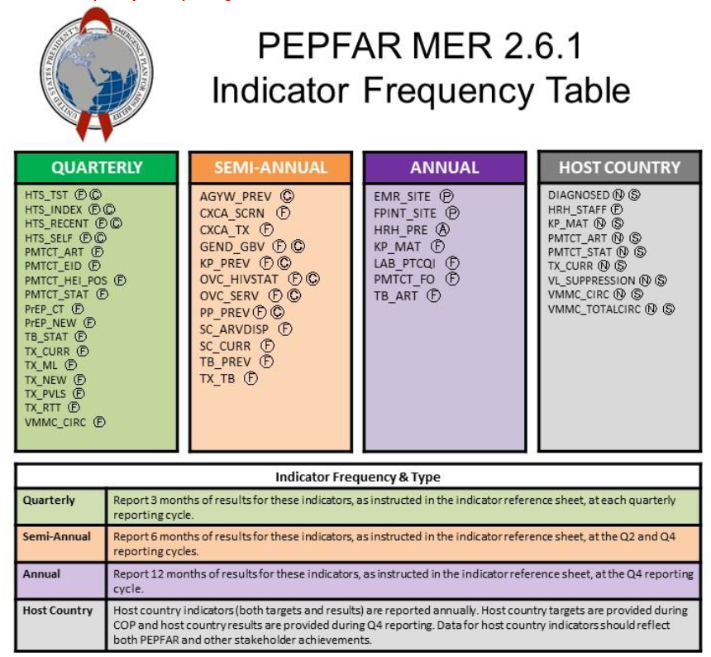
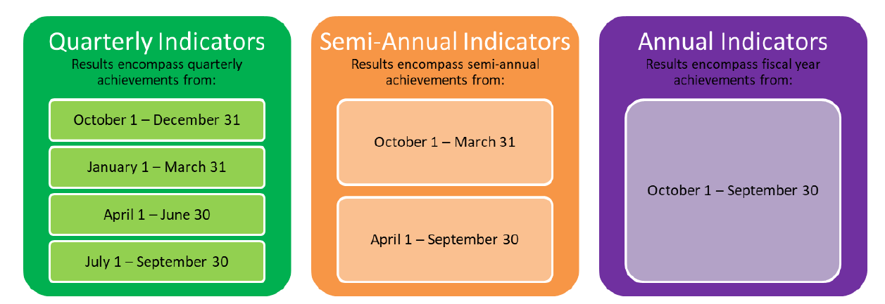
EXAMPLES OF PEPFAR INDICATORS
MER reporting requirements
Notes:
Slide M 5.1.1/#34
Note that these are examples of PEPFAR MER reporting requirements and display a sample indicator frequency table.

Slide 100
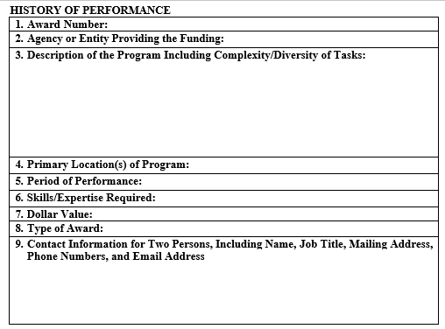
ORGANIZATIONAL CAPACITY AND HISTORY OF PERFORMANCE
Organizational Capacity:
Appears as a narrative within the technical application
Demonstrates that you can perform the SOW of the opportunity by describing past and current work related to the SOW of the opportunity
Includes experience of the prime and the consortium partners
Experience as a subrecipient is relevant
History of Performance/Past Performance:
Put information about prime recipients and consortium partners in the annexes.
Using the template provided by the donor, describe specific projects that you’ve recently implemented related to the SOW of the opportunity.
The donor will contact staff who are familiar with your work and can speak to your performance.
Notes:
Slide M 5.1.1/#35
Organizational Capacity and History of Performance is usually the 3rd most important section in proposals.
This slide provides guidance on what is usually required for these sections. This is where your organization can demonstrate clearly to USAID that you have implemented this type of work before and that you have achieved results.
Organizational capacity is where you can highlight results and give concrete examples of how you’ve been successful in the past in implementing projects that are of similar size and scope.
History of performance is another piece that USAID may ask for and it requires the organization to fill out a template (screenshot in the slide). Highlight that in Box 9 USAID is asking for a person’s name/contact information who is familiar with your work. USAID will contact that individual directly to ask about your performance on that project, so choose carefully!

Slide 101
CROSS-CUTTING ISSUES
The donor may require you to address other important aspects of project design and implementation. For example:
Gender: Conduct a gender analysis and incorporate activities into the application to reduce gender gaps in the expected program outcomes. A gender action plan is required as part of the work plan.
Youth: Develop and implement youth-friendly service packages, employ a Positive Youth Development (PYD) approach, and propose concrete and practical approaches.
Notes:
Slide M 5.1.1/#36
Briefly describe some areas that are typically referenced as cross-cutting issues that the proposal should address, as these topics should be considered and factored into your activities/interventions.
Gender is usually a cross-cutting issue in most USAID programming as we know gender norms/traditions can impact activities.
Youth is another example of a population that needs to be considered and addressed within the proposal. Ask the participants what other areas they have seen to be cross-cutting.

Slide 102
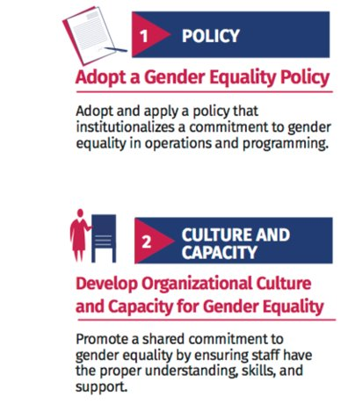
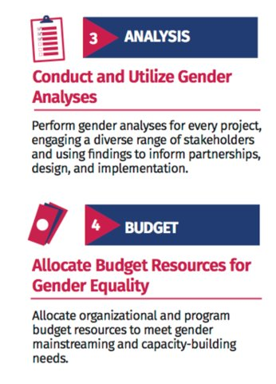
GENDER INTEGRATION 8 MINIMUM STANDARDS (1)
Notes:
Slide M 5.1.1/#37

Slide 103
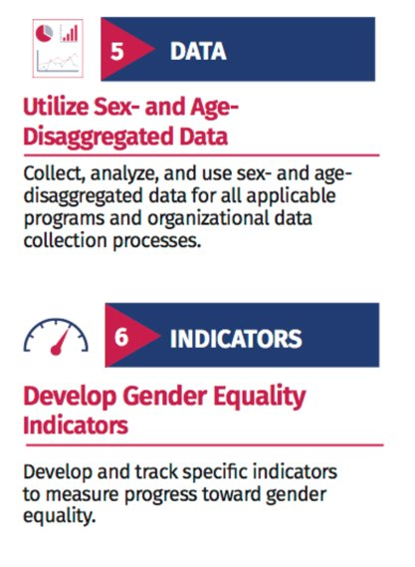
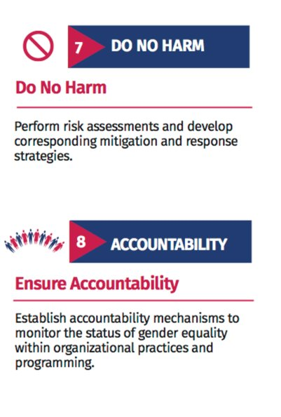
GENDER INTEGRATION 8 MINIMUM STANDARDS (2)
Notes:
Slide M 5.1.1/#38

Slide 104
YOUTH
USAID defines the different stages of youth as follows:
Early adolescence (10–14) Adolescence (15–19)
Emerging adulthood (20–24) Transition to adulthood (25–29)
Notes:
Slide M 5.1.1/#39

Slide 105
YOUTH DEVELOPMENT POLICY (YDP)
VISION: USAID envisions a world in which young people have agency, rights, influence, and opportunities to pursue their life goals and contribute to the development of their communities.
GOAL: Increase the meaningful participation of youth within their communities, schools, organizations, economies, peer groups, and families, enhancing their skills, providing opportunities, and fostering healthy relationships so they may build on their collective leadership.
POLICY OBJECTIVES:
ACCESS: Youth are better able to access high-quality information, safe services, and livelihood opportunities and build the skills they need to lead healthy, productive, and engaged lives.
PARTICIPATION: Youth have the right to fully participate in decision-making as key partners contributing to individual, household, community, and national well-being.
SYSTEMS: Youth have a stronger collective voice in and are better served by local and national systems through more coordinated and effective services, practices, and policies that embody the principles of PYD.
Notes:
Slide M 5.1.1/#40

Slide 106
5.1.2 COST PROPOSAL
Go back to the solicitation document (RFA, RFP) to confirm what the cost presentation should look like; use and/or modify the provided templates. It will most likely contain, at a minimum, a summary budget, a detailed budget, and a budget narrative.
USAID will evaluate your cost proposal (that of your organization and each partner/sub-recipient) on three criteria:
  Reasonable: Costs are generally recognized as ordinary and necessary.
  Allocable: Costs are incurred specifically for the award.
  Allowable: Costs are not disallowed by the terms of the award.
Make sure the budget aligns with the technical proposal (work plan).
Coordination with other teams is key to successful budget development!
Notes:
Slide M 5.1.2/#41
The Cost Proposal is reviewed separately from the Technical Proposal and has two components:1) Budget and 2) Budget Notes which is a narrative explanation of the budget figures.

Slide 107
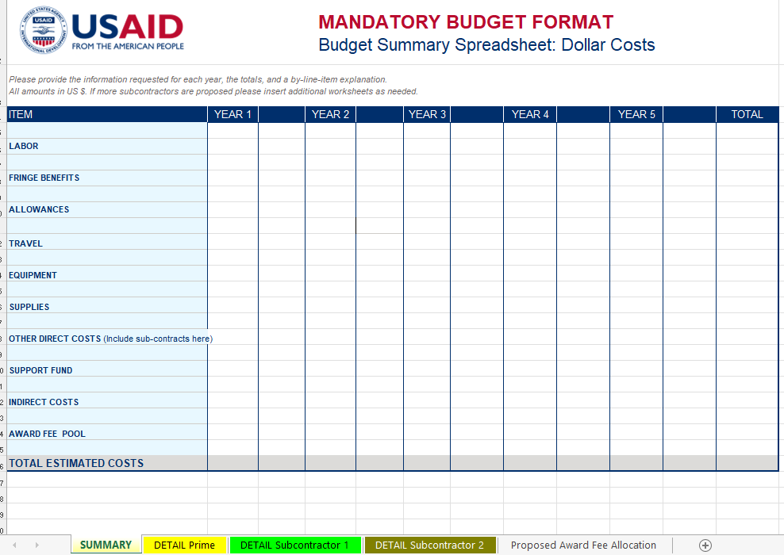
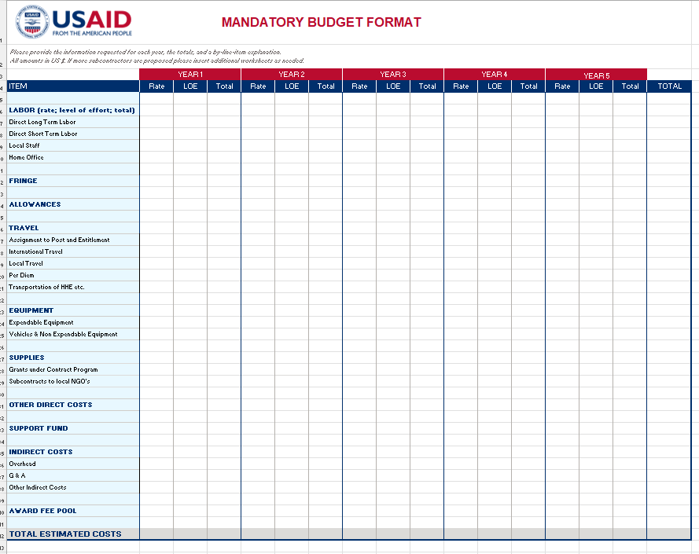
BUDGET TEMPLATE
Ensure that the Excel format and level of detail respond to donor/proposal requirements and meet the policies of your organization.
Notes:
Slide M 5.1.2/#42
The budget covers the Life of the Project and the template you use must include all the details required in the proposal.
Link to the budget template: https://www.usaid.gov/document/attachment-3-budget-template

Slide 108
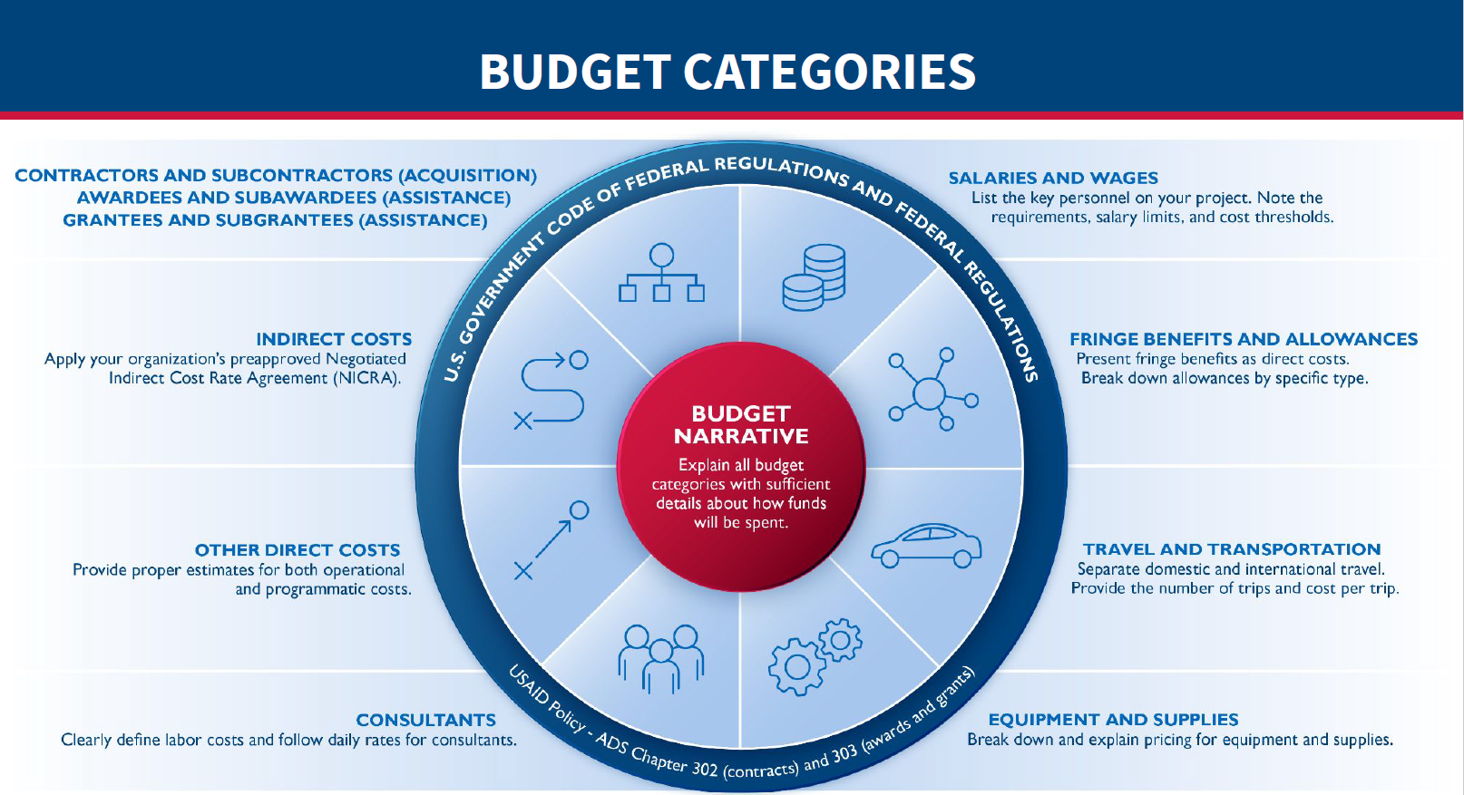
BUDGET CATEGORIES
Notes:
Slide M 5.1.2/#43

Slide 109
SALARIES AND WAGES (1)
Every solicitation asks for a list of key personnel and staff required for your project.
Your budget proposal should include the following for key personnel:
Position
Name
Nationality
Daily Rate
Number of proposed workdays
Total costs
You must follow the requirements, salary limits, and cost thresholds provided.
Source: WorkwithUSAID
Notes:
Slide M 5.1.2/#44

Slide 110
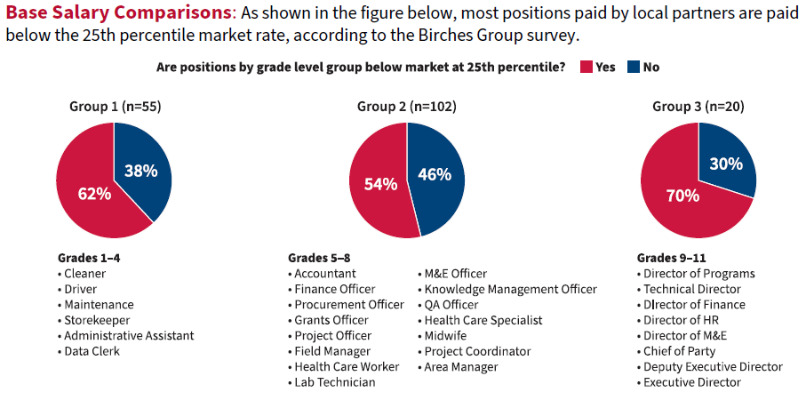
SALARIES AND WAGES (2)
ASAP Salary Survey: In April 2021, ASAP administered an online salary survey to gather profile information about each local implementing partner (LIP) supported, including their number of current staff, staff salaries, salary scales if available, benefits information, and reasons for attrition.
Notes:
Slide M 5.1.2/#45
This and the following slide are very important for participants to understand that the budget preparation phase is the only to ensure you include salary levels that will attract and retain staff. As t is important to understand the local salary market and use the budget available in the proposal to hire the skillset and experience you need. As a reference, please refer to local market salary surveys.
Ensure you include salary levels that will attract and retain staff.
Historically, local organizations have been paid less than INGOs.

Slide 111
SALARIES AND WAGES (3)
Key takeaways from the ASAP survey:
Be aware of market standards for different positions and implement actions that allow you to be competitive within the local job market.
  Review your organization’s salary scales and revise (with HR) if possible.
  Do comparisons within the market.
  Budget for the positions as needed for new awards.
  Advocate with USAID for what is needed to ensure that you can hire and retain high-caliber staff.
Notes:
Slide M 5.1.2/#46
As USAID’s Localization Strategy is successfully implemented, many people who have worked with INGOs are willing to accept jobs with a local organization because of the low salary.
It is important to understand the local salary market and use the budget available in the proposal to hire the skillset and experience you need.

Slide 112
INDIRECT COSTS (1)
Indirect costs are costs incurred for a common purpose that is too time-consuming/costly to allocate to a specific cost objective.
These typically include expenses that cannot be attributed to one single activity, such as general and administrative (G&A) costs associated with executive leadership of the organization, cross-cutting support staff and office space, utilities, and clerical and managerial staff salaries.
To the extent that indirect costs are reasonable, allowable, and allocable, they are a legitimate cost of doing business payable under a U.S. Government assistance award.
For Fixed Amount Awards (FAAs), there is no line item for indirect costs, but you can factor it into the total costs.
Notes:
Slide M 5.1.2/#47
There are two types of indirect costs: 1) 10% De Minimis; and 2) Negotiated Indirect Cost Rate Agreement (NICRA). Alternatively, a project can include all costs for implementing the award as direct costs.
As of September 2023, 2 CFR 200.414(f) states that organizations can charge a 10% de minimis rate of modified total direct costs. It is anticipated that USAID will use the 10% de minimis as of October 2024. The de minimis should be calculated appropriately for each fiscal year.
The Modified total direct costs include all direct salaries and wages, applicable fringe benefits, materials and supplies, services, travel, and up to the first $25,000 of each subaward (regardless of the period of performance of the subaward). The 10% de minimis rate for modified total direct costs can only be elected under an award by a non-profit organization that has never held an indirect cost rate agreement.
The organization must include the 10% de minimis amount in its application and maintain documentation of costs included in its modified total direct costs. It must be used consistently across all USG awards. It is allowable for use indefinitely.
Administrative and clerical salaries should normally be treated as indirect costs (finance and administrative costs). In contrast, administrative and clerical salaries that can be identified specifically with a final cost objective, (i.e. award), should be charged as a direct cost.

Slide 113
FRINGE BENEFITS AND ALLOWANCES
In addition to salaries and wages, an organization may provide:
Fringe benefits such as vacation days, health insurance, and retirement benefits. These may be presented as direct costs or as a percentage per authorized indirect cost rate
Benefit allowances for costs such as housing, storage, and education.
Allowances must be broken down by specific type such as housing allowance.
Source: WorkwithUSAID
Notes:
Slide M 5.1.2/#48

Slide 114
TRAVEL AND TRANSPORTATION
Separate domestic and international travel costs
Provide the number of trips you anticipate and the estimated cost per trip including airfare and per diem. Describe the basis for calculations.
International travel must:
Be approved in advance
Comply with Fly America Act whenever possible
Source: WorkwithUSAID
Notes:
Slide M 5.1.2/#49

Slide 115
EQUIPMENT AND SUPPLIES
USAID rules require you to break down and explain pricing and justify all equipment and supplies.
Equipment: Non-expendable personal property with a useful life of more than two years and a unit cost of more than $500.
Supplies: Include all other items that cost less than $500 and consumable supplies such as pens, pencils, and paper
Source: WorkwithUSAID
Notes:
Slide M 5.1.2/#50

Slide 116
SUBCONTRACTORS
A subcontractor is a partner contracted by a lead, or “prime,” partner to meet activity objectives.
A subcontractor helps make programming decisions, and its performance is measured against activity goals.
Submit detailed budgets for each subcontractor in separate worksheets or tabs of your Excel file.
The format of a subcontractor’s budget should be the same as that of the prime’s budget.
Source: WorkwithUSAID
Notes:
Slide M 5.1.2/#51

Slide 117
GRANTS PROGRAM
        Many proposals include a Grants Program to solicit additional service providers for specific needs
        A portion of the budget is allocated every year for small grants
Notes:
Slide M 5.1.2/#52

Slide 118
CONSULTANTS
Partners may also work with consultants to help with activity implementation.
A consultant is a technical expert or specialist who is not your regular employee. A consultant is also a subcontractor.
Include consultant labor costs in this section of the budget.
These costs can also be presented as a separate section of your cost proposal.
Source: WorkwithUSAID
Notes:
Slide M 5.1.2/#53

Slide 119
OTHER DIRECT COSTS
This section generally includes two types of costs:
Field office operations costs
Programmatic costs
Sometimes, the line between these two categories is difficult to determine.
Do your best to assign direct costs to either the operations or programmatic function.
Source: WorkwithUSAID
Notes:
Slide M 5.1.2/#54

Slide 120
INDIRECT COSTS (2)
Indirect costs include expenses that cannot be attributed to one activity, such as costs in the head office for implementing multiple activities.
Rates for indirect costs may be submitted in two ways:
Established partners typically apply preapproved rates from a Negotiated Indirect Cost Rate Agreement (NICRA) with the Agency.
New partners without a NICRA may opt to budget costs as “direct costs” or they may propose a rate, such as the 10 de minimis rate.
Source: WorkwithUSAID
Notes:
Slide M 5.1.2/#55

Slide 121
INDIRECT COSTS (3)
These typically include expenses that cannot be attributed to one single activity, such as general and administrative (G&A) costs associated with executive leadership of the organization, cross-cutting support staff and office space, etc.
Rates for indirect costs may be set in two ways for the US Government:
10 % or 15% De Minimis:
Before October 2024 USAID Local organizations are entitled to 10 % of Modified Direct Costs
After October 2024 it will be 15%.
NICRA:
Well-established partners typically apply pre-approved rates from a Negotiated Indirect Cost Rate Agreement (NICRA) with USAID. (Note: If you have a NICRA, do not include costs in the budget that are covered by your indirect cost rate.)
Notes:
Slide M 5.1.2/#56
Facilitator’s note: Propose a 15-minute practical exercise to calculate de minimis. ample: The RFA has been released by USAID, and your team is finalizing the cost proposal for the application; the project cycle is 4 years, with total direct costs estimated at $5,058,634. It’s your first application to a USAID RFA, and you want to propose 10% de minimis. The estimated cost for your equipment is $59,190; the office rental cost for the 4 years is $82, 757, and the total estimated cost of the total portion of your subcontractors who exceed $ 25,000, is $ 2,156,026.
Exercise 1: Calculate the total cost of excluded items.
Exercise 2: Calculate the Modified Total Direct cost (MTDC).
Exercise 3: Calculate the estimated total amount of 10% de minimis for your application.

Slide 122
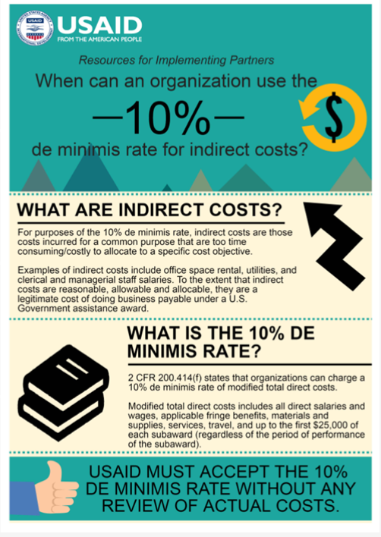
INDIRECT COSTS (4)
As per USG regulations, all local not-for-profit organizations are entitled to the ‘10% de minimis’ and must flow it down to eligible subrecipients.
It must be included in the proposal budget. You cannot request it after you have received funding for your first year. However, you can include it in the Year 2 Budget.
No supporting documentation is required
Notes:
Slide M 5.1.2/#57
Source: chrome-extension://efaidnbmnnnibpcajpcglclefindmkaj/https://www.usaid.gov/sites/default/files/2022-05/India_RFIP_DeMinimisRateIndirectCosts.pdf

Slide 123
10% MODIFIED TOTAL DIRECT COSTS
Step 1: Start with the final budget
Step 2: Exclude:
  Equipment
  Construction
  Charges for Patient Care
  Participant Costs for Training – Scholarships, Fellowships
  Subrecipients >$25,000
Step 3: Subtract excluded amounts from the total budget for MTDC
Step 4: Calculate 10% of MTDC
Notes:
Slide M 5.1.2/#58

Slide 124
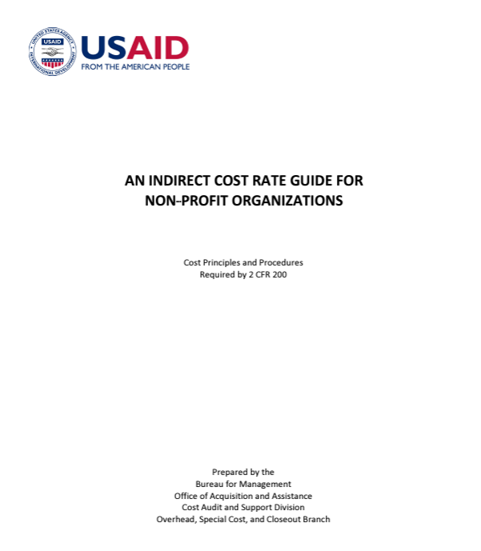
NICRA
Well-established partners typically apply pre-approved rates from a Negotiated Indirect Cost Rate Agreement (NICRA) with USAID. (Note: If you have a NICRA, do not include costs in the budget that are covered by your indirect cost rate.)
It is important local organizations continue to advocate for the NICRA with the Agreement of Contract Officer and their leadership.
Link to UST/TMG webinar: A Guide to Your First NICRA
Notes:
Slide M 5.1.2/#59
A NICRA is a document published to reflect an estimate of indirect cost rate negotiated between the USG government and a Grantee/Contractor’s organization which reflects indirect costs (facilities and administrative costs) and fringe benefits expenses incurred by the organization.
The key to applying for a NICRA is to invest in accounting systems so you can demonstrate your direct and indirect costs. The NICRA is covered in an annual audit. There are other resources available for this topic: https://www.youtube.com/watch?v=g_DnQxiGErU and https://www.usaid.gov/partner-with-us/get-grant-or-contract/trainings-how-work-usaid.

Slide 125
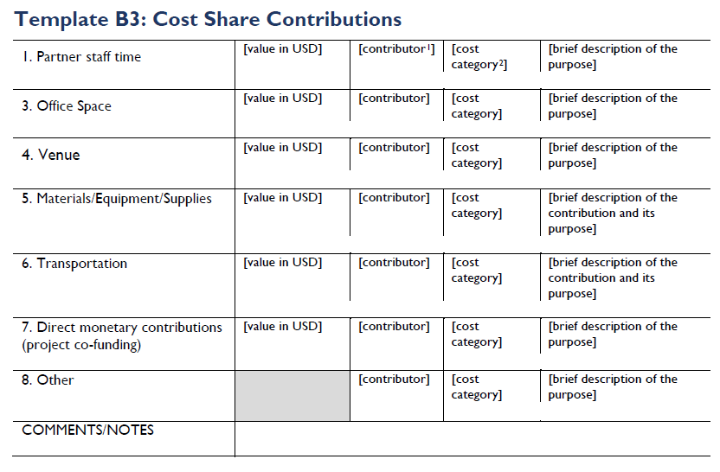
COST SHARE (1)
Cost share, or "matching," refers to the resources that the recipient contributes to the total cost of a project.
Matching becomes a condition of an award when it is part of the approved award budget and is verifiable from the recipient's records; it must be reported on throughout the LOP.
Only non-USG funds or in-kind items not donated by USG, count towards cost share.
Contributions come from the prime recipient directly and/or from its sub-recipients. Cost share can/should flow down to sub-partners, with an awareness of the risks.
Notes:
Slide M 5.1.2/#60
Generally, the cost is not eligible if it is not mentioned in the NOFO.
Many proposals require Cost Share or “matching” resources provided to the activity and included in the budget. This is an appealing element to USAID and needs to be well planned. Only non-USG funds or in-kind items not donated by USG count towards cost share. Many organizations over promise on cost share or do not create the required accounting systems to capture this information.

Slide 126
COST SHARE (2)
Many recipients make the mistake of over-promising on Cost Share within the proposal, and it can be very challenging to meet those commitments during the implementation stage.
  Make sure you have carefully thought through your Cost Share strategy and gotten any subrecipients to sign off on their contributions.
  Be conservative and realistic when proposing the amounts you will contribute, and make sure that all proposed sources are realistic and will remain available over the Life of the Project (LOP).
Notes:
Slide M 5.1.2/#61

Slide 127
BUDGET NARRATIVE
A budget narrative includes:
  Explanations of budget categories
  Descriptions and justifications of each line item
  Sufficient detail for USAID to assess proposed costs and see precisely how its money will be spent
To make it easy for reviewers to understand, ensure that your budget narrative follows the exact format and order of your detailed Excel budget.
Instead of showing mathematical calculations, explain the rationale for the proposed cost items. Justify the quantity and unit costs.
Notes:
Slide M 5.1.2/#62
The Budget Narrative mut mirror the outline of budget spreadsheet and provide sufficient descriptions and justifications for each line item. Remind participants that the budget is reviewed separately from the technical proposal and the reviewers will need sufficient background information to justify the cost.

Slide 128
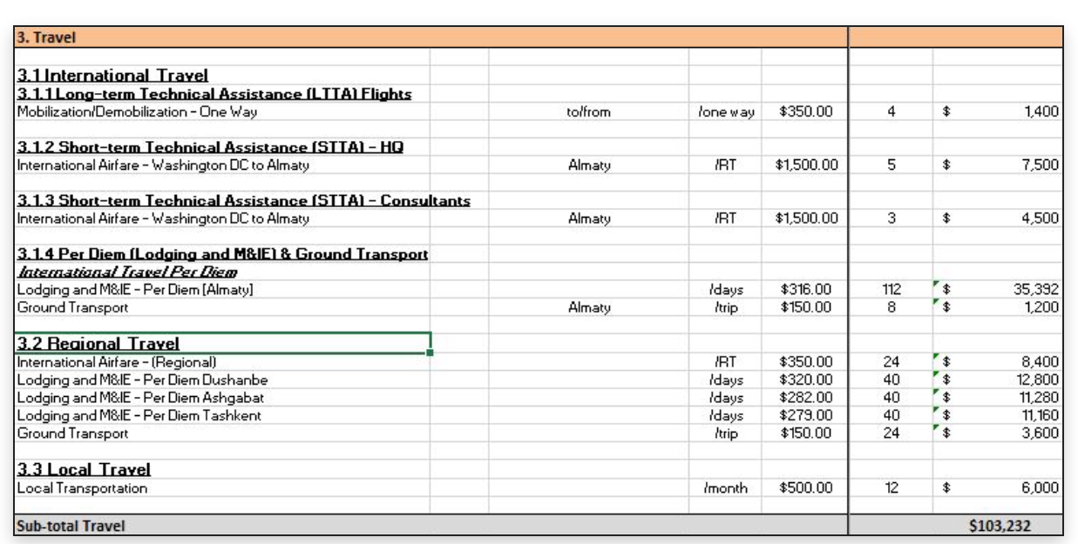
BUDGET NARRATIVE EXAMPLE
3.1.3 Short-term Technical Assistance (STTA) Expatriate/Consultants Flights
The budget includes 3 round-trip airfares at $1,500 on average per airfare from the U.S. city to Almaty for consultants’ travel to post. Airfare costs are based on current Fly America-compliant, refundable economy-class airfare quotes from our in-house travel agent from a U.S. city to Almaty Kazakhstan. Three trips per year are budgeted for each program year.
3.1.4 Per Diem (Lodging and M&IE) and Ground Transport
Per diem is budgeted based on the rates provided in the Department of State Standardized Regulations (DSSR), Chapter 925. The following assumptions have been budgeted per diem: a) International Travel Per Diem: Lodging and M&IE is budgeted at $316/day per the DSSR for international HQ, STTA, and consultants traveling to Kazakhstan. Each trip is budgeted for 14 days inclusive of travel days. We calculated per diem days based on the LOE budgeted under personnel for HQ, STTA, and international consultants. b) Ground Transport: $150 per trip is budgeted for ground transport for HQ, STTA, and consultant travel to Kazakhstan.
Notes:
Slide M 5.1.2/#63

Slide 129
5.2 TIPS AND CONSIDERATIONS FOR A STRONG AND COMPLIANT PROPOSAL PACKAGE
        Get the proposal package ready for review
Once your team has a complete draft, your proposal lead and/or another senior staff member should review the draft to ensure that it is clear, consistent, and professional and that its language reflects the language in USAID’s solicitation.
Obtain as much internal feedback as possible from team members with technical expertise and even from colleagues on other comparable initiatives.
If your organization has a win theme, make sure that your reviewers are aware of this theme and can evaluate its effectiveness.
Make sure they have a copy of the solicitation and highlight the evaluation criteria, as well.
Notes:
Slide M 5.2/#64

Slide 130
KEY CONSIDERATIONS FOR A WINNING PROPOSAL
After a proposal/application has passed the compliance check, USAID reviewers consider three key factors to determine whether it is complete and whether the applicant meets the Agency’s expectations:
Past performance: Experience can help predict success in future efforts.
Cost: USAID aims to fund the best value for high-quality programming.
Responsibility: The Agency will consider financial soundness and business integrity.
Notes:
Slide M 5.2/#65

Slide 131
WRITING/EDITING TIPS
A proposal must grab and maintain the interest of the reader while addressing all evaluation criteria and instil confidence in your technical expertise and ability to communicate.
Be clear: Avoid jargon and overly technical language. If you must explain a technical component of the project, do not assume knowledge or expertise. Spell out all acronyms at first use.
Be consistent: Maintain a consistent tone/voice in your narrative, especially when sections are drafted by different team members. For example, decide if it is appropriate to use “we” to refer to your organization, or to use the third person (e.g., “XYZ Organization).”
Be professional: Avoid informal language, including contractions, and read your proposal from USAID’s point of view to assess how well your idea addresses the needs outlined in the solicitation.
“Mirror” NOFO language: Use the same terminology and framing used in the solicitation. A strong proposal should be very easy for the donor to review, speaking directly to the solicitation’s evaluation criteria.
Notes:
Slide M 5.2/#66
Ask the participants what experience they have had in reviewing a proposal against the requirements.
Some writers will cut past phrases from the NOFO into the outline to mirror elements and ensure they have covered the scope.

Slide 132
TIPS FOR COMPLIANCE WITH THE SOLICITATION
Create a checklist of everything that is required
Only provide what the donor has asked for, and why (for the thing being evaluated, not proposing something the donor is not looking for).
Adhere to the submission deadline.
Meet eligibility requirements. and
Comply with instructions, including page limitations. Pages that run beyond the limit will not be evaluated.
Evaluate and compare/align with criteria.
Notes:
Slide M 5.2/#67
It is very important to create a checklist of what is required and have two reviewers ensure all elements are included. If you do not meet the compliance criteria you will be eliminated from the selection process.

Slide 133
5.3 PROPOSAL REVIEW AND EDITING (1)
Proposal Review Process (1)
Plan for your organization’s reviews at different points in the proposal development process, e.g.:
  Early project design stage
  Mid-way through project design and proposal development
  At the end, before submission
Plan for separate reviews of different aspects/components of the proposal, e.g.:
  Technical and M&E aspects
  Management and staffing aspects
  Financial aspects
  Overall compliance
Notes:
Slide M 5.3/#68
Divide the participants into groups.
Assign half of them the task of identifying the different points in the proposal development process when an internal review (by independent reviewers, not on the proposal team) should take place.
Assign the other half the task of identifying the different components/aspects of the proposal that should be reviewed (by independent specialized reviewers, not on the proposal team).
Have the groups debrief in plenary. Some groups will be tackling the same question, so ask each subsequent one to ONLY add ideas that weren’t already mentioned by groups that presented before them.
Then present this and the following slide to check/validate their ideas and recap what is recommended.
Stress that periodic reviews of the technical and cost applications are critical, and if possible, engage staff not working on the proposal to review and provide feedback on technical and budget content, as well as compliance with USAID requirements.

Slide 134
PROPOSAL REVIEW PROCESS (2)
Identify staff (separate from the proposal team) that can serve as the reviewers of each stage and/or component of the proposal, alert them of timelines well in advance and, if needed, orient them on how to review.
Follow a consistent process for each review; give reviewers instructions with clear deadlines; share the call for proposals with them in advance, pointing out scoring criteria.
Notes:
Slide M 5.3/#69
Review, review, and review again the complete proposal! Periodic reviews of the technical and cost applications are critical.
If possible, engage staff not working on the proposal to review and provide feedback – technical and budget content, as well as compliance with USAID requirements.

Slide 135
AIMS OF DIFFERENT TYPES OF REVIEWS
To assess the pre-planning strategy/goals (review during early stages of design);
To predict competitors’ likely solutions and strategies (review during early stages of design);
To assess proposed partnerships;
To predict how the donor will evaluate your proposal, and propose ways to improve it;
To verify cost proposal matches the technical proposal;
That technical proposal accurately reflects M&E indicators;
To verify compliance and execution of your win strategy;
To review your budget and approve your pricing strategy;
To confirm that your proposal incorporates necessary changes from previous reviews and is ready to submit (final review); and
To record lessons learned (after-action review) and improve your proposal development process.
Notes:
Slide M 5.3/#70
Discuss the aims of these different types of reviews, using this slide as a guide.

Slide 136
REVIEW QUESTIONS
Cost proposal: Does it match the technical proposal and management section?
MEL Plan: Are the selected indicators in line with the technical proposal and does the cost proposal have sufficient funding?
Notes:
Slide M 5.3/#71
Consider the review questions while reviewing the proposal.

Slide 137
TIME MANAGEMENT IS KEY!
Allow at least two weeks for review and editing.
Keep these reviews on a tight schedule; they may undergo multiple organized levels of review with specific goals at each session.
The proposal manager supporting your development team will track the schedule your team develops.
Proposal timeframes are short, so this manager should remind your team members about internal deadlines.
Notes:
Slide M 5.3/#72

Slide 138
5.4 PROPOSAL FINALIZATION AND SUBMISSION
For proposal finalization and packaging, allocate plenty of time on the proposal development calendar for:
Copy-editing: Check for spelling errors, grammar, consistent word use, acronyms, etc.
Formatting: Include headers, footers, page numbers, signatures, alignment, tables, text boxes, graphics, etc.
Packaging: Compiling the various components and meeting requirements (number of hard copies, etc.)
Final compliance check/sign-off
Notes:
Slide M 5.4/#73
Ensure that you build in time during your proposal development schedule for an editor to review your narrative for grammar, punctuation, American English spelling, formatting, clarity, and flow. The editor should reference the formatting requirements in the solicitation and the guidance in the USAID style guide to ensure a compliant, high-quality document.
When packaging the proposal, be sure to label all attachments as Annex 1 of 4, Annex 2 of 4, and so forth.
Submitting an error-free proposal shows the donor that you are detail-oriented and attentive to the quality of your work.
It is also important for your editor to help your team adhere to any page limitations stated in the solicitation, as the donor will not review any pages beyond the stated limit.

Slide 139
PROPOSAL SUBMISSION
Aim to submit your application 24 to 48 hours before the deadline (in case of ICT problems, for instance, and other unforeseen last-minute issues).
Ensure that you use the correct submission email address; copy others at your organization.
Review the solicitation for any email size restrictions or other submission instructions.
Ask the donor for confirmation of receipt. (Call them, if needed).
Notes:
Slide M 5.4/#74
Share practical examples of when things – which may seem so simple – have gone wrong and all the efforts made to develop the proposal went wasted. For instance, the horror stories of the internet going down right when the team was trying to send out the proposal and them missing the deadline, or the proposal being sent to the wrong address and the team not realizing it until it’s too late; or the package file size is too big and either refusing to send or bouncing back. These real examples offer insight into the reasons why it is so important to build in buffer time and aim to submit the proposal before it is due – rather than waiting until the last minute.
Also point out the importance of noting what time it’s due in WHICH TIME ZONE.
It’s important to emphasize that an on-time but imperfect proposal can win, but a late perfect proposal will never win. USAID is extremely strict about its submission deadlines, and it will not consider or read any proposal that is received after the stated deadline.

Slide 140
MODULE 6:
POST-SUBMISSION PHASE
Notes:
Slide M 6. /#1

Slide 141
But we submitted the proposal – aren’t we all done?!
Notes:
Slide M 6. /#2
Ask the participants in plenary: Why are we presenting a section called “post-submission phase? We submitted the proposal – aren’t we all done now?!
Have them brainstorm what possibly could still remain to be done. Take a few hands from in-person participants or have virtual participants type their ideas into the chat box.

Slide 142
6.1 RECOMMENDED POST-SUBMISSION ACTIONS
Hold an after-action review involving the proposal team and reviewers; you might also have a separate one with the consortium partners.
Debrief as a team to discuss how you might improve the process the next time you apply for an award.
Prepare for the donor to come back with questions/clarifications on your application.
If the donor notifies you that you weren’t successful, request in writing a debrief or a copy of their evaluation of your response (within 10 days of notification from USAID).
Use any feedback obtained to build expertise, enhance systems, and reassess alignment with donor priorities.
After USAID has announced that your proposal has won, notify all consortium members.
Notes:
Slide M 6.1/#3
Then project and read this slide to validate their guesses and fully answer your above question.

Slide 143

KEEP LEARNING AND PRACTICING
Writing a USG proposal requires teamwork, attention to detail, and awareness of deadlines. The process can be daunting for organizations that have never applied for such awards, but with discipline and motivation, you can craft a strong and competitive proposal package.
Each time you apply for another proposal, you will get better and better at it – especially if you are applying the learnings from post-action reviews and the feedback you get from the donor.
Notes:
Slide M 6.1/#4
When presenting this slide, try to be motivational and inspirational – this is the last slide of the training and is meant to give the participants hope and confidence that they can do this… despite how challenging it is.

Slide 144

6.2 WRAP UP & FINAL Q&A
Notes:
Slide M 6.2/#5
Wrap up the training session as follows:
Conduct a brief energizer activity that gauges how they are feeling about the process. A few options are as follows:
Have them stand on an imaginary line that represents a continuum of “no confidence to high confidence” – and have a few of those on the extreme ends explain why. OR
Ask them to raise a colored piece of paper (having handed out one set to every participant in advance) to explain how they are currently feeling about the proposal process, whereby red means ‘not good’, yellow means ‘fine/OK’, and green means ‘great’ – and have a few from each color group explain why. OR
Ask them to rate their current level of confidence/readiness to undertake the proposal process on a scale of 1-5, with 1 being ‘very low’ and 5 being ‘very high’ – and have those in the extremes explain why.
Conduct a final Question-and-Answer (Q&A) session in plenary. If time allows and if you have the available experts, an interesting way to do this could be to have a panel of BD experts – and allow time for the participants to ask them questions. The trainer/facilitator would moderate the session.
As appropriate, representatives from the donor, organizer and other key partners conduct speeches to emphasize key take-away messages, thank the participants (and any panelists), and make closing remarks.
For in-person events, it can also be nice to conclude by having the participants share their main observations on what worked well and what they would’ve liked to be done differently. Have everyone stand in a circle, then toss a ball to random participants; when they hold the ball, it is like a microphone and only they are allowed to speak. They must share one positive aspect and one negative aspect about the training, then they toss it to someone else. Depending on how large the group is, this can be done just for a selection of participants – or for everyone.
After the training, be sure to send an email to all the participants thanking them for their participation and sending the training manual and slides as well as other resources for future use.

Slide 145
Thank you for your time and active participation!
This publication is made possible by the support of the American people through the United States Agency for International Development (USAID) and the President’s Emergency Plan for AIDS Relief (PEPFAR). The contents are the sole responsibility of IntraHealth International and do not necessarily reflect the views of USAID or the United States Government.

