Slide 1
ASAP Webinar for USAID Local Partners:
COP23/FY24 Expenditure Reporting
September 17, 2024
Erin Dunlap & David Song
USAID/OHA Expenditure Analysis Branch
Notes:
Note: this session will be recorded

Slide 2
Please type an answer to either of the questions in the chat box:
What was your biggest challenge reporting to ER, in previous years?
OR
What is your greatest concern, if you are doing ER for the first time?

Slide 3
Welcome and Agenda
Overview of the PEPFAR Financial Framework
Requirements/What’s new for FY24 reporting
ER Resources to Assist IPs
USG Financial Data Use
Q&A and Discussion
Notes:
Time for questions at the end of each section

Slide 4
What is the PEPFAR Financial Framework?
Notes:
Note: this session will be recorded

Slide 5
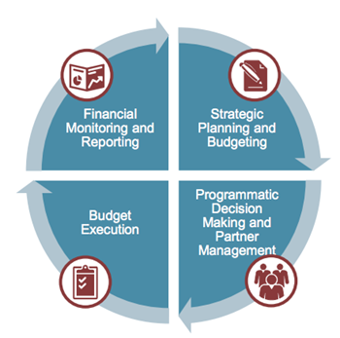
Introduction to the PEPFAR Financial Framework: Why Must We Report on Budget & Expenditure Data?
Increase reliability, usability, and timeliness of financial data to achieve program impact
Improve accountability and efficiency of PEPFAR programs
Clarify linkages between COP/ROP (Country Operational Plan/Regional Operational Plan) and central funding budgets, program implementation, budget execution and financial management and reporting
Notes:
Already report to USG w/SF-424 and other financial reports, but the distinction here is PEPFAR financial data
--using historical budget and expenditure data to set future budgets

Slide 6
Financial Process Timeline
COP Budgeting
Work Planning
Expenditure Reporting
Jan
Feb
March-May
June-Aug
Sept
Oct
Nov
Dec
Agency inputs to COP level budgets
Planning Level Letters released by SGAC, which sets topline funding by Agency & OU Earmarks
COP Budget Development & Approval Meetings
Partner Work Plan Development
Final Work Plans Approved
Close of Fiscal Year & Kick Off of Expenditure Reporting
Initial Expenditure Reporting Completion & Partner Submission
Partner Revisions & Final Expenditure Reporting Submission
**starting with COP23/FY24, work plan budget templates no longer need to be submitted in DATIM

Slide 7






Financial Classification Overview
Goal: To have common classifications across both budgeting and expenditure reporting that will answer the following questions:
Organization classification: Who is spending the money?
Program classification: What is the purpose?
Beneficiary classification: Who is benefitting?
Interaction type: Is there direct interaction with the beneficiary?
Cost category: What is being purchased?

Slide 8


How is an “Intervention” Categorized in PEPFAR’s Framework?
Whether the intervention is happening at the site or across PSNUs/SNUs
Site-Level
Site Level
Above Site
Care & Treatment
Testing
Program Management
The purpose of the activities implemented
Program Area
Prevention
Socioeconomic
Above Site Programming
Whether the activity directly interacts with the beneficiary (SD) or supports or strengthens the site, service providers, SNU, or national system (NSD)
Interaction Type
Non-Service Delivery
Non-Service Delivery
Service Delivery
Beneficiary
Key Pops
OVC
PBFW
Which population resources are being allocated to serve
Children
AGYW
Military
Non-Targeted

Slide 9



The Building Blocks of IM-Level Budget & Expenditures
PEPFAR Financial Framework
ER Only!
Program Area
(C&T, HTS, PREV)
Interaction Type
(service delivery (SD) & non-SD)
Beneficiary
(Pregnant women, Key Pops)
Cost Category
(Salaries, travel, supplies)
INTERVENTION: Determined by in-country teams and approved by GHSD during the COP process. Interventions are the basis for both budgeting (as reflected in the FAST) and expenditures (as reflected in ER submissions)
For EXPENDITURE REPORTING ONLY, Partners further breakdown interventions by cost categories = “what we are buying”

Slide 10
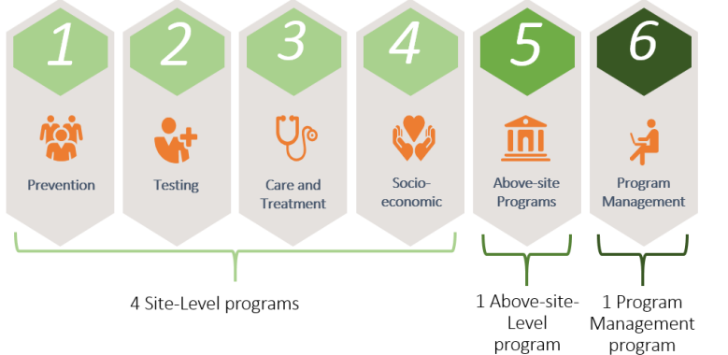
Financial Classifications: #1 Program Area
Program areas are the broadest aggregation of PEPFAR efforts, encompassing everything PEPFAR does to achieve and sustain control of the HIV/AIDS epidemic
Each program area is disaggregated into subprograms, which are unique to the program
Notes:
SGAC defines a program as a “distinct organization of resources directed toward a specific strategic objective, or, alternatively, a set of activities that achieve a common outcome.” A single activity should not be classified in isolation of its broader purpose and common outcome since the same or similar activities may be implemented to achieve different purposes.
Program classification is the broadest aggregation of PEPFAR efforts. The sum of the six major program areas, Prevention, Testing, Care and Treatment, Socioeconomic, Above-Site Programs and Program Management, encompasses everything PEPFAR does within a mechanism to achieve and sustain control of the HIV/AIDS epidemic. All programs are directly related to HIV control, thus ‘Testing’ is ‘HIV Testing’ and ‘Prevention’ is ‘Prevention of HIV’, etc.
A major change to the program classification structure from years past is that there is no longer an Orphans and Vulnerable Children program area. OVC has been replaced by the Socioeconomic program area and OVC is now categorized as a beneficiary group, which I’ll explain later in further detail.
The first level of classification for PEPFAR programs is whether the programs are implemented at the site or above-site level. Site level programs are those that have the purpose of interacting with beneficiaries or personnel at the point of service delivery, for example, in facilities or communities. Above-site level programs are those that have the purpose of supporting personnel or systems at the SNU or central level, for example the health system.
Of the six major PEPFAR programs, four, Prevention, Testing, Care and Treatment and Socioeconomic are at the site level and two, Above Site Programs and Program Management, are at the above-site level. Each of these programs is further disaggregated into subprograms, which are unique to the program area.

Slide 11
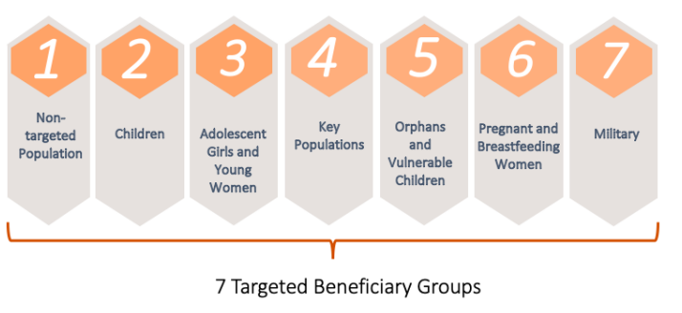
Financial Classifications: #2 Beneficiary
The targeted beneficiary populations are the intended recipients of the PEPFAR programs. The following requirements must be met:
Specific activities that clearly help the targeted beneficiary group in a unique way
Severable funding that is easily accounted for separately from other interventions, especially those with similar program areas.

Slide 12
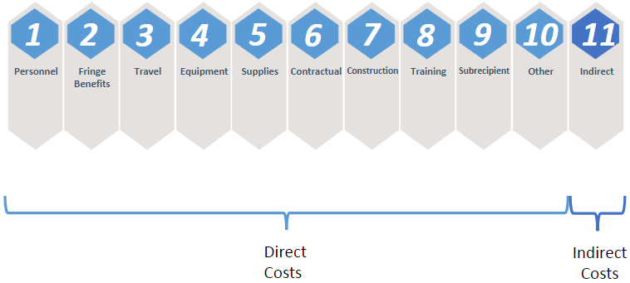
Financial Classifications: #3 Cost Category
What is the implementing partner purchasing with their PEPFAR money?
*This Data Element is ONLY introduced during Expenditure Reporting

Slide 13
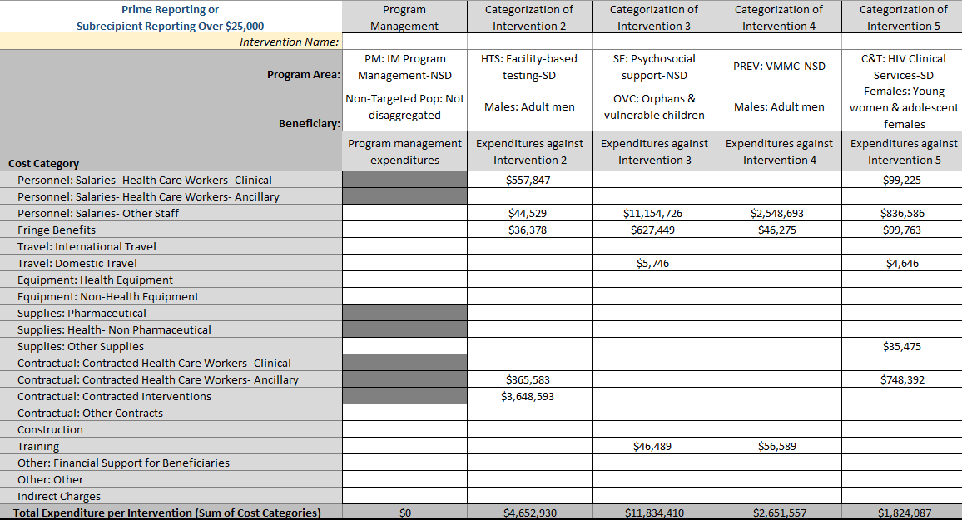
Expenditure Reporting Template
Going down the column we see investments by unique interventions of spend per program area, beneficiary, and cost category
1
2
3
Notes:
The first step when thinking about how to classify your expenditures from the past fiscal year is to select the Program Area. We will be reviewing how to correctly enter expenditure information into this template later on this presentation, but for now it’s important to remember that you always need to work your way from top to bottom on the template, first selecting the program area followed by the beneficiary then object class/cost category.

Slide 14
Questions?

Slide 15
COP23/FY24 Expenditure Reporting Requirements & What’s New?

Slide 16

PEPFAR Expenditure Reporting Process Basics
Methodology
Report all expenditures for the fiscal year that just ended, COP23/FY24
(Oct 1, 2023 – Sept 30, 2024)
Cash basis of accounting, from the perspective of the reporting partner
Reported annually in USD ($), not local currency!
Only PEPFAR funding (i.e. do not count USAID malaria $, or Gates HIV $)
The Prime Partner is responsible for completing ER through either method:
1) directly entering into DATIM all FY24 expenditures on behalf of all IPs
OR
2) Uploading and submitting all eligible ER templates (prime and all subs) into DATIM, for successful completion of this PEPFAR reporting requirement
For complete definitions of program areas, beneficiaries, and cost categories please refer to the ‘PEPFAR Financial Classification Reference Guide” found on datim.zendesk.com.

Slide 17
Reminder: One Partner Per Template!
Partner
Template
Submission
Prime Recipients
Complete expenditure template detailed by cost category for PRIME expenditures
Upload Prime AND all separate subrecipient templates to DATIM, ensure total across templates reflects mechanism total expenditures
Subrecipient or prime partner (on behalf of the sub) completes one separate template per subrecipient, with data detailed by intervention only.
Subrecipient with ≤$25,000 in expenditures
Send to Prime partner for review & DATIM submission
Subrecipients with >$25,000 in expenditures
Subrecipient completes their own expenditure template detailed by cost category
Notes:
Also new this year- ALL first tier subs are now expected to have their OWN template submitted in DATIM. This expands on the detailed reporting for subrecipients with greater than $25k that was started last year. This year, first tier subs (as in, directly contracted with the prime) will each have a template, however, subrecipients with greater than $25k in expenditures will detail their costs by cost category and subrecipients with less than $25k in expenditures will still only detail their costs by intervention (program area, interaction type, and beneficiary)- similar to previous years. The Prime partner will still be responsible for uploading all first tier sub templates along wi

Slide 18
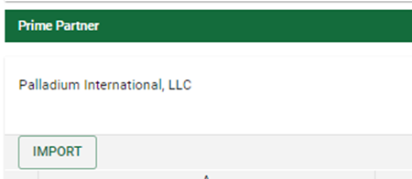
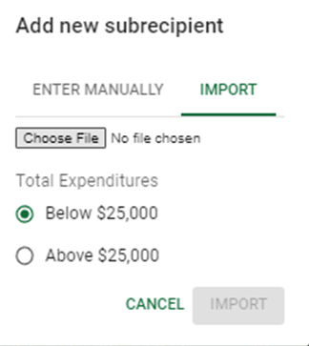
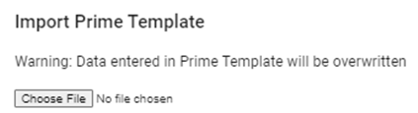
Reminder of changes from last year!
Import Template Option:
  Each partner will complete their own template, using ONE of the following tabs:
  Primes will upload or enter their own template, then each template for each sub
1
3
2

Slide 19
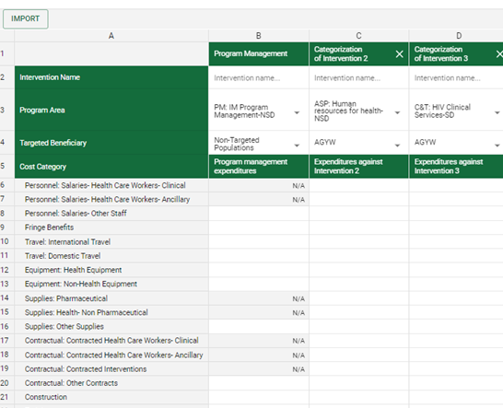
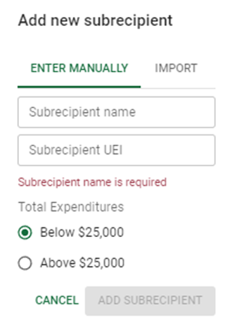
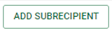
Reminder of changes from last year!
Direct Data Entry Option: Add each subrecipient separately!
  Primes will complete the online data entry in the ERB processor app, adding subrecipient data directly or copy & pasting subrecipient data from templates
Hybrid Option: Import or manually enter each subrecipient!
1
3
2

Slide 20

What’s New: Clarified Cost Categories & Program Areas!
No substantive changes to any of the reporting categories
Clarifications to guidance on specific program area, beneficiary, and cost category definitions
Intended to reduce overlap and answer common questions about where costs should be classified
Tip: Use the Ctrl+F function on your keyboard to search for keywords related to your question like “vehicle” or “bank fee”

Slide 21
What’s New: Targeted Beneficiary Reporting!
Targeted Populations:
Children
Adolescent Girls & Young Women (AGYW)
Key Populations
Orphans & Vulnerable Children (OVC)
Pregnant & Breastfeeding Women
Military
Non-targeted population
Select a targeted group if both criteria are met:
Activities planned for the population are specialized and targeted to meet the specific needs of that population group.
The activities have costs separate and identifiable from work for other beneficiary groups.
Otherwise- select “Non-targeted population” and your expenditures will be automatically ALLOCATED to sub-beneficiary groups based on your MER results!

Slide 22
What’s New: Allocated Beneficiary Applied Later, Upon Data Processing, Based on MER Results!
Example: A general population care & treatment program, non-targeted in its design, serves both KP and non-KP
Example: A tailored care & treatment program designed to reach key populations serves MSM and FSW
Targeted Beneficiary
$10M Non-Targeted C&T
$10M Key Populations C&T
MER Target/Results
200 MSM TX_CURR
200 AGYW TX_CURR
300 Non-KP Women Age >24 TX_CURR
300 Non-KP Men Age >24 TX_CURR
700 MSM TX_CURR
300 FSW TX_CURR
Auto Allocated Beneficiary in Dataset
$2M MSM
$2M AGYW
$3M Adult Women
$3M Adult Men
$7M MSM
$3M FSW
200 MSM TX_CURR = 20% of MER results, so 20% of $10M is $2M allocated to the MSM beneficiary. Read more here!
Notes:
In this example, two different programs support MSM amongst other populations. In the first example, a general C&T mechanism provides “not targeted” services. While the targeted beneficiary is considered “non-targeted”, a allocated beneficiary calculation is still made using MER targets- thus acknowledging the resources expected to serve MSM. In the second example a KP targeted C&T program serves both MSM and FSW. The intervention is considered targeted toward Key Pops, and an allocated beneficiary is calculated using MER targets to determine what proportion of funds are attributable to MSM.
For further information, please check out the “Allocated Beneficiary Guide” available on DATIM Zendesk.

Slide 23
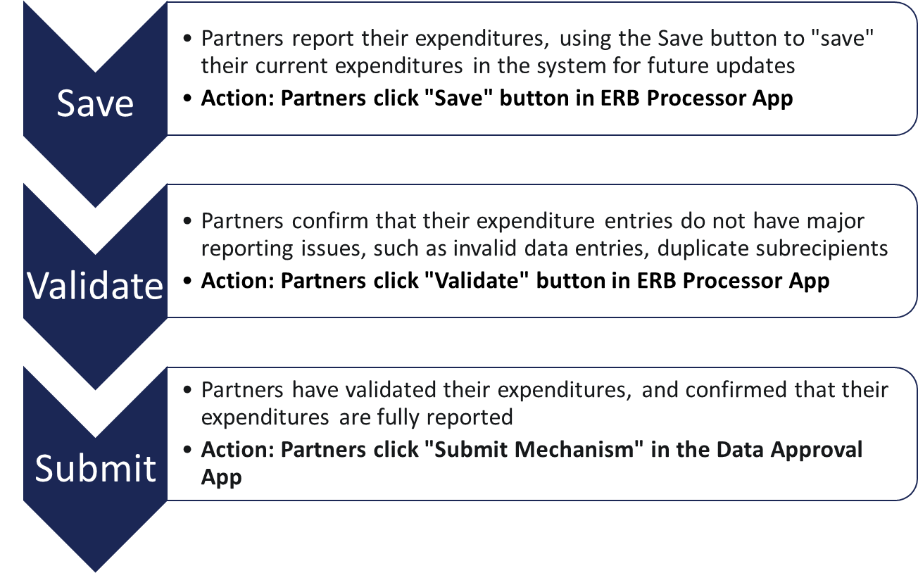
What’s New: Save! Validate! Submit!
1
Partners will need to ensure that they have successfully clicked "Submit Mechanism“ in the Data Approval App.
Otherwise, the partner's expenditures will not be successfully reported to PEPFAR.
2
3

Slide 24
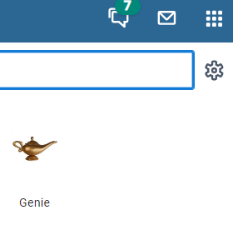
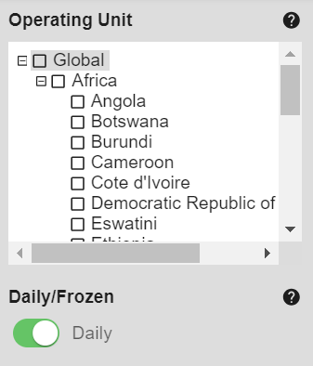
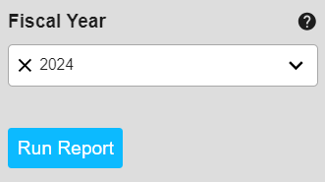
What’s New: Exporting Expenditures via Genie!
New this year missions and partner’s can DOWNLOAD a structured dataset of their data using the DATIM Genie app!
As in previous years- within the ERB Processor App, each partner within a mechanism will also have an "Export" button that will produce an excel export that shows entries in a template format
1
2
3
Users can select data on expenditures from the reporting year (FY24), historic year’s data, and budget data for reference and review
Select ER Financial Structured Dataset report type option

Slide 25
COP23/FY24 Q4 Expenditure Reporting Timeline
Date | Owner | Expenditure & HRH Reporting
Prior to 10/1 | Partner | DATIM users (prime partners only) request accounts or reactivate expired accounts for ER & HRH
Oct 1 | Partner | DATIM OPEN: The soonest IP can upload FY24 IM ER & HRH submissions
Nov 15 | Partner | INITIAL ER & HRH SUBMISSION DEADLINE
Nov 22 | USAID | DATA RELEASE: Initial submission dataset released and available to aid USAID review of initial IP submissions for data quality (OHA resources available)
Dec 2 | Partner | DATIM OPEN: IP cleaning and re-upload of FY24 IM expenditure & HRH reporting
Dec 13 | Partner | FINAL ER & HRH SUBMISSION DEADLINE

Slide 26
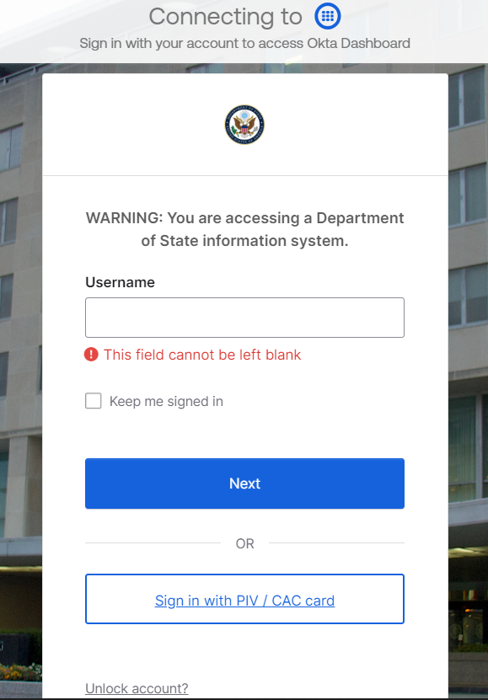
Okta & DATIM Accounts
As of June 18, 2024, DATIM now requires Okta Single Sign On (SSO) and Multi-Factor Authentication (MFA).
You are now only able to access DATIM using an Okta account through state.okta.com. If you are an active DATIM user, you should have received an email from Okta/SE-ICAM that guides you through the Okta account and Okta Verify registration and setup.
If you did not receive an Okta activation email (and after checking your junk or spam folder), please submit a help desk ticket: https://ghsddatasystems.zendesk.com/hc/en-us/requests/new

Slide 27

Okta & DATIM Accounts
At least one person from each prime partner organization will need to have a registered ER/Budget DATIM.org account in order to successfully upload and submit an ER template in DATIM
If you have logged into DATIM the past 95 days:
  Access will be granted to DATIM automatically as your account has not been deactivated due to lack of activity
If you have not logged into DATIM the past 95 days, your account has been deactivated, and you will need to contact your DATIM User Administrator here to start the reactivation process:
Go to register.datim.org
Select “Contact my DATIM user administrator about something else”
In the “Message to User Administrator” section request account reactivation, making sure to include your DATIM username.
Once activated, you will be directed to migrate your account to Okta upon attempted login
If you have not logged into DATIM at all:
  Users without existing DATIM accounts will need to request a new account.
    Register at https://register.datim.org/

Slide 28
Unique Entity Identifier (UEIs)
EVERY organization will need to include their Unique Entity Identifier (UEI) with their ER submission, regardless if you are a prime partner or a subrecipient partner.
More background information regarding the UEI can be found here
If a subrecipient UEI is unknown at the time of reporting, use '111111111111' (12 digits).
If a subrecipient is not required to have a UEI (such as PIOs), please enter '999999999999' (12 digits). TBD subrecipients are not permitted to report.
For G2G awards, the person completing the template will need to enter a dummy number of 111111111111 (the "1" digit entered 12 times) for any field asking for a partner “UEI” in the ER template.

Slide 29
Data Entry Options:
-Offline downloadable ER template
-Direct entry in DATIM

Slide 30
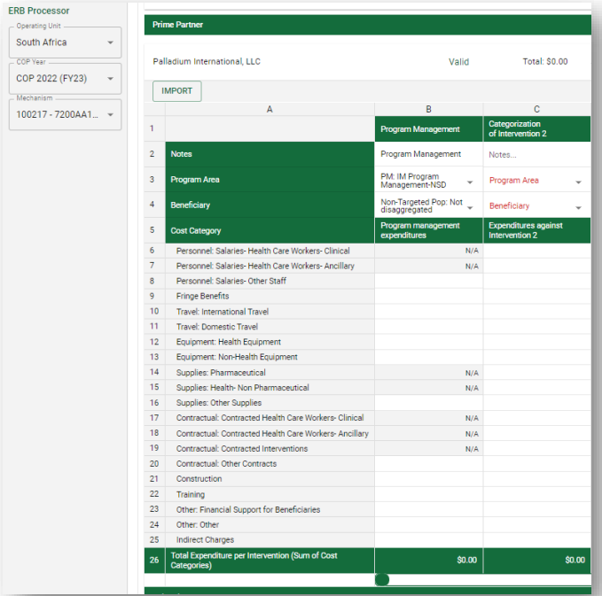
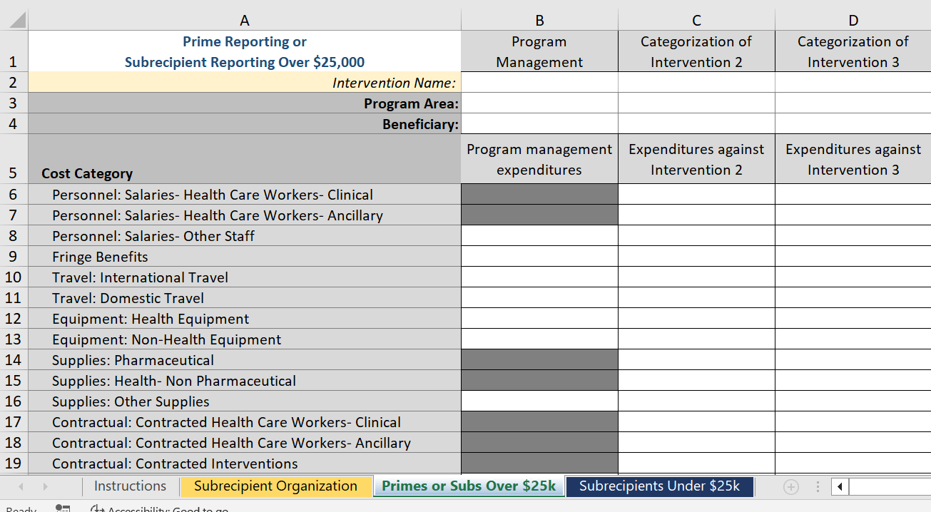
Data Entry Instructions in DATIM>ER Guidance> Section 3
Option 1: Direct data entry instructions
OR
Option 2: Offline ER template completion instructions
Check out this direct data entry demo video!

Slide 31
Data Submission Options:
-Offline ER Template
-Direct entry in DATIM

Slide 32
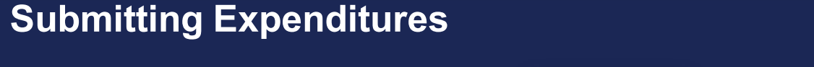
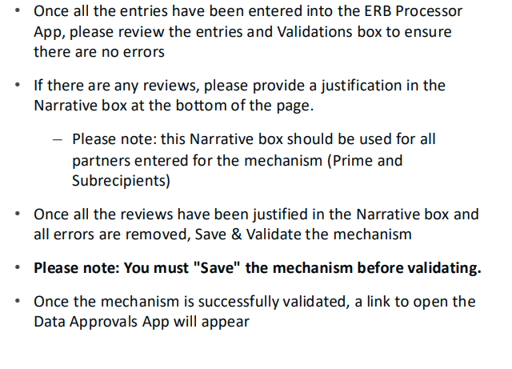
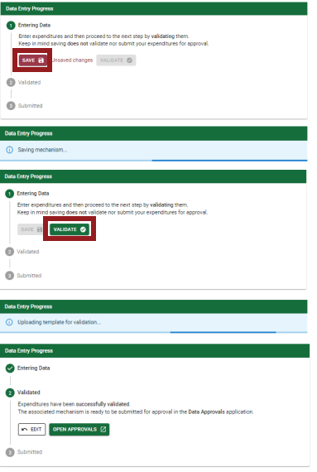
Data Submission Instructions in DATIM>ER Guidance> Section 4
Don’t Forget! All users must submit their ER submission in the Data Approval App!
Offline ER template submission instructions
Direct data submission instructions

Slide 33
Questions?

Slide 34
COP23/FY24 Expenditure Reporting RESOURCES

Slide 35
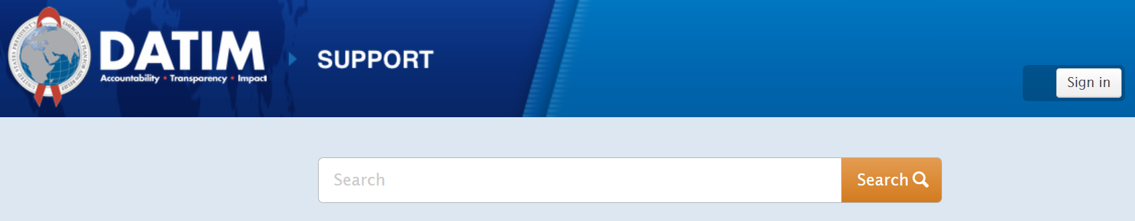
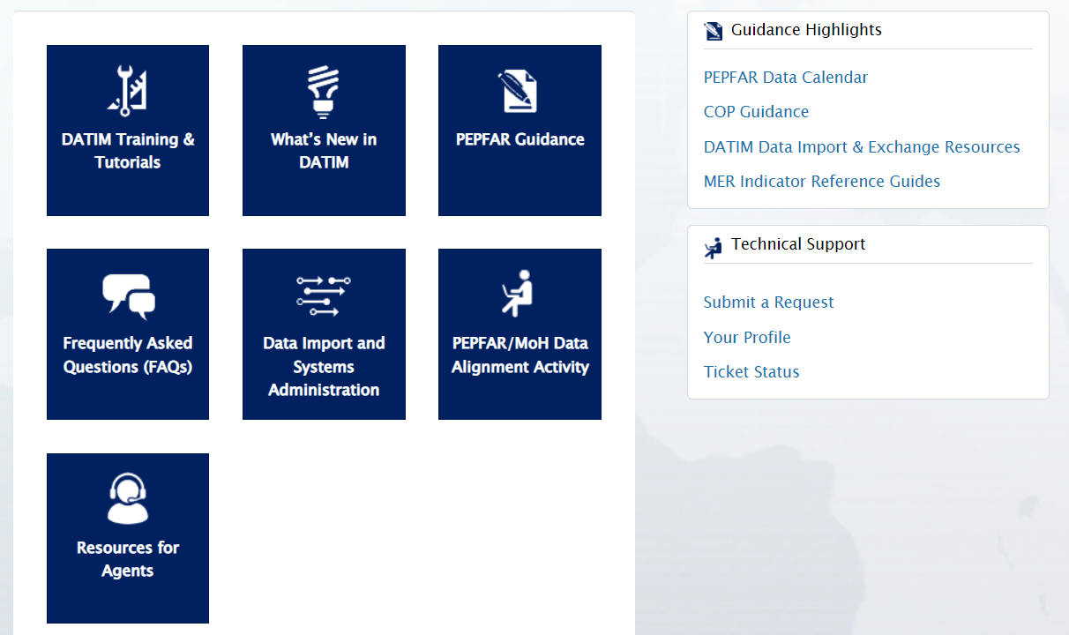
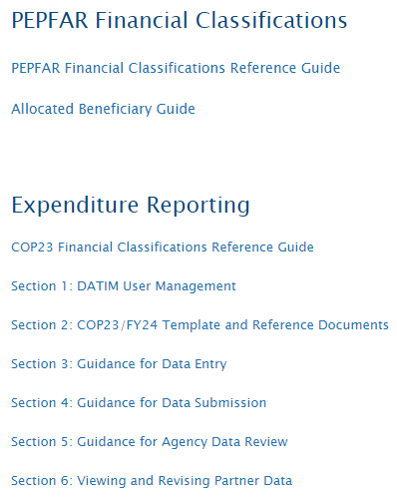
Expenditure Reporting Available Resources: Guidance
Resources *NOW* Available On DATIM Zendesk:
Guidance for data entry
Guidance for data submission
COP23/FY24 ER template
Classification Reference Guide dated August 2024
What’s New for COP23/FY24 Reporting?
Navigate to datim.zendesk.com,
PEPFAR Guidance

Slide 36
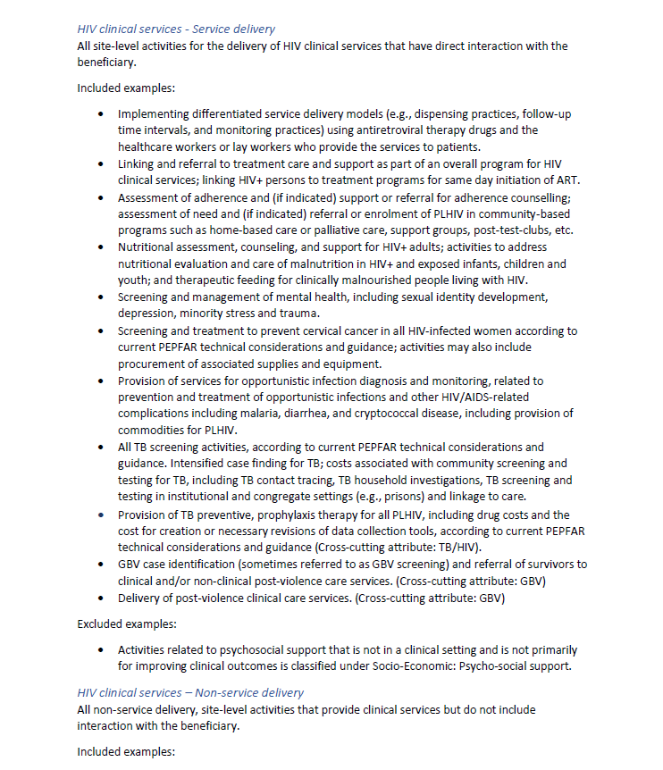
The Financial Classification Reference Guide Has All of the Answers to Your Questions!
Common questions:
Should a certain activity be categorized as service delivery or non-service delivery?
Which cost category should I choose to allocate IP office rental expenditures
Should referrals and linkage related activities go under testing or treatment?
I don’t see a DREAMS beneficiary as an option, which group should I choose to classify DREAMS activities?
Navigate to datim.zendesk.com>PEPFAR Guidance>Expenditure Reporting> COP23/FY24 PEPFAR Financial Classification Reference Guide

Slide 37
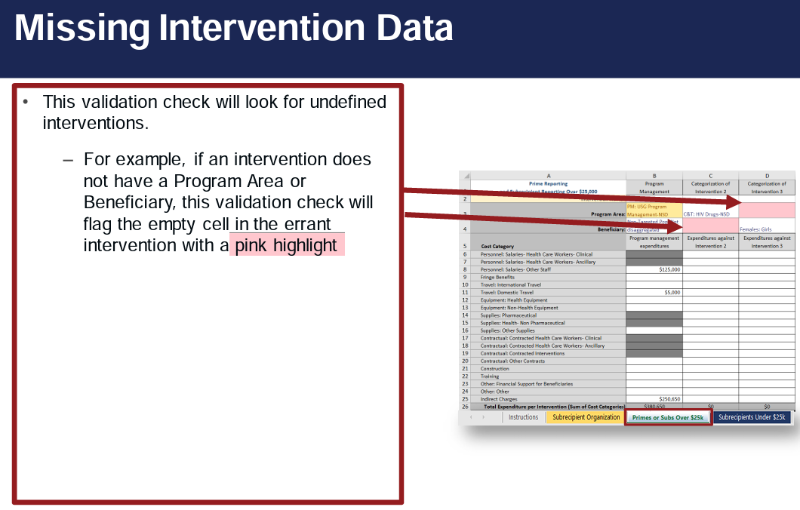
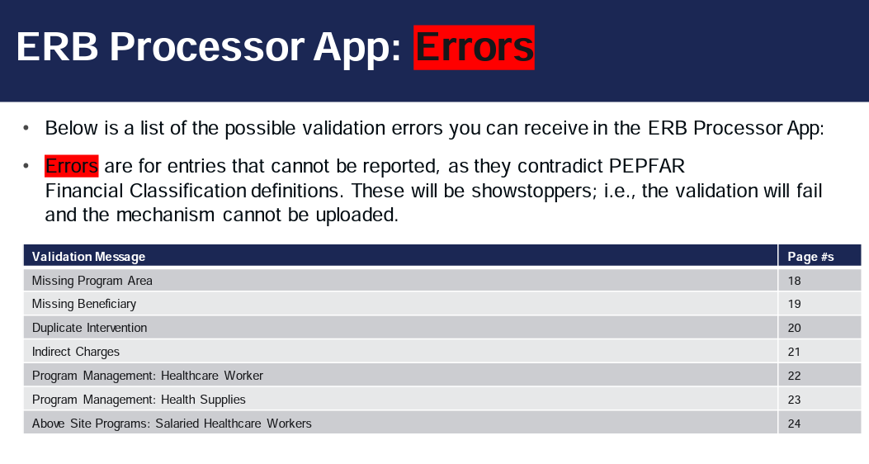
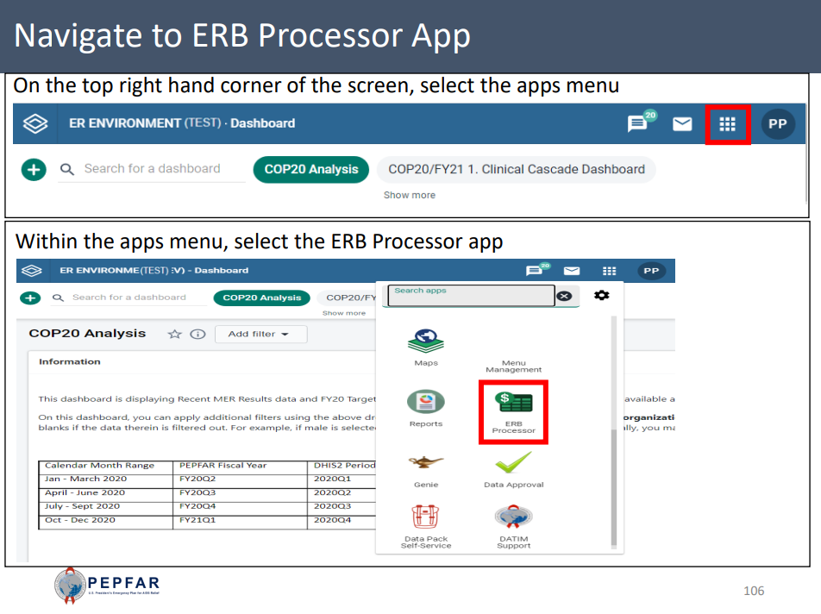
Step-by-Step Instruction on Errors, Warnings, & How to Successfully Upload & Submit
How to I clear this red flag error? How do I submit in DATIM?:
List of all errors and warnings
Step-by-step instructions on how to clear errors or better understand warnings
How to submit a template OR complete direct data entry
Navigate to datim.zendesk.com>PEPFAR Guidance> Expenditure Reporting> Section 3: Guidance for Data Entry & Section 4: Guidance for Data Submission

Slide 38
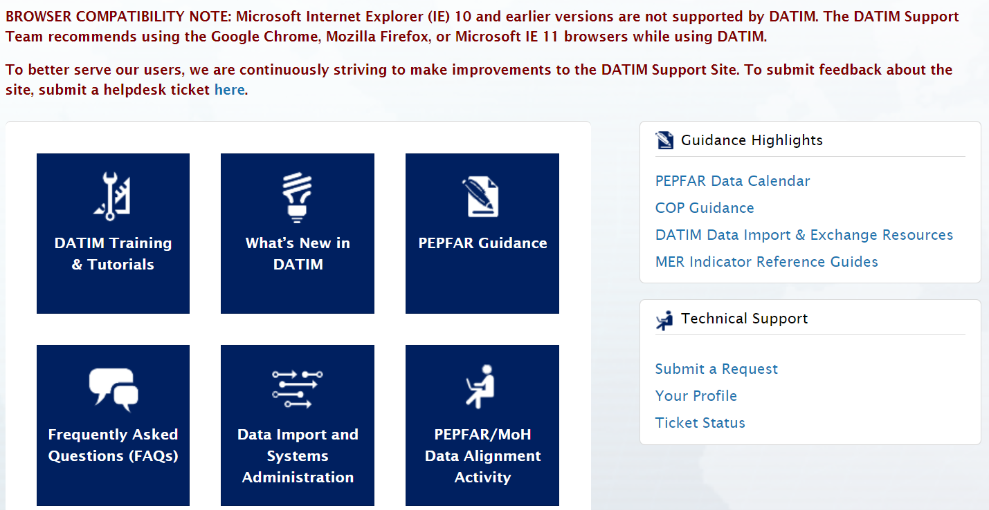
Expenditure Reporting Resources: Help Desk Tickets
Reasons to Contact the Help Desk:
Invalid template upon upload and cannot clear the error after checking DATIM tutorials
Mechanism is missing in DATIM
Cannot upload/submit
Cannot reject/recall a template
Username/password issues
Technical glitches or questions navigating the system
Navigate to datim.zendesk.com, click on ‘Submit a Request’

Slide 39
USAID-Specific Resources
COP23/FY24 COP Budget Reference Files (reach out to your COR or activity manager to request this)
For IP: USAID ER Submission Guidance
For IP: USAID Classification Guidance
Additional materials for new partners:
  Best Practices for USAID Implementing Partner Reporting
  Financial Data Quality Framework
Distributed to USAID Country Teams on September 6, please reach out to your AM or A/COR or oha.ea@usaid.gov to request a copy of these resources

Slide 40
Technical Assistance for All USAID IPs and OUs
Each OU USAID team will have a HQ-based USAID ER backstop to support the ER process.
Backstops will provide oversight and high-level technical assistance, particularly around data analysis and use
Questions regarding categorizations, or definitions of program areas/cost categories can also be routed to your A/COR, and/or you can contact someone from the EA team at OHA by emailing oha.ea@usaid.gov.
For all questions related to DATIM submissions (error upon upload, forgotten password, IM does not appear in DATIM, data approval app isn’t visible, etc.),
please contact technical support at DATIM Zendesk by clicking on ‘Submit a Request’

Slide 41
Questions?

Slide 42
PEPFAR Financial Data Quality

Slide 43
How is an “Intervention” Categorized in PEPFAR’s Framework?
Components:
Whether the intervention is happening at the site or across the PSNU/SNU/OU
Site-Level
Site
Above Site
C&T
HTS
What kind of activities are being implemented
Program Area
PM
ASP
PREV
SE
Whether the activity directly interacts with the beneficiary (SD) or supports or strengthens the site, service providers, SNU, or national system (NSD)
Interaction Type
Non-Service Delivery
Non-Service Delivery
Service Delivery
Beneficiary
Key Pops
OVC
PBFW
Who benefits from the activity- note that above site interventions are typically non-targeted
Children
AGYW
Military
Non-Targeted

Slide 44
Where we know there issues of clarity in the guidance
From piloting USAID’s data quality protocol, we found there’s often confusion around:
Non-site Program Management (PM)
Site level (C&T, HTS, PREV, SE) management & supervision
VS.
Let’s go through each of these!
Above Site Programming (ASP) Program Area
Site Level Non-Service Delivery
Interaction Type
VS.
ER Data “Program Management” staff reporting
HRH Data “Program Management” staff reporting
VS.
Splitting/ Disaggregating Costs
Lumping/ Aggregating Costs
VS.

Slide 45
Points of Classification Clarification
Site-Level Management |  | Non-Site Program Management
Non-service delivery costs for facility or other point of service personnel or efforts at the site to manage or supervise Care & Treatment, Testing, Prevention, or Socioeconomic activities. | Vs | “Program Management” program area expenditures incurred by the Partner as mechanism management & operations costs associated with implementing the award (e.g. admin/legal/finance staff, office rent, etc.).
Site-Level Non-Service Delivery |  | Above Site Programming
An Interaction Type for activities (e.g. training, supervision, and mentorship) that support or strengthen the facility, site, or service providers without directly interacting with the beneficiary. | Vs | A Program Area for activities that support the broader health system such as national and subnational-level quality improvement, surveillance and health systems strengthening.
HRH Inventory Program Management Staff |  | ER/Budget IP Program Management Staff
Non-site level salaries and fringe for staff associated with award management & operations (e.g. finance, legal, admin, support, etc.) Only one primary program area may be selected for each individual staff. | Vs | Partner’s non-site level costs associated with staff time for award management & operations (e.g. finance, legal, admin, etc.) – salaries & fringe may be split across PM & other interventions as needed.

Slide 46
Finding a Balance in Allocating Budget & Expenditures Interventions
Issue of “preponderance” most largely impacts interaction type: Service Delivery & Non-Service Delivery
Ex. Reporting a large non-kp general pop with SD and NSD as separate interventions
Ex. Reporting a small KP HTS intervention that does index testing
SPLITTING: Disaggregate interventions to highlight breadth and depth of program approaches
LUMPING: Group interventions to demonstrate a more cohesive picture
Cons:
Reduces precision of detailed expenditure reporting
Cons:
Reduces accuracy of estimates for shared costs
Notes:
*There’s no “one size fits all” approach for expenditure reporting…
*More detail doesn’t necessarily equal better reporting
*Report expenditures at the level you’d typically budget at
*Focus on program outcomes rather than inputs
*USG field ensures similar interventions across similar types of mechanisms

Slide 47
PEPFAR Financial Data Use

Slide 48
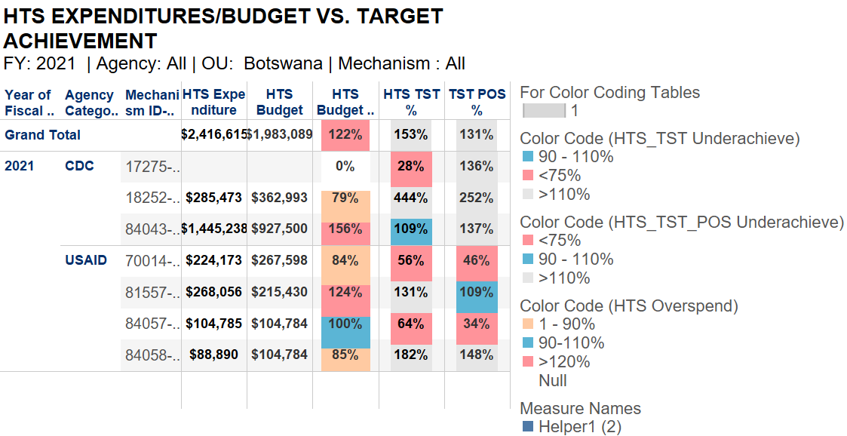
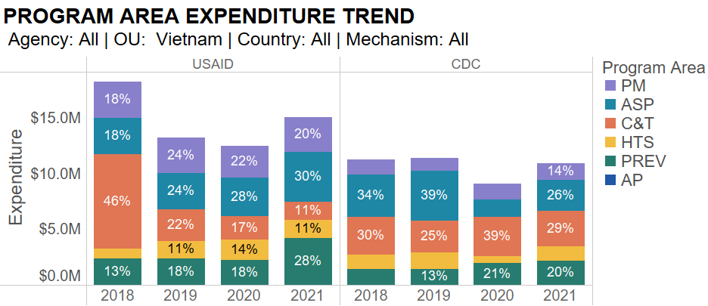
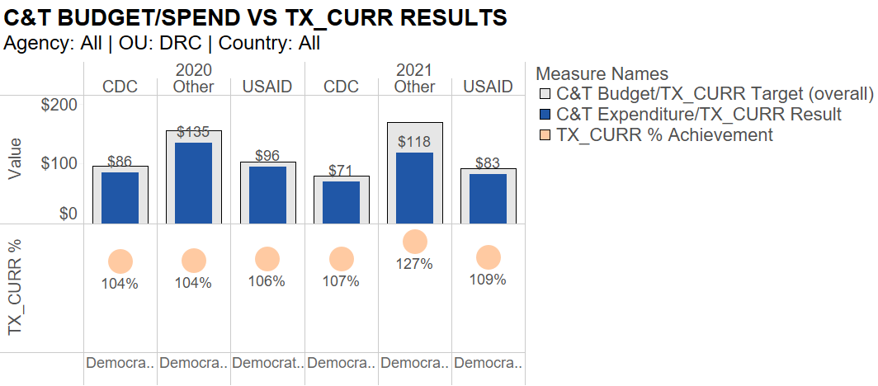
What Happens to PEPFAR Work Plan and Expenditure Data After an IP Submits to USAID?
Data Considerations
Why did we not achieve 100% of targets and yet we expended 100% of the budget? Was service delivery disrupted or more costly than anticipated?
Are we seeing efficiencies over time as IMs mature from start-up?
Can we improve our budget projections for next year?
Are we investing at the right amounts for the groups of people we are targeting in our testing, linking them to treatment, and reaching them through prevention programs?
What types of activities/program areas should we be investing in order to get closer to epidemic control? Do we see that in the data?

Slide 49
How Does Financial Data Lead to Program Improvements?
Access to routine, standardized, and comprehensive detailed financial data across the PEPFAR portfolio allows us to monitor and plan our programs in different and better ways
Expenditure and budget data can be used to inform:
  Assessment of performance
  Allocation of resources at the partner and agency level
  Major shifts in strategy and/or focus
  Formulation of data-driven budget

Slide 50
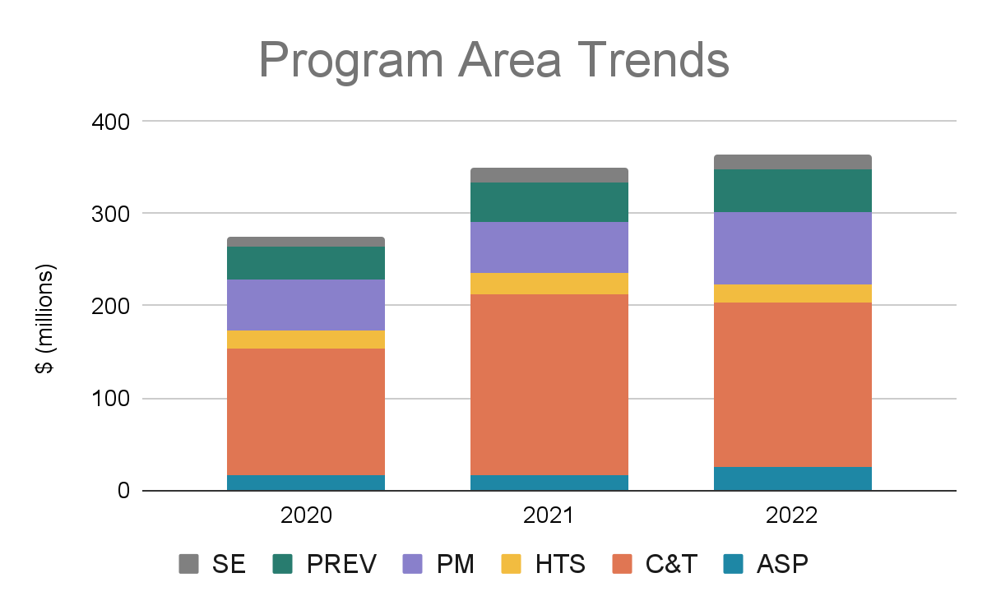
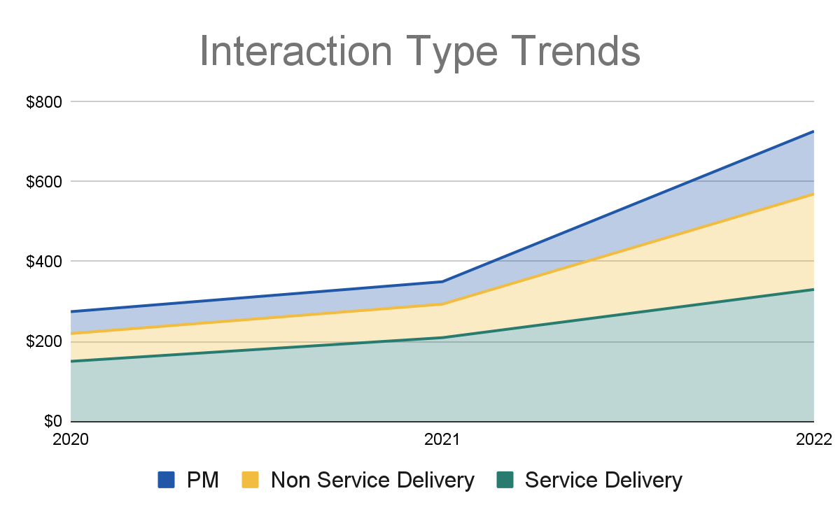
What is the Purpose of the Spend?
How were investments spent over time and how has funding changed for different program areas?
Are we focusing our resources on the right strategies to reach our targets?
What does the data tell us about the types of activities/program areas we should be focusing on in order to get closer to epidemic control?

Slide 51
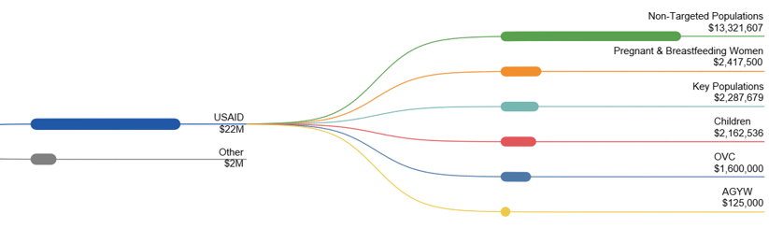
Who are we Serving?
What beneficiary groups are our resources reaching?
Are we focusing our resources on the right populations?
Where should resources be targeted in order to better reach our targets across different beneficiary groups?
COP Budget=
$24 million

Slide 52
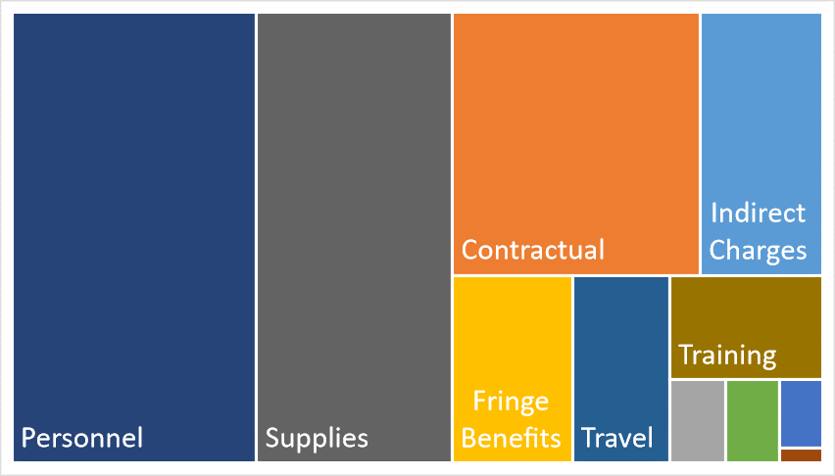
What are our Investments Buying?
Are we spending our resources on the right things to meet our program goals/targets? Are different implementation models reflected with different spending patterns?
How should we potentially shift investments in the next fiscal year to achieve greater program success?
Notes:
So the better quality expenditure data we have, the more we can answer questions like “are we focusing our resources on the right strategies to reach our targets?” in a landscape of shrinking budgets.

Slide 53
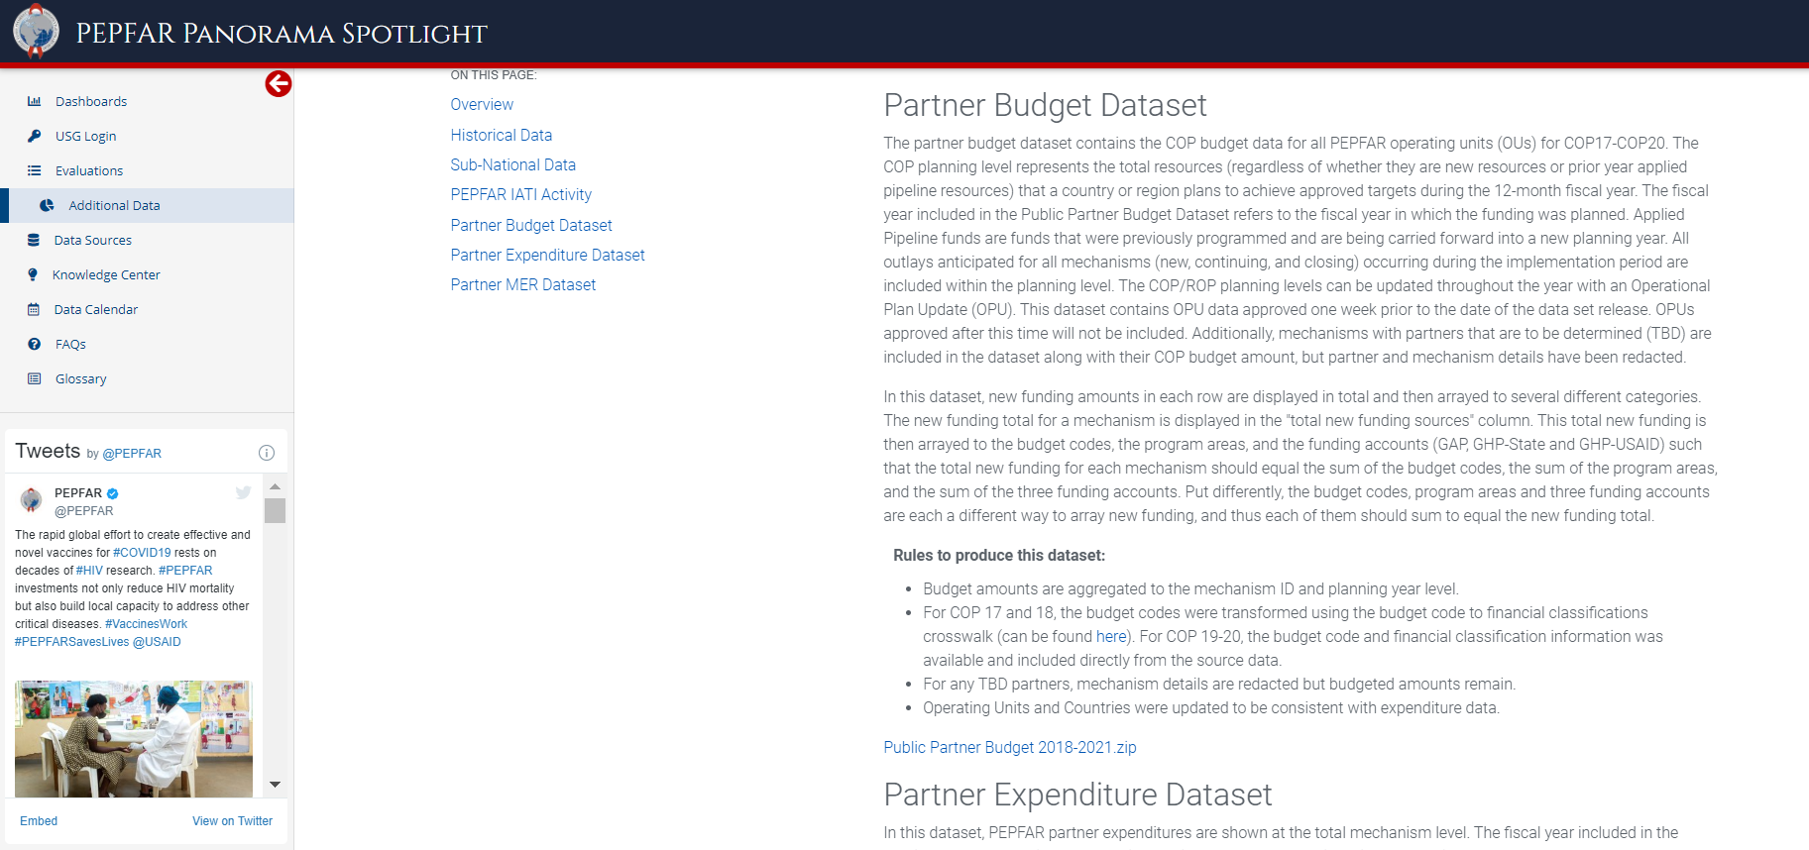
Accessing ER Data: IPs Can Download IM-Level Financial Data on PEPFAR Panorama Spotlight
Spotlight is PEPFAR’s public data source
Budget amounts are aggregated to the mechanism ID, budget code, and planning year level.
PEPFAR implementing partner expenditures are shown at the total mechanism level
PEPFAR Panorama Spotlight: https://data.pepfar.gov/additionalData

Slide 54
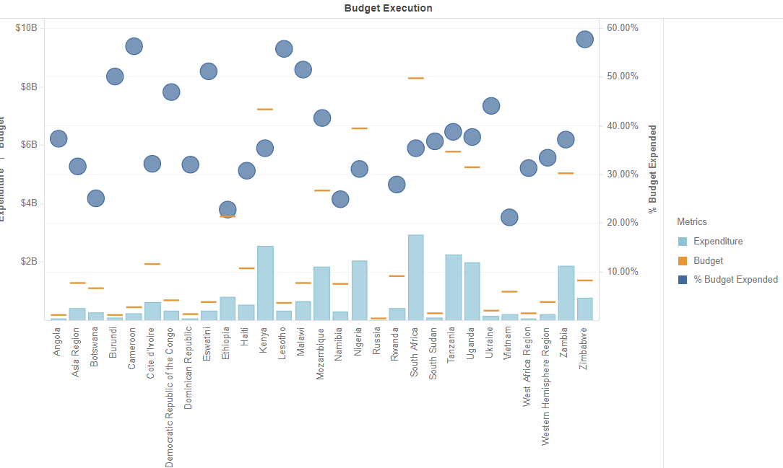
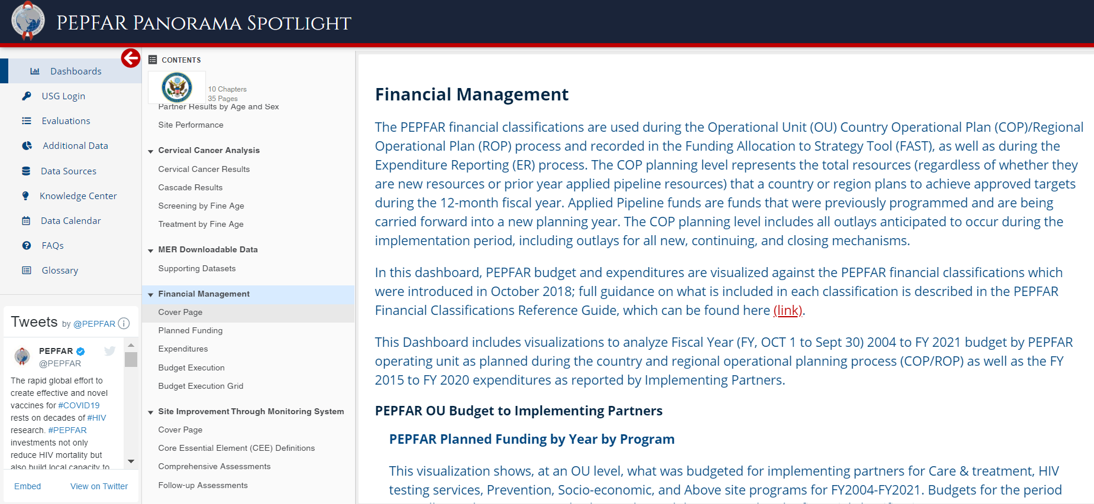
PEPFAR Panorama Spotlight Dashboards
Financial management visuals look at total funding and expenditure
PEPFAR Implementing Partners can review their budget execution at IP/IM level
Reach out to oha.ea@usaid.gov if you would like to learn more about your analyzed financial data
PEPFAR Panorama Spotlight: https://data.pepfar.gov/library

Slide 55
Questions?

Slide 56
APPENDIX SLIDES

Slide 57
Clarifying Concepts in PEPFAR Financial Classifications

Slide 58


Concepts in Classification: Site Level vs. Above-Site Level
Is it that clear cut? Let’s talk through these examples:
Why?
Routine monitoring and evaluation of programs for the purposes of managing performance
These activities, often done by an M&E advisors or technical advisors that may work from a partner office and not at a specific site, are done to support and improve site level services for that partner, as opposed to addressing broader PSNU/SNU/OU level systems or quality improvement needs
Above Site?
or
Site Level?
Technical assistance to HIV facilities to improve clinic management and HIV service provision through the review and use of routinely collected data
Above Site?
or
Site Level?
Provision of healthcare workers (e.g., detailing or seconding or placing IP-employed healthcare workers at a MOH site in order to increase the number of healthcare workers providing services at that site)
While the workers may be supporting MOH staffing gaps and addressing PSNU level HRH needs, they are provided to address specific site level program areas (C&T, PREV, HTS, SE)
Above Site?
or
Site Level?

Slide 59
So what is “Above Site” and what is “Above Site Programming”?
Let’s refer to the PEPFAR Financial Classifications
Tip: If you can’t find the link to these classifications, try searching in your browser for “PEPFAR DATIM Financial Classifications” or navigating to “PEPFAR Guidance” from the DATIM Zendesk homepage: https://help.datim.org/
Notes:
Here we will look together through the description of Site level vs Above Site and the relevant program areas on page 18. For more context we can look at the “Above Site Programming” section on page 36 and the “Program Management” section on page 42.

Slide 60



Concepts in Classification: Interaction Type
Service Delivery:
Program activities
involving direct interaction with the beneficiary are defined as service delivery.
While the distinction between “Service Delivery” and “Non-Service Delivery” is usually clear, there is often confusion about Above Site and activities that are at the site level but not directly related to the patient
Non-Service Delivery:
Expenditures for activities that support, facilitate, or strengthen the facility, site, service providers, or subnational unit or national system- without directly interacting with the beneficiary. All “Above Site” activities are non-service delivery.

Slide 61
Concepts in Classification: Above Site Programming vs. Non-Service Delivery
Let’s talk through these examples:
An individual who is trained as a doctor but whose role is to supervise a cadre of roving nurses but not routinely provide patient care
Above Site Programming (ASP)?
or
Site-Level Non-Service Delivery
Hint: Page 18
Training of site-level staff, including pharmacy or clinical staff on stock management or ordering of ARVs and related commodities
Above Site Programming (ASP)?
or
Site-Level Non-Service Delivery
Hint: Page 20
Technical assistance for the supply chain infrastructure and development of tools to
forecast, prevent stock outs, assess stock levels, etc
Above Site Programming (ASP)?
or
Site-Level Non-Service Delivery
Hint: Page 34

Slide 62
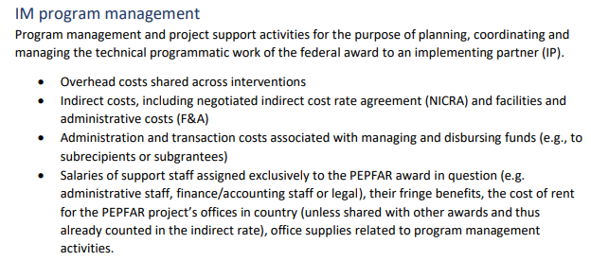
Concepts in Classification: Program Management for ER
Based on the PEPFAR Financial Classifications
Page 39!

Slide 63
So how does the HRH Handbook define “Program Management” and it’s associated staffing expenditures?
Refer to the latest PEPFAR HRH Handbook
Tip: If you can’t find the link to this handbook, try searching in your browser for “PEPFAR DATIM HRH Handbook” or navigating to “PEPFAR Guidance” from the DATIM Zendesk homepage: https://help.datim.org/
Notes:
Here we will look together through the description of Site level vs Above Site and the relevant program areas on page 18. For more context we can look at the “Above Site Programming” section on page 36 and the “Program Management” section on page 42.

Slide 64
Concepts in Classification: Program Management for HRH
As of FY24, Program Management staff costs are defined as non-site level salaries and fringe in both HRH Inventory & Expenditure Reporting
Because of the design of the two data collection efforts, some differences remain:
Expenditure Reporting
Purpose is to understand our implementation
A person’s salary & fringe can be allocated across multiple Program Areas they support, including PM
HRH Inventory Reporting
Purpose is to understand our staffing footprint
Only ONE primary Program Area can be selected per individual

Slide 65
Concepts in Classification: Program Management Staff for ER
Let’s talk through these examples:
Why?
Salary of Technical Advisors that provide trainings or support capacity building across sites but operates out of the main partner office
In Expenditure Reporting, we can allocate costs across different interventions that the people or items support. For example, supplies like gloves and alcohol swabs may be used for both testing and viral load (as part of C&T). For staff, we may see positions that split their time across technical program areas (e.g. a nurse that supports HTS and Prevention) AND staff that support efforts on the contract management side as well as advising technical work or conducting M&E.
Program Management
or
Technical Program Area
Project Directors and Chief of Party who manage the project administration but also provide technical direction setting and guidance
Program Management
Technical Program Area
or
Staff that hold multiple roles such as a “Grants Contract Manager” who conducts some administrative work managing the project but who also advises programs and does M&E across sites
Program Management
or
Technical Program Area
Hint: Page 39

