Slide 1
Proto Credit to Yankundiye Vianney, COPED
USAID/Burundi
Health Office and
Localization
USAID/Burundi Industry Day 2024
Dr. Arlette Kamariza
June 26, 2024

Slide 2
Core activities by Program and cross cutting programs
Cross-Cutting Activities
HIV: Achieve and sustain epidemic control through the ‘three 95s’
HEALTH SYSTEMS
Logistics/ Health Management Information Systems
Data availability & use
Laboratory systems
Health-care provider
Facility-based quality improvement
Supply chain management
Leadership
Maternal & Child Health: Reduction of maternal and child morbidity & mortality
Family Planning: Increased demand for and access to FP services
Malaria: Case prevention; Case management Facility and community; Surveillance Monitoring and evaluation, Entomology; Community Engagement, SBC
New
Global Health Security: Rapid response across the preparedness pillars in support of GoB priorities
GENDER
Gender-Based Violence (GBV) prevention and response

Slide 3
Investments Across 5 Funding Streams
Funding Type (# of projects) Budget | Mission-Managed Awards | Field Support Activities (management based in Washington)
HIV/TB (9) $27 million | SIMS - Wiyizire Extension* - GBV Bridge* - Baho Mbeho-Mpore (new GBV) | EpiC - RISE Global Health Supply Chain-Procurement & Supply Chain Management ((GHSC-PSM: Task Order (TO)1)) - PSI (DOD)
Maternal Child Health (4) $5 million | Tubiteho* | US Census Bureau - DHS* - MPHD*
Family Planning (FP) (4) $10 million | Tubiteho* - Mpore GBV* | GHSC-PSM (TO3) - MPHD*
Malaria (6) $15 million | Tubiteho* ICH | GHSC-PSM (TO2) - DHS* - - PMI Evolve - CHISU- MPHD* - Breakthrough Action
Global Health Security (5) $3 million | None planned at present | None planned at present

Slide 4
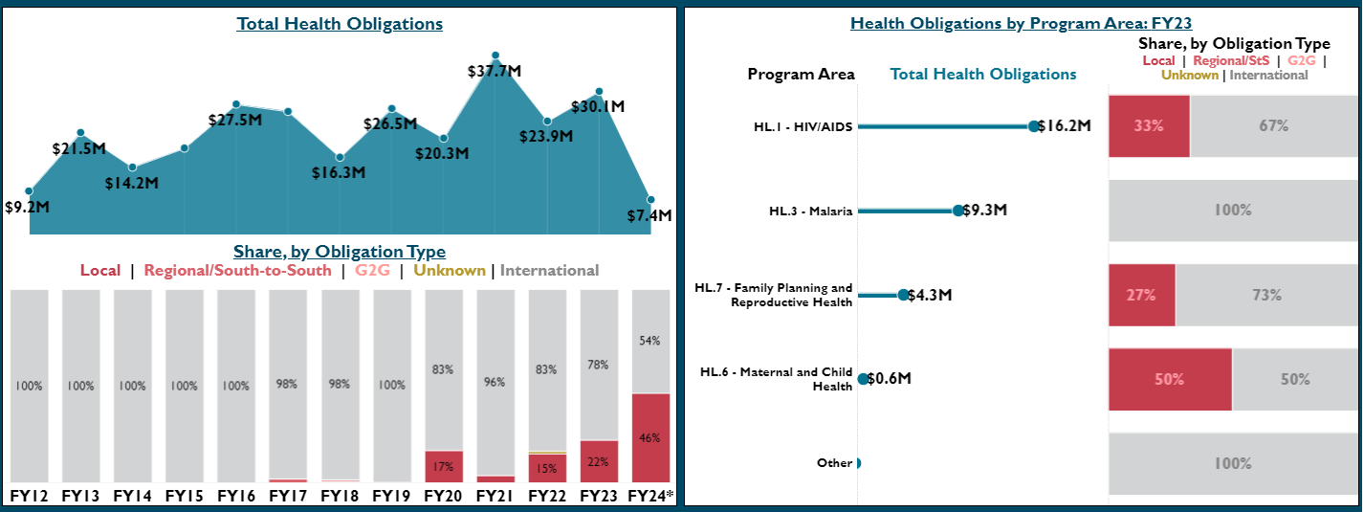
Total Health Investments to Burundi Local Partners
Notes:
Burundi has made great strides in increasing its total investments in local partners in the health sector
HIV/AIDS sector is leading by amount of funding to local partners ($16.2M), whereas the maternal and child health sector has a greater percentage of its total portfolio currently going to local partners (50%)

Slide 5
PEPFAR Burundi Localization Journey

Slide 6

PEPFAR’s Long History of Local Engagement
Start of President’s Emergency Plan for AIDS Relief (PEPFAR)
Start of interagency PEPFAR Local Capacity Initiative
70% funding goal set by Ambassador Birx for PEPFAR Local Partner transition
Community-Led Monitoring (CLM) added as a requirement in COP guidance
2008
2015
2019
2023
2003
2013
2018
2020
New Partners Initiative Helped Local partners receive direct funding
($200 Million)
Local Stakeholders (CSOs) and Govts first invited to in-person COP meetings
First USAID Meeting with Local Partners
5th Annual Local Partner Meeting -
West & Central Africa & Beyond
Notes:
Talking Points
PEPFAR has a long history of of Local Engagement:
2008 - PEPFAR started the New Partners Initiative program.
2015 - was first year Local stakeholders were invited to COP
2018 - former Amb Birx set 70% funding goal for Local Partner transition
2019 - we hosted our first in person Local Partner gathering
2023 - our most recent in-person gathering of Local Partners in Accra, Ghana, which included seven partners from Burundi:
Alliance Burundaise contre le Sida et Pour la promotion de la Santé (ABS)
Association Nationale des Franchise Sociale (ANFS)
Association Burundaise pour le Bien-Être Familial (ABUBEF)
FVS-Amie des Enfants (FVS-AMADE)
Initiative d’Appui au Développement Humain Durable (IADH)
Réseau burundais des personnes vivant avec le VIH/SIDA (RBP+)
Service Yezu Mwiza
We recognize all of our Partners here in Burundi, all of you in this room, have done truly exceptional work.

Slide 7
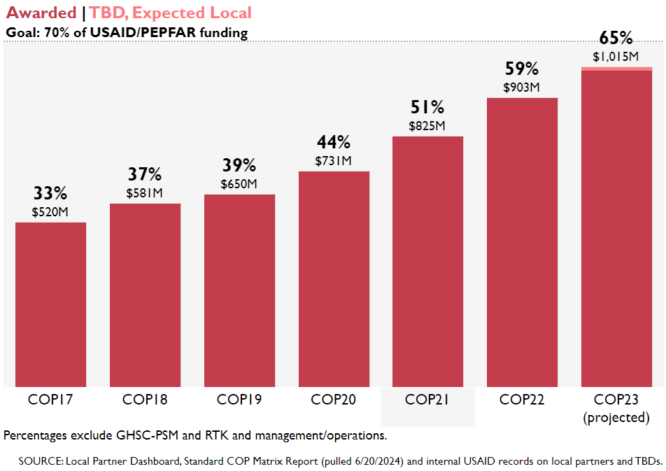
USAID/PEPFAR has increased direct funding to Local Partners
65%
of USAID/PEPFAR program funding through Local Partners
The number of Local Partner organizations has increased from 91 in COP17 to 162 in COP23.
Notes:
Talking Points
We’ve seen a local partners assume a tremendous increase in service provision. This has been driven by a shift in financial support: moving our funding away from often US based international organizations on-the-ground local partners
In COP21, an impressive 51% of all PEPFAR funding went directly to local partners. This represents an increase of $300 million in annual approved funding as compared to COP17
Meanwhile, the number of prime local partners carrying out the work significantly increased over that same time period, growing from 91 to 162, almost doubling.
PEPFAR’s ambitious goal of distributing 70% of our funding directly to local prime partners, originally proposed in 2018, is now within sight thanks to the hard work and dedication of each of the local partners joining us today

Slide 8
Burundi’s progress towards achieving its localization goal
Award to COPED (OVC) and SWAA (GBV)
Award to ANSS and SWAA (KP Program)
CLM
FY
20
FY 22
FY
24
FY
18/19
FY 21
FY 22/23
Award of New GBV Program to a local partner
- SIMS 3rd Party Contractor
- Community-Focused Services for Local Transition (Preparation)
EpiC Transition Award to locals (Preparation)
Baho Mbeho with 6 local subs

Slide 9
PMI Localization Plans

Slide 10
Vision Statement
PMI invests intentionally in programs, systems, and staffing to support local ownership of malaria program priorities, resources and implementation through dignified and equitable partnerships that drive improved malaria outcomes in the partner countries in which we work.

Slide 11
Long-term Goals
PMI aims to implement a cohesive localization vision, including tailored approaches for PMI partner countries and a long-term strategic approach for ensuring greater country ownership..
Specifically, by the end of 2031, PMI aims for the following to occur:
All entomological monitoring to happen through local bilateral awards
80% of case management/service delivery buy-ins shifted to local or regional bilateral awards
All Therapeutic Efficacy Studies implemented through local or regional awards
80% of warehousing and distribution through local or regional awards
All Operational Research (central and bilateral) prime partners are local or regional institutions
Double the share of products sourced from the African continent by funding levels from the FY23 baseline (from 10% to 20%)

Slide 12
Medium-Term Targets to Achieve Long-term Goals
In support of PMI’s long-term goals, PMI’s has set medium-term (to achieve by end of the current strategy / end of CY 2026 / Malaria Operational Plan FY 2025 implementation) targets:
At least 10% of PMI partner country obligations are channeled directly to local primes, including Government to Government Grant (G2G).
9 of 13 (~70%) of G2G eligible PMI partner countries have G2G agreements that include malaria funding.
Every PMI partner country has direct local funding in at least one PMI Specific Investment Area.
12 of 30 PMI partner countries have direct local funding in at least
five of the 18 PMI Specific Investment Areas
5. 24 of 30 PMI partner countries achieve the indicators for locally led programming that are relevant to their country

Slide 13
Burundi’s progress towards achieving its localization goal
Design and competition
Integrated Community Health Award
PMI Budget
MCH Budget
FP Budget
FY24
FY 25
FY 23
Internal Discussions

Slide 14
What did we learn?

Slide 15
CHALLENGES
Insufficient Mission’s staffing to support/ Manage or Mentors LP
USAID funding opportunities are often limited to local organizations already partnered with larger international contractors. This restricts access for many promising emerging local actors.
Many emerging LPs have limited experience in project management methodologies like monitoring and evaluation (M&E) or project planning. Training or streamlined procedures can address this.
LESSONS LEARNT
Development of a clear exit strategy that includes capacity building plan ensures a smooth transition and empowers local partners to continue the project independently.
Local partners have a deep understanding of the community's needs, values, and communication styles. This can lead to more culturally appropriate interventions and increased trust from the target population.
Maintain flexibility to address unexpected situations and cultural variations. Local partners offer crucial guidance in overcoming these hurdles.
Strong communication, transparency, and mutual respect are essential for a successful partnership with any local partner, regardless of the sector.

Slide 16
Murakoze!

