Slide 1
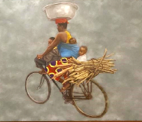
USAID/Burundi
Sustainable Development Office (SDO) Portfolio Overview
USAID/Burundi Industry Day 2024
Woman on a Bike, Artist, Clovis Ngoy
Sustainable Development Office (SDO) team:
Audace, Christian, Fidela, Jean-Claude, and Lori
June 26, 2024
*
‹#›

Slide 2
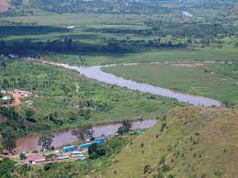
Linkages to Integrated Country Strategy and
Results Framework
Ruvubu river
Connecting Burundi, Tanzania and Rwanda
Notes:
Aligns with MG2 & 3; MO 2 & 3

Slide 3

MG 1: Invest in People: Burundian systems for health and education are strengthened.
MG 2: Invest in the Economy: The foundation for a stronger Burundian economy is created.
US EMBASSY Bujumbura Integrated Country Strategy
MG 3: Invest in Society and the Region: Burundi is a peaceful, open, and stable actor at home and in the region.
Mission Objective under MG 3
Health
Humanitarian Assistance
Democracy and Governance
Economic Growth
Key Issues
Mission Objectives under MG 1
Mission Objectives under MG 2
Link to US Embassy Bujumbura Integrated Country Strategy
Notes:
USAID/Burundi programming contributing to the ICS - MG1 for HA activities; MG2 for EG activities; and MG 2 & 3 for DG activities

Slide 4
USAID/Burundi Results Framework
Key Approaches:
Humanitarian-Development-Peace Coherence
Conflict Sensitivity
Adaptive Management
Goal Statement
Support Burundi in laying a foundation for sustainable development that capitalizes on achieved peace and stability
DO 1: Enhancing Sustainable Livelihoods
DO 2: Building Public Trust
IR 1.1: Quality Health Services and Systems Bolstered
IR 2.1: Accountable Governance Strengthened
IR 1.2: Agriculture Market Systems Strengthened
IR 2.2: Advocacy for Democratic Reform and Human Rights Promoted
IR 1.3: Education Systems Supported
Cross Cutting Priorities: Environmental Protection Diversity, Equity, Inclusion, and Accessibility
Notes:
SDO portfolio aligns with DO1, IR1.2; DO2, IR2.1 and 2.2; with all cross cutting priorities
New RF as way forward thinking how portfolio will contribute towards its objectives
Opportunity to also highlight any potential challenge

Slide 5
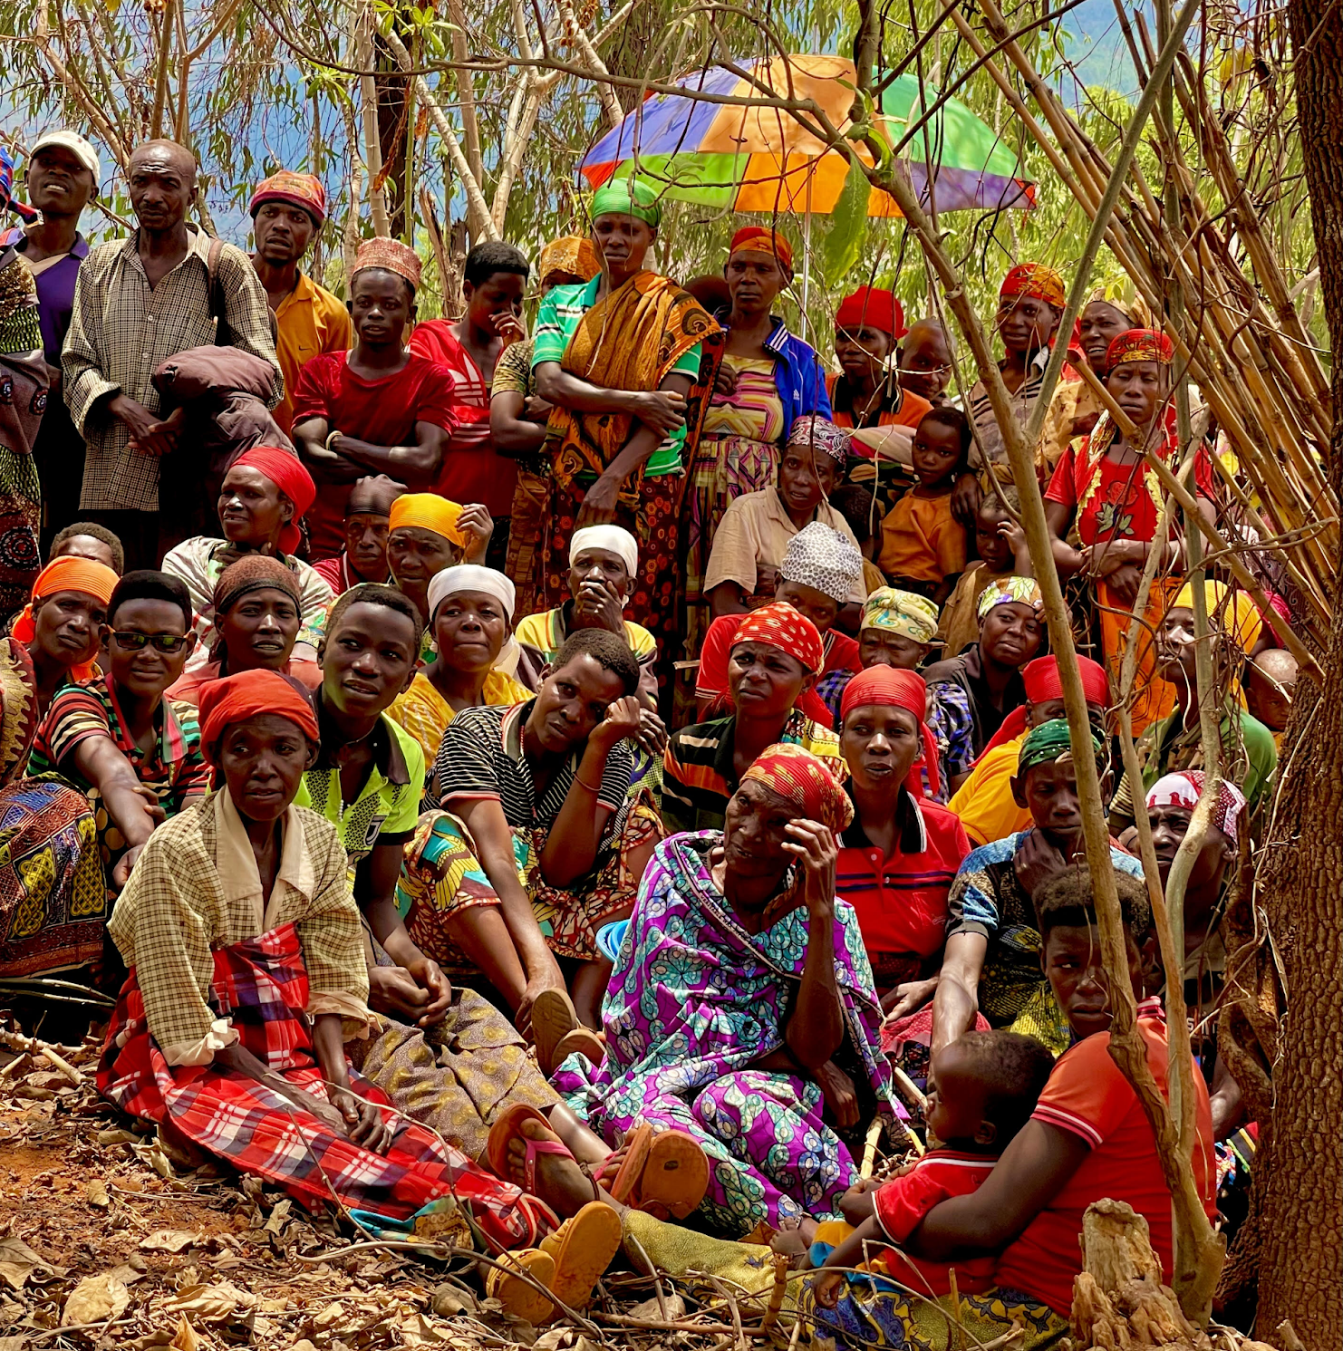
OVERVIEW OF SDO PORTFOLIO: PEOPLE. PROSPERITY. PEACE.
Humanitarian
Assistance
Food and Nutrition Assistance
Refugees Food Assistance
Returnee Food Assistance
IDP Assistance
Economic Growth
Agriculture and Livelihoods
Energy
Regional Trade
Economic Governance
Democracy and
Governance
Countering Trafficking in Persons
Social Cohesion
Civil Society
Economic Empowerment

Slide 6
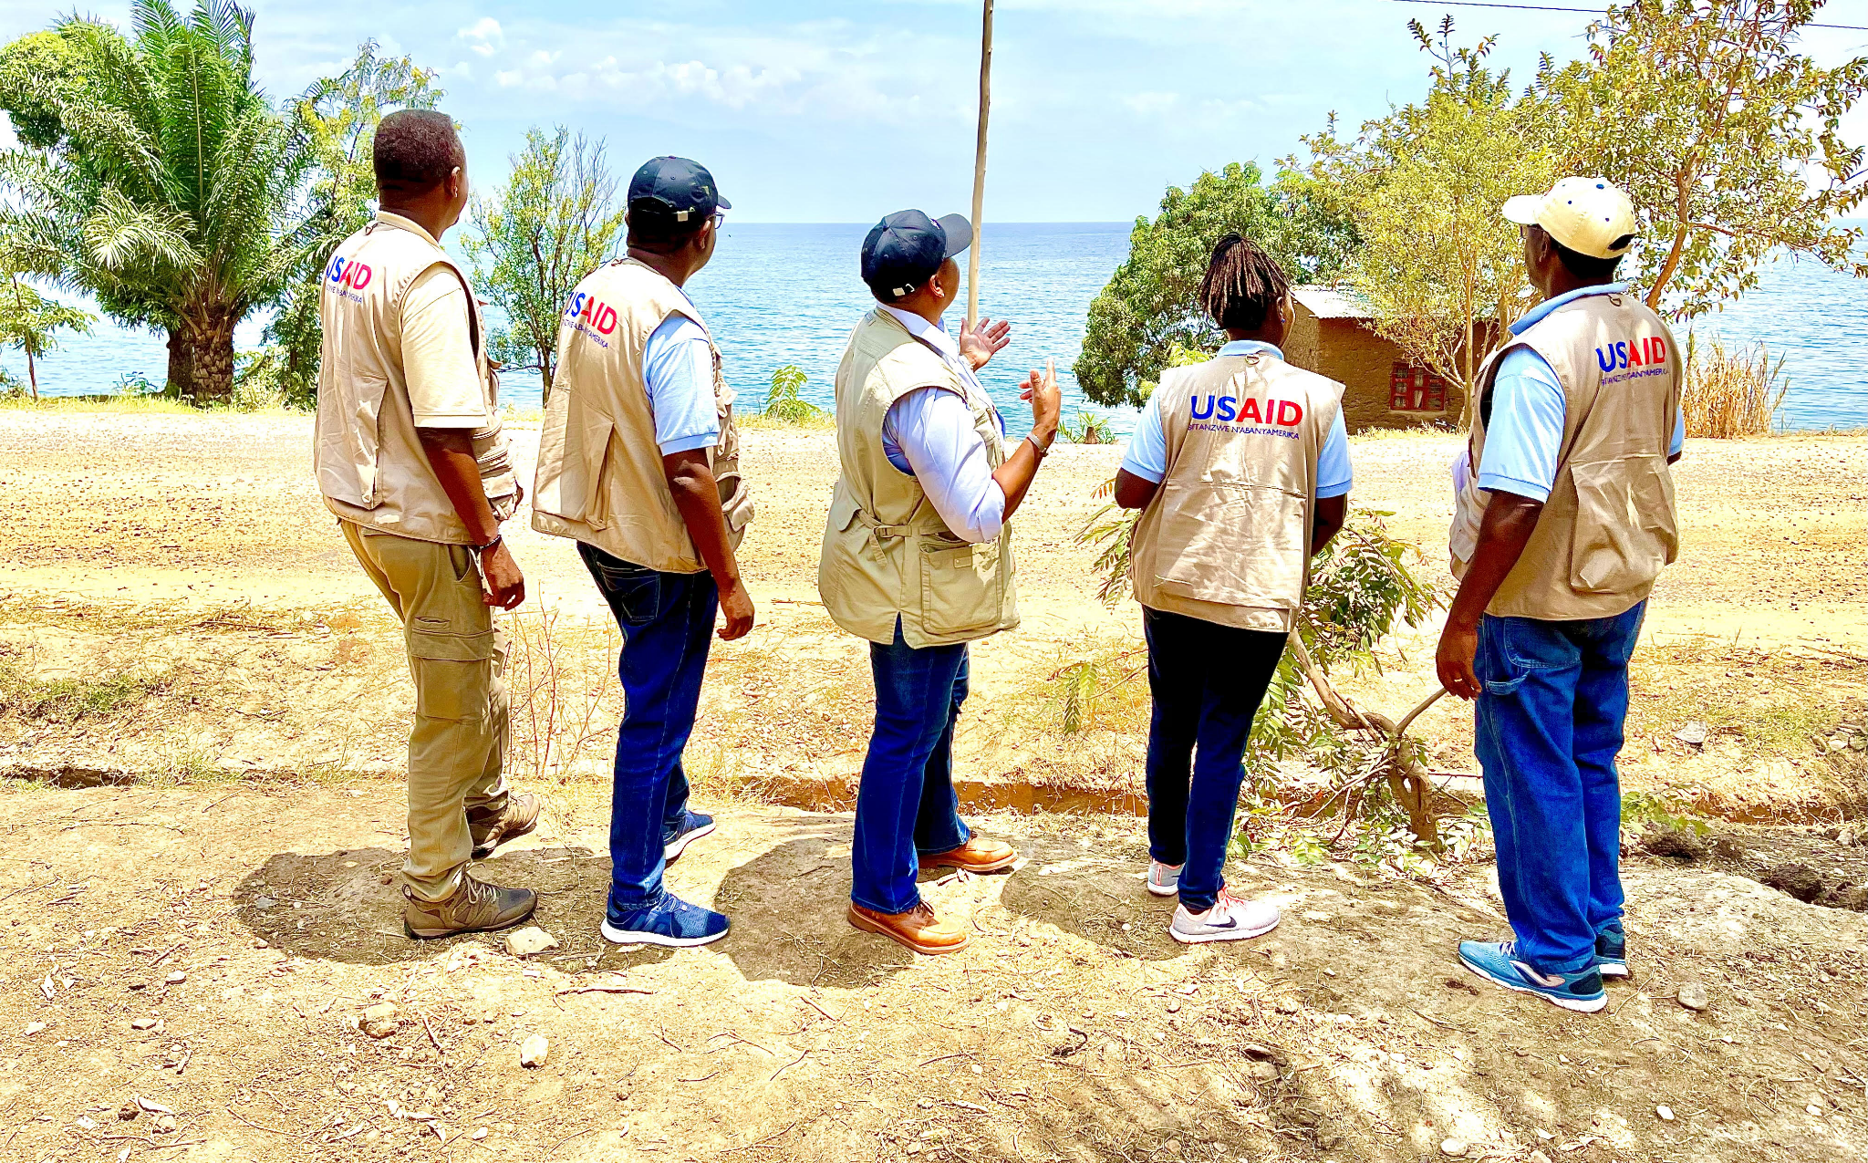
Merci. Thank you. Murakoze Cane.

