Slide 1
USAID/Burundi
2024 - 2027
Strategic Framework
USAID/Burundi Industry Day 2024
Raymond Grant, Program Officer
June 26, 2024

Slide 2
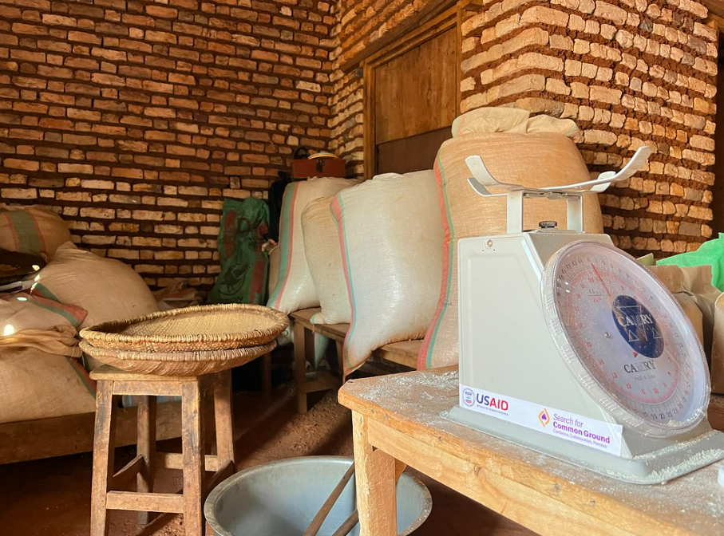
Purpose of USAID’s Strategic Framework
Establishes USAID’s development goal and objectives for Burundi
Prioritizes USAID’s development sectors for Burundi
Lays the groundwork for USAID to work with Burundian organizations

Slide 3
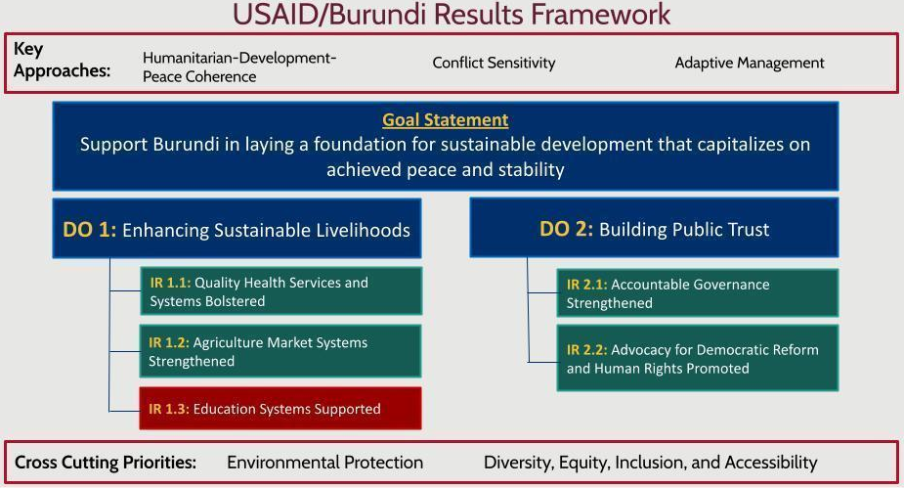

Slide 4
USAID’s Priorities for Burundi
Strengthen CSOs to address Burundian citizens’ needs
Promote the role of marginalized communities including women, children and youth
Provide humanitarian assistance to those in dire need
Increase collaboration and program implementation with local organizations

Slide 5
USAID/Burundi’s Localization Initiative
Increase the number of USAID’s local partnerships
Allocate more Mission resources directly to local partners
Create opportunities for local organizations to design USAID activities
Maintain strong partnerships with local organizations

Slide 6
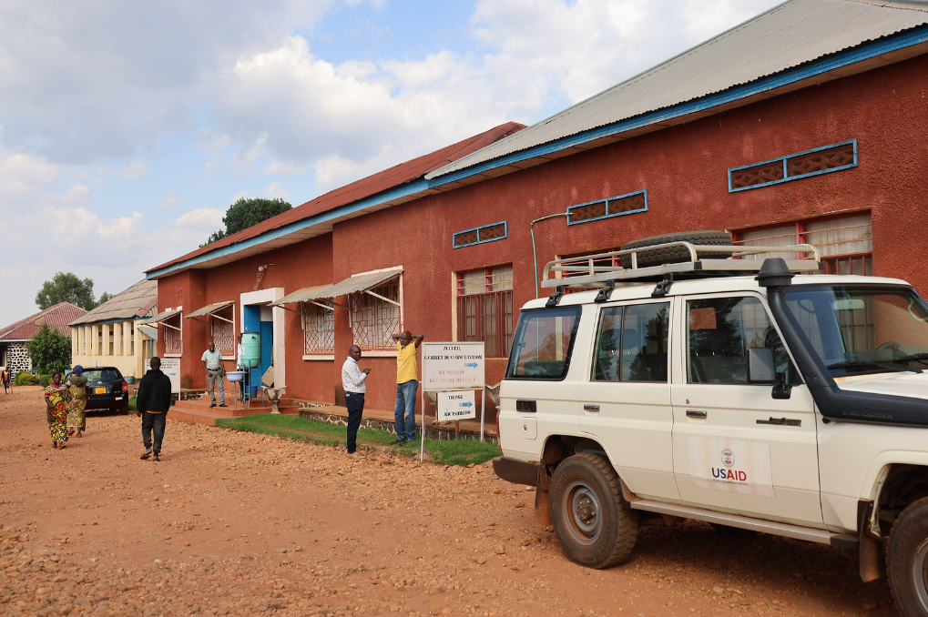
Collaboration with Local Organizations
USAID/Burundi will strengthen CSOs’
Locally led development planning
Program implementation
Monitoring and evaluation
Capacity strengthening

Slide 7
Raymond Grant
USAID/Burundi Program Officer
rgrant@usaid.gov

Slide 8
Thank you!
Merci!
Murakoze!

Slide 9
Key Assumptions for USAID’s Strategy
Burundi will continue to have political stability
Government of Burundi (GOB) communities continue their commitment to developing Burundi
Sustained or increased GOB budget for environment, health, education, and agriculture
Civil society organizations (CSOs)’ participation and advocacy
Strong relationships continue between the U.S. Embassy and the GOB

